Slide 1

FOUNDATIONS OF TRAUMA-INFORMED CARE
Training for All Staff
Notes:
Welcome. As our session title suggests, this training is designed to all staff with the knowledge you need to be a part of implementing trauma-informed care in our facility. While most of the new CMS requirements build on skills and information many of us have, the understanding of the role of trauma in the lives of older people is new to our field, and so this session will help you to help all staff lay the foundation needed to implement this kind of approach.

Slide 2


CMS Requirements of Participation
In September 2016 CMS issued changes to the Requirements of Participation, to be implemented through a three stage process
Included policies designed to strengthen the provision of person-centered care to residents —a model in wide use across services for older Americans
Involves a holistic approach to meeting the needs of each individual resident
Considers psychosocial and spiritual aspects of well being in addition to physical health
Recognizes residents’ rights to care that is shaped to meet their preferences and goals to the greatest extent possible
Notes:
As you know, we are in the midst of implementing many new policies and procedures in response to changes made by CMS in 2016 to our Requirements of Participation. A number of the new requirements are designed to strengthen the way we provide person-centered care to residents — care that considers all aspect of each resident’s needs, wishes and goals.

Slide 3
CMS Requirements of Participation
To provide this kind of care to all residents, we must be equipped to understand and work with the circumstances, needs and wishes of people from a wide variety of backgrounds and lived experiences
New RoPs include an emphasis on providing services that are culturally competent and trauma-informed
CMS has pointed nursing home leaders the 2014 publication SAMSHA’s Concept of Trauma and Guidance for a Trauma-Informed Approach
Trauma-informed care is a relatively new discipline for nursing home communities
Notes:
If you think about it, the only way to provide care that is responsive and tailored to each resident’s wishes, needs and goals, is for all of us to be able to work well with residents from a wide range of backgrounds who have had all kinds of life experiences.
To that end, the new RoPs include a requirement that facilities provide services that are culturally-competent and trauma-informed.
CMS has pointed us to a SAMSHA publication that offers guidance on what trauma is and what a trauma-informed approach entails. That publication was not developed with a specific focus on applying this approach to older adults. This course and short handouts of lessons are designed to utilize and build on the SAMSHA guidance.
We’re going to start with a look at trauma itself — what exactly is trauma?

Slide 4


When you hear the word trauma, what picture or image comes into your mind?
Notes:
So let’s start with the most basic question — when you hear the word trauma, what picture comes into your mind?
Please take a minute or two to jot down your responses to this question. We’ll talk about what you came up with in just a couple of minutes.

Slide 5


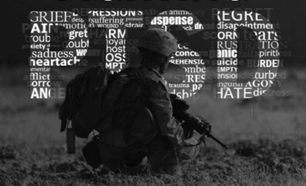


Notes:
What pictures came to mind for you?
When many of us hear the word trauma, we probably picture something similar to what you pictured.
We may picture a veteran….
Or a child who has been abused or neglected…
Or a woman – or a man –who has experienced abuse in a relationship or family

Slide 6




Notes:
There are actually quite a few other traumas that might not come to mind right away, but are important to keep in mind, like:
Being in an accident — a car or plane crash, for example
Having hate speech directed at us, or being the victim of a hate crime
Living with a family member who is experiencing a serious illness — physical or mental illness

Slide 7
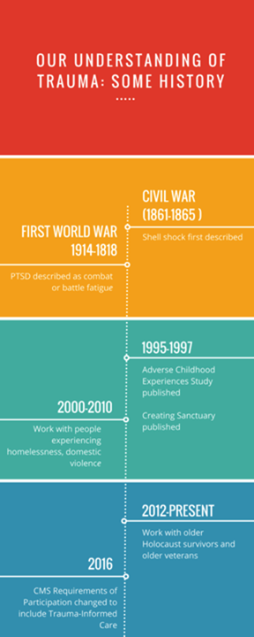


Notes:
We first came to understand trauma through attempts to treat its harmful effects. This work dates back to the Civil War, when doctors and nurses began to see soldiers suffering from what we now call PTSD or post traumatic stress. In early days the condition was referred to as shell shock, combat or battle fatigue. It continues to be an issue this day with soldiers and veterans.
The earliest and most extensive work on trauma outside the military occurred in organizations serving children. In 1995, a landmark study called the ACEs (Adverse Childhood Experiences) study was published — the study demonstrated the close connection between childhood abuse, neglect, maltreatment and household dysfunction and poor adult health and other life outcomes. The study showed that the number of these adverse experiences correlates to a wide array of negative health outcomes, from diabetes, cancer, heart disease and autoimmune diseases to teen pregnancy and unemployment.
More recently work on trauma has extended beyond children soldiers veterans to include adults dealing with other traumas, including domestic violence and homelessness.
The field of aging services has come to the work of treating trauma in recent years. Work on traumatic stress in older adults really got started within the past ten years with efforts to serve elderly Holocaust survivors. Work around this same time was emerging within the field of services to aging veterans experiencing PTSD. Finally, the field of aging services has begun to address methods for treating older people who have experienced abuse as children.

Slide 8

So What Exactly Is Trauma?
Trauma — individual trauma results from an event, series of events, or set of circumstances that is experienced by an individual as physically or emotionally harmful or life threatening and that has lasting adverse effects on the individual’s functioning and mental, physical, social, emotional, or spiritual well-being.
SAMSHA’s Concept of Trauma and Guidance for a Trauma-Informed Approach (2014)
Notes:
Here’s the definition offered in the SAMSHA publication I just mentioned.
Events don’t have the same impact of everyone – what is traumatic for me may not produce traumatic stress for you. There is a genetic dimension to this that we’re beginning to understand. However, the impact of an adverse event is not a choice.
One way of thinking about this is that a trauma is something that happened to you.

Slide 9
HOW COMMON IS THE EXPERIENCE OF TRAUMA?
While Americans once considered trauma to be a relatively infrequent occurrence, most research finds that a majority of us —between 55 and 90%— have experienced at least one traumatic event.
The ACEs study found that almost two thirds of respondents reported at least one adverse childhood experience. And not all adverse or difficult experiences occur in childhood.
Potentially traumatic experiences include experiencing or witnessing:
Domestic and sexual violence
Natural disasters
Car, train and airplane crashes
Combat
Becoming a refugee
Homelessness
Medical trauma
Violent crime
Bias and discrimination
Hate crimes and hate speech
Notes:
While Americans once thought trauma was a rare occurrence, we now know differently. The ACES study I mentioned earlier demonstrated that 2/3rds of all adults experienced at least one adverse experience in childhood — and other research suggests somewhere between 55 and 90% of us have experienced at least one traumatic event in our lives.
This isn’t surprising if you think about the whole range of events that can prove traumatic — here’s just a partial list.

Slide 10

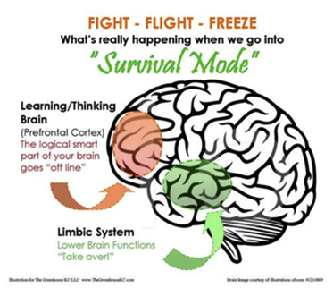

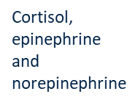
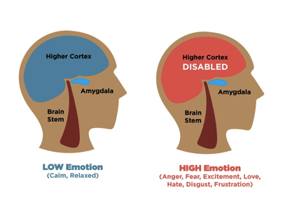

When confronted by external stimuli that are perceived as threats in the environment, humans react with a stress response.
What’s happening inside the brain
Notes:
A couple of words about humans and stress. Human beings evolved to have a stress response – to respond to events outside ourselves, whether it was saber toothed tigers back in the days of cave men or bad driving, raised voices or other events now.
The mid brain or amygdala reacts to these kinds of events immediately with an outpouring of stress hormones, increased heart rate, narrowed field of vision – this allows you to decide whether to fight, flee or freeze. In the midst of this kind of a hijack your higher brain functions, located in the front of the brain — the prefrontal cortex – are temporarily offline, which is why it feels like we can’t think straight.
This is a normal response, and normally this reactions passes quickly once the threat is gone or turns out not to be a threat at all. The body’s reaction calms down and the higher brain functions come back online.

Slide 11
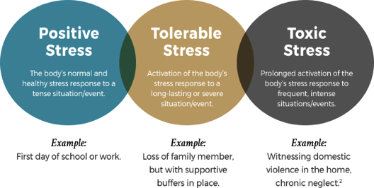
Stress vs. Traumatic or Toxic stress
Notes:
So the stress response is natural — and we all know that stress isn’t always a bad thing – a little bit of stress can motivate us to try harder and stretch. That said, there are degrees of stress – in terms of how intense it is and how long it lasts — that is bad for us. When the stress we’re under is very, very intense or goes on for a long period of time, the stress moves beyond positive or even tolerable to toxic.
Toxic Stress is another term for traumatic stress — when people experience this level of stress that normal stress response we just described never really turns “off.” That means the person’s body and brain are experiencing an excess of stress hormones, and the brain tends to easily be triggered to go into fight-flight-freeze mode — and this is where the negative long term health and life outcomes come from.
In other words, traumatic or toxic stress is the kind of stress that is harmful to humans, and the kind of stress that the “S” in the term PTSD refers to.

Slide 12

How is Trauma different from
Traumatic Stress?
Traumatic stress refers to “the emotional, cognitive, behavioral and psychological experiences of individuals who are exposed to, or who witness, events that overwhelm their coping and problem solving abilities.”
In other words, a trauma, which produces traumatic stress, occurs when our coping mechanisms are overwhelmed by outside events.
Notes:
We just talked about how trauma is something that happened to you in the past — traumatic stress is what’s happening to you NOW that is related to the past trauma.

Slide 13

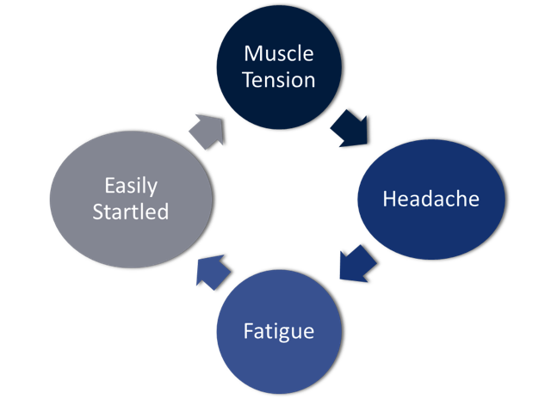

IMPACT OF TRAUMATIC STRESS ON THE BRAIN
AND BODY
Notes:
Here are some physical manifestations of the impact of traumatic stress.

Slide 14
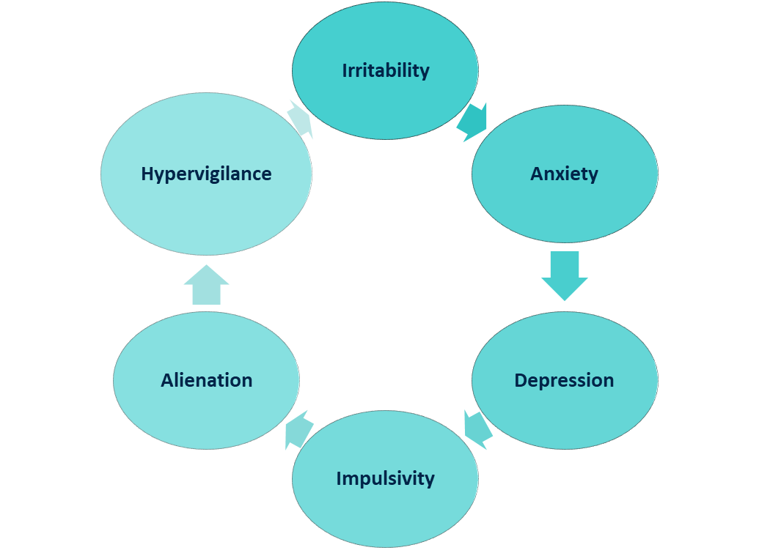

IMPACT OF TRAUMATIC STRESS ON THE BRAIN
AND BODY
Notes:
Here are emotional manifestations of traumatic stress

Slide 15
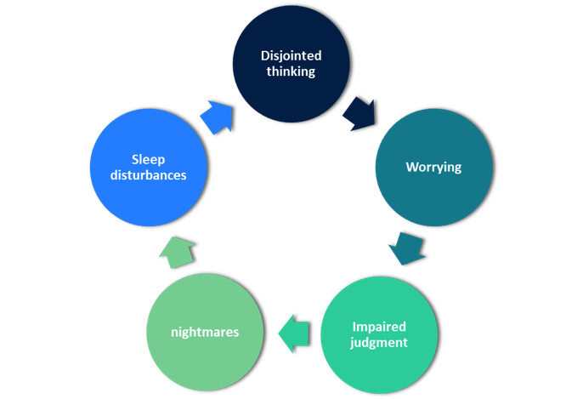

IMPACT OF TRAUMA ON THE BRAIN AND BODY
Notes:
We also see changes to cognitive function in some people who are experiencing traumatic stress — and these are particularly important to know about in working with older people, as cognitive issues we’re seeing and assuming are Alzheimer's may actually be caused — wholly or in part — by traumatic stress.

Slide 16

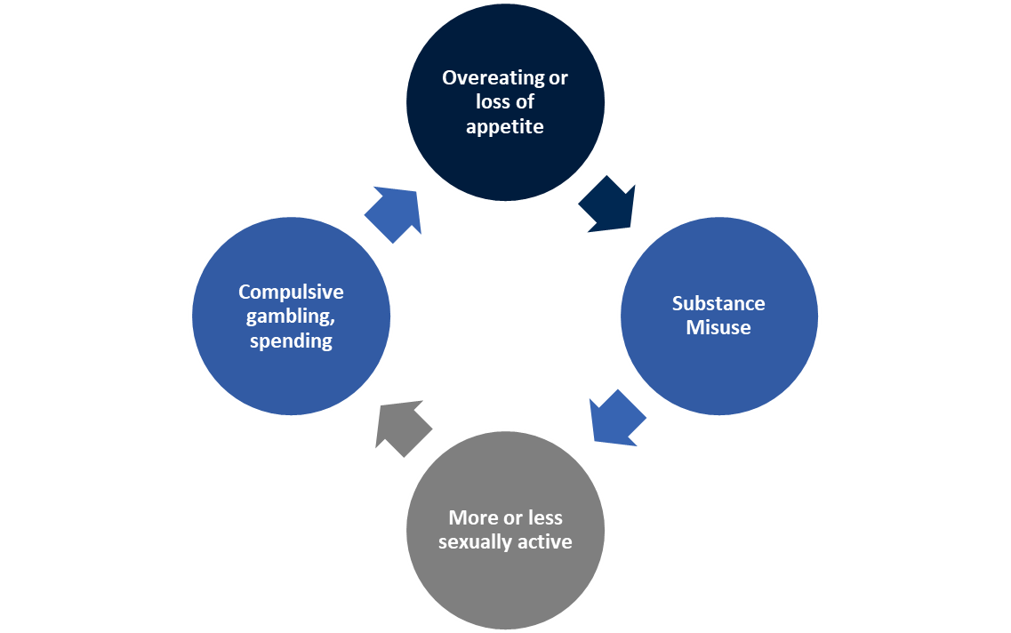

IMPACT OF TRAUMATIC STRESS ON THE BRAIN AND BODY
Notes:
The fourth domain where we see signs of traumatic stress is in observable behavior. Again the behaviors listed here are ones we see frequently in older residents — and so understanding the role of trauma is important as a tool for helping us determine what is really going on to drive these behaviors.

Slide 17
TRAUMA AND OLDER ADULTS: CONSIDERATIONS
Past adverse experiences
Current or recent traumas, including elder abuse or neglect
Traumas relating to the aging process
  Loss of loved ones
  Loss of own capacities
  Loss of roles and identity and of home
  Increased dependence
Notes:
So when we think about older people and trauma, we want to keep in mind that residents may have a trauma history we weren’t aware of — from childhood or earlier in their adult lives.
Older people of course are also sometimes experiencing traumas in their current lives or very recently — for example, we may have residents with us who have been neglected or abused in the recent past.
Of course the aging process itself involves losses that can be traumatic as well.

Slide 18



PUZZLING BEHAVIORS IN OLDER ADULTS
Notes:
In our work we sometimes encounter of difficult – and puzzling — behaviors in our residents. Some of what you might see include
Jealously guarding personal possessions – sometimes almost a hoarding behavior
Refusing to have lights turned out at night
Refusing personal care – to allow help with washing — or refusing medical treatment
Hitting, biting
Lying
Talking to people who aren’t there
It’s been said that “behavior is communication.” In working with others all of us are always trying to understand what behaviors mean. Sometimes we might be thinking medically, sometimes psychosocially.
If a resident is irritable, we may ask ourselves if she is experiencing some physical discomfort – could be irritated skin, or upset stomach or some other kind of pain – or we may wonder if she’s fighting with her roommate or the family member who just visited.
Thinking about the possibility that past trauma might be a factor is just another piece of the puzzle – another possible explanation for what we’re not sure we understand.

Slide 19

IF TRAUMA HISTORY ISN’T CONSIDERED… COMMON MISDIAGNOSISES
Dementia
Psychosis
Personality disorders
Mood disorders – bipolar, depression
Oppositional – willful misconduct
Hoarding is actually correlated to childhood physical or sexual abuse
Notes:
A resident won’t allow help with personal care and swats away a CNA who is trying to help. How might that relate to trauma? The resident may have experienced being physically violated – rape, sexual abuse.
Refusing to cooperate with medical treatment could relate to a past medical trauma, like a botched surgery, a very painful medical treatment, or even a concentration camp experience.
When a resident lies, we know this could be a result of dementia, but it could also be a symptom of dissociation. During a trauma, when people can’t fight or flee, they sometimes remove themselves mentally by dissociation. When a pasttrauma gets triggered, some trauma survivors will dissociate again, and sometimes they really “leave the scene” mentally and so actually don’t know what happened.
We have all probably seen instances where an agitated resident hits, bites, or talks to people who aren’t there. One possibility as to what’s going on is that a past trauma has been triggered and the person is having a flashback. This is like when veterans sometimes hit their spouses in their sleep when having a nightmare flashback to a combat scene.
All this means that older adults can easily be misdiagnosed if trauma history isn’t considered. This slide offers some common misdiagnoses that have been documented.

Slide 20
What is trauma-informed care?
Trauma-Informed — a program, organization or system that is trauma-informed realizes the widespread impact of trauma and understands potential paths to recovery, recognizes the signs and symptoms of trauma in clients, families, staff and others involved with the system; and responds by fully integrating knowledge about trauma into policies, procedures and practices to actively resist re-traumatization.
Notes:
So – an organization that offers person-centered care to residents who have experienced trauma is, in essence, offering trauma-informed care. What does that mean?
We know that facilities like ours are not first and foremost involved in treatment of mental or behavioral health issues. While we will want to consider ways we can support and provide those kinds of services to residents when possible, any organization can be trauma-informed, even if it isn’t a treatment center. Schools, for example, are increasingly becoming trauma-informed.
An organization can be said to be trauma-informed when it
Realizes the widespread impact of trauma and understands potential paths to recovery
Recognizes the signs and symptoms of trauma in clients, families, staff and others involved with the system
Responds by fully integrating knowledge about trauma into policies, procedures and
Practice, and in so doing s actively
Resists re-traumatization
These are called the “four Rs” of trauma-informed care

Slide 21

THE 4 “R’s” of a Trauma Informed Approach
Realization — all those involved in your organization at all levels realize that:
Trauma can affect individuals, families, organizations and communities
People’s behaviors can be understood as coping strategies designed to survive adversity and overwhelming circumstances (past or present)
Recognition — all those involved in your organization are able to recognize the signs of trauma and have access to trauma screening and assessment tools
Responding — your organization responds by applying a trauma-informed approach to all aspects of your work. Specifically, everyone on staff in every role has changed their behaviors, language and policies to take into consideration the experiences of trauma among residents, their families and staff
Resisting retraumatization of residents and staff members by ensuring that practices do not create a toxic environment — for example understanding the impact of using restraints or seclusion on a resident with a trauma history
Notes:
Here’s a bit more on what the 4 Rs mean in the real world of our facilities:
Realization — all those involved in our organization at all levels realize that
trauma can affect individuals, families, organizations and communities
and that people’s behaviors can be understood as coping strategies designed to survive adversity and overwhelming circumstances (past or present)
Recognition — all those involved in our organization are able to recognize the signs of trauma and have access to trauma screening and assessment tools
Responding — our organization responds by applying a trauma-informed approach to all aspects of our work. Specifically, everyone on staff in every role has changed their behaviors, language and policies to take into consideration the experiences of trauma among residents, their families and staff
Resisting retraumatization of residents and staff members by ensuring that practices do not create a toxic environment — for example understanding the impact of using restraints or seclusion on a resident with a trauma history

Slide 22


Six Key Steps on the Trauma-Informed Care Journey
Step 1: Ensure senior leadership commitment
Step 2: Appoint and empower a task force
Step 3: Launch at a kickoff event and initial training
Notes:
While the change process to become trauma-informed at the organizational level will be detailed in future trainings, here is a broad brush picture of that process, described as a series of steps. These are the recommendations of experts and leaders who have successfully implemented trauma-informed care:
Step 1: Ensure senior leadership commitment
To successfully begin this change process, strong and explicitly articulated buy-in from the chief executive, senior management and board leadership are key. Our managers and leaders are showing this commitment by participating in a training session like this one.
Step 2: Appoint and empower a task force
Next, leaders should assemble and appoint a multidisciplinary task force or working group to lead the initiative from start to finish. The task force should be made up of staff members from key organizational functions and from different levels. The Task Force will set goals and establish core values for the initiative, in conjunction with senior leadership, and will keep the work moving forward throughout the process. Task Force members also serve as champions of the work throughout the organization.
Step 3: Launch at a kickoff event and initial training
Many organizations launch this initiative with a kickoff event, which often includes an initial training session for all staff, covering core concepts of trauma, traumatic stress, its impact and its importance in the organization’s work.

Slide 23
Six Key Steps on the Trauma-Informed Care Journey
Step 4: Conduct an organizational assessment
Step 5: Involve residents, families and community partners
Step 6: Provide ongoing training and supervision
Notes:
Step 4: Conduct an organizational assessment
in order to know more about which areas of your organization will require specific kinds of work in this effort, conducting a trauma-informed organizational assessment is highly recommended. A future toolkit will offer a simple assessment tool along with information on validated instruments that assess your organization in greater depth.
Step 5: Involve Residents, Families and Community Partners — buy-in from everyone involved with our organization is vital for this initiative to take hold, and so developing forums and means for engaging our residents, their family and friends, and our partner organizations is an important step. Among the ways to involve others is to provide what is sometimes called neuro education—training that helps others understand the essentials of trauma, how traumatic stress manifests and what is possible in terms of self care, self advocacy and healing.
Step 6: Provide ongoing training and supervision— as we continue on the trauma-informed care journey, leaders are encouraged to continue to offer professional development for staff members, sometimes by professional discipline, on the ways in which a trauma-informed approach can be integrated into their work. Information on our organization’s commitment to trauma-informed care should also be built in to staff onboarding and volunteer orientation sessions. In order for this approach to take hold, it is also very importantl that staff supervisors be trained and supported in inquiring about and coaching on trauma-informed approaches as a part of their ongoing work with all staff.

Slide 24



But we’re a nursing home community, not a counseling center!
Trauma-Specific Treatment
Vs.
Trauma-Informed Care
Notes:
As we start to look at what it means to be a trauma-informed organization, you may be wondering what exactly trauma-informed care means for a nursing home, given that our work is not focused on providing mental health treatment, unlike some of the residential settings for children that helped shape this approach. Even in those settings – and of course in ours – there is a different between trauma-specific treatment vs. trauma-informed care.
Trauma-specific treatment can be mental health or behavioral health treatment that is designed to lessen the impact of post traumatic stress and help individuals develop knowledge and skills to enable them improve their health and well-being.
Trauma-informed care is providing care to all people that includes an understanding of trauma and its impact, and that involves
Building staff skills; and
Creating an environment that help people feel and be safe and better able to benefit from all kinds of care, to function better and to live well.

Slide 25
Trauma-Specific Services
Refers to evidence-based and promising prevention, intervention, or treatment services that address traumatic stress as well as any co-occurring disorders (including substance use and mental disorders) that developed during or after trauma.
Trauma-Informed Care
Trauma-informed care is a strengths-based service delivery approach “that is grounded in an understanding of and responsiveness to the impact of trauma, that emphasizes physical, psychological, and emotional safety for both providers and survivors, and that creates opportunities for survivors to rebuild a sense of control and empowerment”
Also involves vigilance in anticipating and avoiding institutional processes and individual practices that are likely to retraumatize individuals who already have histories of trauma, and it upholds the importance of consumer participation in the development, delivery, and evaluation of services.
(SAMSHA, 2014)
Notes:
Here are definitions from the SAMSHA publication I mentioned earlier.
Trauma-specific services refers to evidence-based and promising prevention, intervention, or treatment services that address traumatic stress as well as any co-occurring disorders (including substance use and mental disorders) that developed during or after trauma.
Trauma-informed care is a strengths-based service delivery approach “that is grounded in an understanding of and responsiveness to the impact of trauma, that emphasizes physical, psychological, and emotional safety for both providers and survivors, and that creates opportunities for survivors to rebuild a sense of control and empowerment.
Trauma-informed care also involves vigilance in anticipating and avoiding institutional processes and individual practices that are likely to retraumatize individuals who already have histories of trauma, and it upholds the importance of consumer participation in the development, delivery, and evaluation of services.

Slide 26


Trauma-Informed Care at the Individual and Organizational Levels
What is the end goal?
The whole organization — why?
Other than residents, who else is included?
Notes:
To truly provide trauma-informed care, we need to understand what this care looks like for individual residents and what it requires us to become as an organization.
While working with a resident in ways that are sensitive and attuned to the possibility of prior trauma as a part of the individual’s story and lived experience is important, experience has shown that for people who have experienced trauma to live well they must experience a sense of safety — the kind of safety that was violated by the traumatic experience. For the traumatic stress response to be triggered less often and for the response to pass more quickly, individuals need to feel — and to be — physically and psychologically safe.
It’s also true that the reality that traumatic experiences are common applies not only to residents but to all of us — all staff, all of us in this room — to family members of residents — to everyone. A trauma-informed organization provides everyone with a environment that of safety, and so it makes it possible for everyone to do better and to create a better experience for others.

Slide 27

Trauma-Informed Care at the Individual Level:
Three Core Principles
Principle 1: The impact of adversity is not a choice.
Notes:
When we focus in on what’s involved in providing trauma-informed care at the individual level, to individual residents, there are 3 core principles to keep in mind.
Principle 1: The impact of adversity is not a choice.
Adverse or difficult life experiences affect all of us in ways that are more about neurophysiology and less about character than we might think..
Despite the commonly shared belief that ‘what doesn’t kill us makes us stronger,’ the evidence from neurobiology and public health increasingly demonstrates that adversity causes changes in the brain and body that occur outside our awareness and are not subject to being overridden by ‘grit’ or toughness.
In addition to the clear findings of the ACEs study scientists are increasingly able to explain the mechanisms behind these negative health consequences as well as the ways in which adverse experiences in childhood permanently change the developing brain.
As we’ve said, when a child experiences adversity that is intense and/or prolonged the normal bodily stress response remains activated or never really turns off. This kind of prolonged activation of the stress response can disrupt the ongoing development of the child’s brain and other organ systems and set the stage for stress-related diseases and cognitive impairments throughout the lifespan.

Slide 28
Trauma-Informed Care at the Individual Level:
Three Core Principles
Principle 2: Understanding adversity helps us make sense out of behavior.
Notes:
Principle 2: Understanding adversity helps us make sense out of behavior.
We cannot fully understand behavior or respond to it effectively without understanding prior adverse experiences.
In working with older adults, all of us —clinical and non-clinical staff members— are continuously — whether we realize it or not — observing behavior and interpreting what that behavior means.
Our capacity to assess the meaning of behavior is incomplete without the addition of a consideration of the prior adversity.
A trauma-informed approach to assessing behavior doesn’t replace other ways we do this — it adds an essential missing piece to the puzzle that can help make sense out of puzzling behavior and helps us understand why our interventions sometimes are ineffective or even backfire.
A few examples of behaviors and disorders that may stem from prior trauma and can easily misunderstood include:
Hoarding
Self-harming, self-neglect, noncompliance with treatment
Drug use, alcohol use and smoking
Insomnia, eating disturbances
Depression, personality disorders, bipolar disorder, schizophrenia
Given how often wes encounter these behaviors and diagnoses, adding a trauma-informed lens to the process of assessing and diagnosing observed behavior represents an important new tool in the tool set in for our field.

Slide 29
Trauma-Informed Care at the Individual Level:
Three Core Principles
Principle 3: Prior adversity is not destiny.
Notes:
Principle 3: Prior adversity is not destiny.
In an environment of safety and support, change, healing and better lives are possible.
There are two key dimensions to emphasize regarding the potential for older people who have experienced adversity to thrive: the role of individual human potential and the role of a supportive environment.
Human potential for healing across the lifespan — the good news is that the latest findings about neuroplasticity – the ability of the brain to change – is that it lasts a lifetime. Because the brain can continue to change in older adults, methods developed to harness neuroplasticity in response to the impact of traumatic stress are promising for this population as well. Some of these methods are simple ones any of us can use with residents, with each other on staff s – and ourselves.
The role of a safe and supportive environment
Safety — because adverse or traumatic experiences by definition are the result of a lack of safety and in turn make affected individuals feel unsafe, later environments have the potential to make the feeling of threat or danger worse or to lessen it.
In an environment that feels and IS safe, people experience less traumatic stress and greater comfort and opportunity for well-being and healing.
Support — Like safety, social support is a hallmark of all trauma-informed approaches and is considered a key factor in both lessening the impact of adverse experiences as they occur and in enabling individuals to develop resilience afterwards.
In an environment that is safe and supportive, residents with trauma histories can
function better and experience a great sense of well-being and improved health outcomes.

Slide 30

Trauma-Informed Care at the Individual Level:
Three Core Practices
Asking about and screening for trauma
  General guidance
  Do’s and don’ts
Notes:
It might seem that the simplest way to find out about an individual’s trauma history is just to ask — but it’s not that simple. Many people feel uncomfortable talking about traumatic experiences — others may never have thought about them in this way.
Here is some guidance — this subject too merits future skills training.
Generally — 9nquire in a physically private and safe setting
Avoid the common pitfalls:
Do
Normalize reactions and responses:
“You are not alone.”
“I know that this has happened to others.”
“Many people have had these experiences and are deeply affected by them. They often feel angry, embarrassed, and fearful for some time afterwards. It is an understandable reaction to a very frightening experience.”
Validate the experience and its effects:
“That must have been very frightening.”
Don’t
Appear to doubt or disbelieve the person’s account of what happened.
Inquire about details of the trauma episode at this time.
Ask questions or make statements that suggest that you hold the person responsible for this incident like: ““What were you doing in a place like that?”

Slide 31
Trauma-Informed Care at the Individual Level:
Three Core Practices
Asking about and screening for trauma
  Some language you can use
  Mind shift from “what’s wrong with you?” to
  “what happened to you?”
Notes:
Specific language that can be used:
“Because most people have had difficult experiences at some point during their life, I’ve begun to ask about them routinely.”
“Some people have told me about difficult experiences they had during their lifetimes, such as being threatened or ___. Has anything like that ever happened to you?”
Here’s a very simple set of screening questions one expert in working with trauma survivors has developed:
Do you feel safe speaking to me today? If not, what would help you feel safer?
Do you feel safe being here/living here today? If not, how can we help you feel safer?
Did you feel safe at home as a child? If not, how does that affect you today?
When dealing with difficult or puzzling behavior, another important step is to shift from thinking or asking “what’s wrong with you?” and thinking or asking “what happened to you?”
This starts with the premise that current behavior is shaped by prior experiences and helps us stay out of snap judgment and instead stay present to the possibility of prior adverse experiences that can be inquired about and understood.

Slide 32
Trauma-Informed Care at the Individual Level:
Three Core Practices
Identifying triggers
Notes:
A trigger is a stimulus that sets off a memory of a trauma or a specific portion of a traumatic experience. Imagine you were trapped briefly in a car after an accident. Then, several years later, you were unable to unlatch a lock after using a restroom stall; you might have begun to feel a surge of panic reminiscent of the accident, even though there were other avenues of escape from the stall.
Some triggers can be identified and anticipated easily, but many are subtle, often surprising the individual or catching him or her off guard. A trigger is any sensory reminder of the traumatic event: a noise, smell, temperature, other physical sensation, or visual scene.
Triggers can generalize to any characteristic, no matter how remote, that resembles or represents a previous trauma, such as revisiting the location where the trauma occurred, being alone, having your grandchildren reach the same age that you were when you experienced the trauma,, or hearing loud voices.
Triggers are often associated with the time of day, season, holiday, or anniversary of the event.
One way of identifying potential triggers is for individuals to consider what situations s/he finds stressful or overwhelming and reminds him/her of past traumatic experiences.
Triggers are “reminders of dangerous or frightening things that have happened in the past”

Slide 33
Trauma-Informed Care at the Individual Level:
Three Core Practices
Deescalation
Notes:
Deescalation
A person with a trauma history, when triggered, is likely having a traumatic stress response that physiologically mimics a state of imminent threat— heart racing, fight-flight-freeze response, dissociation, strong emotions.
Keys to deescalation are to help create a sense of calm and safety that allows the individual to return from what’s sometimes called the “there and then” to the present moment or “here and now.”
Some tips from those working in the field include:
Remain calm and connect in a gentle, positive way — avoid raised voices or harsh tones. Be cautious about physical contact.
Help redirect attention in ways that are grounding, like noticing out loud physical sensations and things in the physical environment — the floor beneath our feet, the chair you’re sitting on.

Slide 34
The Six Key Principles of a Trauma-Informed Approach at the Organizational Level
Safety
Trustworthiness and Transparency
Peer Support
Collaboration and Mutuality
Empowerment, Voice and Choice
Cultural, Historical and Gender Issues
Notes:
What does a trauma informed organization look like?
Trauma-informed care is much more than an approach or a way to better care for older adults. The organization itself must become trauma-informed. This might mean changing the way we provide services and supports to individual residents, and the way we interact with our fellow staff members. It takes everyone in the organization working to create a culture of safety for anyone who comes in contact with the organization (including other staff, family members, etc.). An organization that is trauma informed creates an environment of:
Safety – all people in the organization (staff, residents, families) feel safe. This includes the safety of the physical setting and the way people treat each other.
Trustworthiness – the organization works to build trust with all those involved.
Support – the organization acknowledges the difficult life experiences of others, and helps others feel cared about and heard.
Valuing others – the organization values each individual’s voice and choice. It also encourages staff and residents to express themselves, and values every individual’s opinions, perspectives, and needs.
Cultural, Historical and Gender Issues — the organization acknowledges that there are communities and groups that have experienced disproportionate amounts of trauma and disempowerment, and works to create an environment that values all groups — all perspectives, experiences and voices.

Slide 35

Secondary Trauma
Secondary trauma refers to the impact on those who work closely with clients who have experienced trauma, in which professionals are themselves traumatized by hearing about those experiences and then themselves exhibit posttraumatic stress symptoms. This can occur after a single traumatic incident or over time.
Common terms that sometimes overlap with secondary trauma:
Burnout
Compassion Fatigue
Vicarious Trauma
Also bear in mind that staff often have their own trauma histories, or experiences with primary trauma.
Puzzling behaviors in staff may stem from traumatic
stress from either — or both — of these kinds of
trauma.
Notes:
There is one more aspect of trauma-informed care that we want to address — and that is the reality that as staff members we may experience something called secondary trauma. Other terms you may have heard are compassion fatigue and vicarious trauma.
Here’s a definition of secondary trauma.
Staff bring their own adverse experiences from their own live, and then hear and work with the traumas residents have experienced or are experiencing. Then the work itself can involve traumatic incidents working with residents.
Many people drawn to helping professions do so out of compassion, often from their own experiences and the desire to help. The rate of secondary trauma among people in work like ours is high, and there are ways todeal with issues we have as employees and between ourselves and other employees that are also trauma-informed. We will address those in a future training — for now, being aware of the reality of secondary traumatic stress — as well as the impact of primary traumas too — among our staff is an important dimension of leading the trauma-informed care journey.

Slide 36




What’s the next step?
Notes:
Our managers, senior staff and board leaders are also receiving similar training to what we’ve done here today as a first step on this journey. There will be another toolkit, training materials and other resources offered to us through LeadingAge in coming weeks.

Slide 37
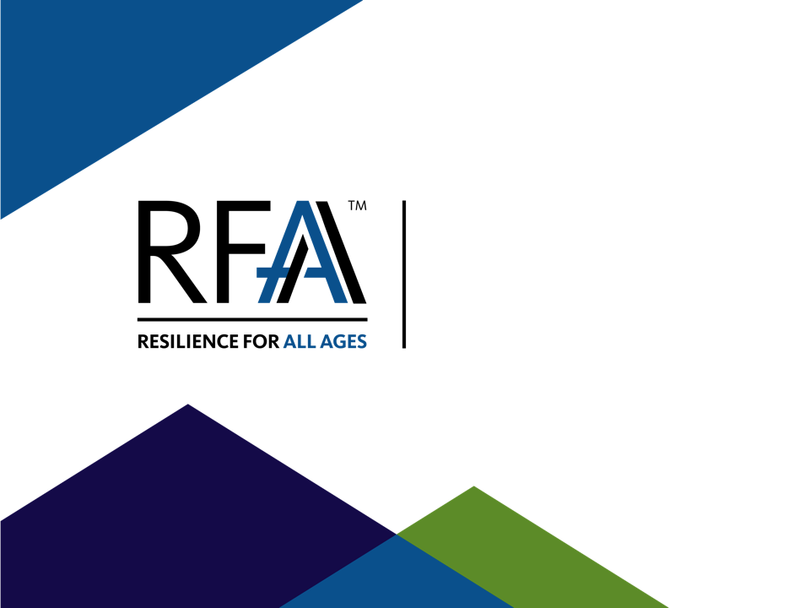
INSERT CONTACT INFO FOR
RFAA HERE

