Slide 1

Caring for the Resident Environment Competency
Staff Training
Notes:
Hello and Welcome to the program on -
NOTE TO SPEAKER: As attendees enter the room, this slide should be on the screen. Be certain each person signs the attendance sheet or uses whatever facility method tracks their attendance at in-services. Introduce yourself and the topic of competency as it relates to the provision of care and services for Resident Environment
NOTE TO SPEAKER: Whenever you see the symbol to the left in the speaker’s notes, please read the associated instructions. Whenever you see bold and underlined content in the speaker’s notes, please emphasize this information to the attendees.
There are over 1.5 million adults over 65 living in nursing homes, between 16-27% have accidents due to environmental hazards
F584 Safe Environment §483.10(i) Safe Environment.
The resident has a right to a safe, clean, comfortable and homelike environment, including but not limited to receiving treatment and supports for daily living safely.

Slide 2
Objectives
Obtain a basic understanding of the Requirement of Participation for areas related to caring for the resident environment
Review the resident policies and procedures for a safe resident environment
Verbalize understanding of the facility process for including the resident preferences and choices in management of the resident environment
Notes:
Today’s in-service has 3 objectives (read) and additional key points (below) that will be instrumental in caring for the resident environment. We will also need to:
1. Assess to find individual preferences, routines, religious, and cultural needs through our assessment process and ongoing care conferences
2. Develop of a person-centered plan of care from the preferences, routines, religious and cultural findings and include them in our daily cares safely
3. Evaluate and Analyze the preferences, routines, and findings in the assessment and monitoring phase – to find the most effective and safe methods of incorporating these into the environment
4. Identify and apply specific strategies for preventing or minimizing hazards, risks, and institutional characterizations –by use of our monitoring systems, audits, rounds, and reporting systems
5. Identify efficient and effective communication strategies –developing ongoing communication to all staff, volunteers, and contracted the safe interventions including their preferences, routines, religious, and culture desires
6. Monitor appropriately for effectiveness of environmental changes and adaptations and Modifying the changes, as necessary– again ongoing audits and monitoring and ability to effectively change those as needed to adapt to safe environment but not just for resident but all residents and staff
and lastly,
7. Obtain a basic understanding of the Requirement of Participation for Caring for Resident Environment competency.
The requirement for sufficient and competent staff for Review the policies and procedures for Caring for Resident Environment is found at F584. You hear about “F tags” when surveyors find deficiencies. “F tags” or “Federal tags” are numbers assigned to the regulations a skilled nursing facility like this one must follow in order to participate in the Medicare and Medicaid programs. The facility has signed a contract with The Centers for Medicare and Medicaid Services (CMS) agreeing to follow the regulations and to allow surveyors to inspect the facility for compliance.
F584 specifically indicates nursing facilities must provide a safe, clean, comfortable, and homelike environment.
2) Review the policies and procedures for Caring for Resident Environment.
Residents requiring a comprehensive assessment to items for the person centered individual plans of care. So, we will talk about how we assess and how we develop person-centered care plans.
Environment and setting addressing the resident’s customary routines, interests, and preferences are expected to be provided since these promote engagement and positive relationships among residents and staff as well as an atmosphere conducive to mental and psychosocial well-being.
Competencies regarding identifying hazards and risks in the resident environment
Verbalize understanding of documentation related to hazards and accidents

Slide 3
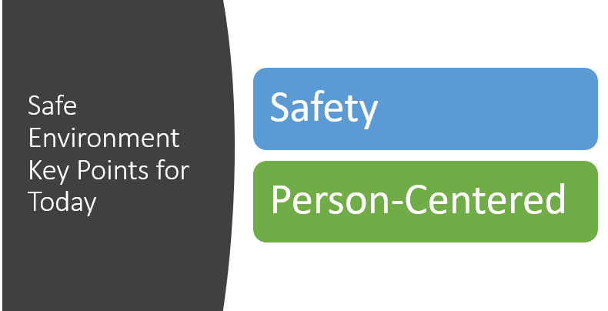
Notes:
Today we are going to talk about safety to address areas such as:
Clean, sanitary, orderly and comfortable
Clean linens
Comfortable and safe lighting
Comfortable and safe temperatures
Safe and functioning equipment
Safe electrical systems and more!
We will also address Person-centered:
Resident preferences, home-like with their own belongings, lighting preferences, sound, comfort and more

Slide 4
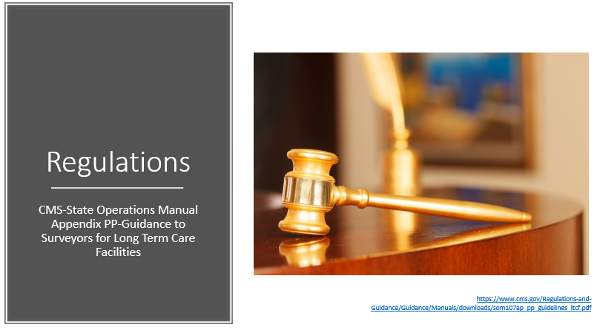
Notes:
The Requirements of Participation include the Federal regulations that Long Term Care Facilities must comply with. We will talk about the specific regulations that revolve around a safe resident environment. The facility is required to perform a facility wide assessment to determine resources necessary to care for the residents competently. Evaluation of the environment is part of that regulation as well.

Slide 5

F584 Caring for Resident Environment
The facility MUST provide—
§483.10(i)(1) A safe, clean, comfortable, and homelike environment, allowing the resident to use his or her personal belongings to the extent possible.
(i) This includes ensuring that the resident can receive care and services safely and that the physical layout of the facility maximizes resident independence and does not pose a safety risk.
(ii) The facility shall exercise reasonable care for the protection of the resident’s property from loss or theft.
https://www.cms.gov/Regulations-and-Guidance/Guidance/Manuals/downloads/som107ap_pp_guidelines_ltcf.pdf
Notes:
CMS – the Centers for Medicare and Medicaid Services – write the requirements, the rules.
CMS states the facility must provide a safe, clean, comfortable, and homelike environment, allowing the resident to use his or her personal belongings to the extent possible.
Those are the rules. Let’s take a closer look at some background information and recommended interventions.

Slide 6
Basic Definitions
Environment” refers to any environment in the facility that is frequented by residents, including (but not limited to) the residents’ rooms, bathrooms, hallways, dining areas, lobby, outdoor patios, therapy areas and activity areas.
A “homelike environment” is one that de-emphasizes the institutional character of the setting, to the extent possible, and allows the resident to use those personal belongings that support a homelike environment. A determination of “homelike” should include the resident’s opinion of the living environment.
https://www.cms.gov/Regulations-and-Guidance/Guidance/Manuals/downloads/som107ap_pp_guidelines_ltcf.pdf
Notes:
Environment- lets discuss our environment here in this facility, what does it include?
Now Relate the facility environment to your home environment…
Now name some items that make our environment homelike?
Do the residents have family pictures?
Items? Magazines, books, games, hobbies
Furniture?
What are some items that make a facility NOT Homelike?
-overhead paging
-piped in music
-institutional medication carts and equipment
-Alarms
-Furniture/décor consistent with home and in good repair
-Centralized glassed in nurses stations
-Signage labeling work rooms, clean utility, soiled utility in an area of view to residents and visitors
-Meals served on trays, we don’t use delivery trays at home to get to the table we carry our plates or fix them at the table.

Slide 7
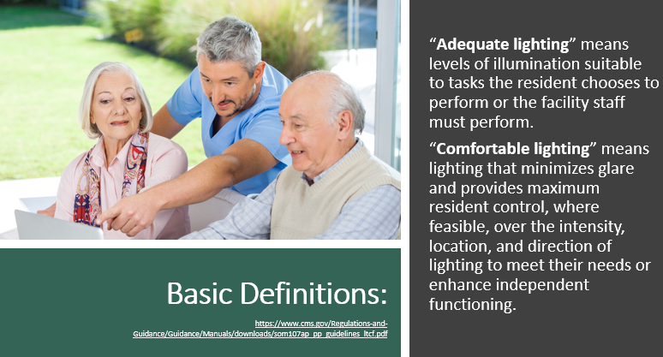
Notes:
Now that we have reviewed the basic two and have our mind set with those, we now need to understand the parts of the regulatory language lets start with some basic definition review:
“Adequate lighting” means levels of illumination suitable to tasks the resident chooses to perform or the facility staff must perform.
Can anyone give an example of when lighting is NOT suitable? How about at night, when you get out of bed to use restroom, do you have nightlights? Do you step on or trip on items?
Ideas of how to correct that? Different bulbs – type of wattage, lamps, natural light
(advance slide)
“Comfortable lighting” means lighting that minimizes glare and provides maximum resident control, where feasible, over the intensity, location, and direction of lighting to meet their needs or enhance independent functioning.
When is lighting NOT comfortable? Sunlight straight into eyes or glaring on shiny floors.
What can we do to make it comfortable? Window shades, drapery, matt finish flooring
What do you do at home when it is too bright or too dim? Is there a burnt out light bulb, need a table lamp, you should report and help residents just as you would in your home

Slide 8
Definitions
“Comfortable and safe temperature levels” means that the ambient temperature should be in a relatively narrow range that minimizes residents’ susceptibility to loss of body heat and risk of hypothermia, or hyperthermia, or and is comfortable for the residents.
“Comfortable sound levels” do not interfere with resident’s hearing and enhance privacy when privacy is desired and encourage interaction when social participation is desired. Of particular concern to comfortable sound levels is the resident’s control over unwanted noise.
https://www.cms.gov/Regulations-and-Guidance/Guidance/Manuals/downloads/som107ap_pp_guidelines_ltcf.pdf
Notes:
How do you feel if your furnace is broken in the winter?
What do you do about it? What if you were outside in the 95 degree weather, would you wear a sweater? Sunscreen? Find Shade? Cool drink?
Well so do our residents need us to think of these things and make sure they are in place for them. Have you ever been cold or hot at home and another person in your home with you is not?? We need to think and monitor for those things with our residents also and our range to keep environment is 71-81 F
(advance slide)
Does anyone have a problem with loud sounds? Have sensitive hearing? Startled by loud sudden sounds? So do our residents, and we do not like those in our home either and we like the piece and quiet that we choose at home, well so do they
What about repetitive noises, neighbors, yelling, swearing? We need to be aware that those can also disturb an environment for our residents.
Overhead paging, piped in music, bed and chair alarms, door alarms, call bells are for institutions not homelike

Slide 9
Definitions
“Orderly” is defined as an uncluttered physical environment that is neat and well-kept.
“Sanitary” includes, but is not limited to, preventing the spread of disease-causing organisms by keeping resident care equipment clean and properly stored. Resident care equipment includes, but is not limited to, equipment used in the completion of the activities of daily living.
https://www.cms.gov/Regulations-and-Guidance/Guidance/Manuals/downloads/som107ap_pp_guidelines_ltcf.pdf
Notes:
Ok just like home, we like things neat, clean, and everything in its place. We clean, dust, disinfect and do all those duties at home and our residents to make sure their home is the same. Keeping paths clear, hallways and exits clear for exiting in emergency or in a hurry, items off floors so that we do not trip
(advance slide)
We also clean our homes and disinfect them. Many bacteria live on horizontal, vertical surfaces and even airborne. We need to be stellar with our disinfection and infection control practices at all times and keep our residents environment clean and sanitary
We make sure food is safely prepared, stored, and served, not leaving out sitting just as we do in our homes.
Would you leave it sit in front of your family member after an hour or two? We may need to remove them so a confused resident does not eat it and become ill
So now lets look deeper at the meaning of a Hazard and a Risk.

Slide 10

F558 Reasonable Accommodations of Needs/Preferences
“The right to reside and receive services in the facility with reasonable accommodation of resident needs and preferences except when to do so would endanger the health or safety of the resident or other residents.”
https://www.cms.gov/Regulations-and-Guidance/Guidance/Manuals/downloads/som107ap_pp_guidelines_ltcf.pdf
Notes:
We will need to encourage the resident to personalize their living environment—however, we need to make sure that it doesn’t infringe the safety or rights of the other residents as well. This will be everyone’s responsibility to monitor.

Slide 11

Hazards
“Hazards” refer to elements of the resident environment that have the potential to cause injury or illness.
  “Hazards over which the facility has control” are those hazards in the resident environment where reasonable efforts by the facility could influence the risk for resulting injury or illness.
  “Free of accident hazards as is possible” refers to being free of accident hazards over which the facility has control.
https://www.cms.gov/Regulations-and-Guidance/Guidance/Manuals/downloads/som107ap_pp_guidelines_ltcf.pdf
Notes:
What can we do to decrease hazards and risks? First a comprehensive assessment process to identify any areas of risk, then a person-centered care plan that addresses any potential risks, followed by consistent implementation of the care plan interventions!

Slide 12
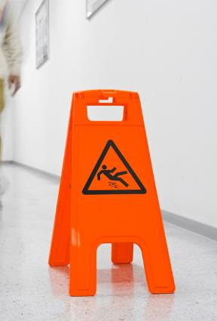
Hazards
Wet Floors
Needles (Hazardous Waste) Isolation items
Unlocked Medication and Treatment Carts
Plants
Chemicals or Toxins
Water temperatures
Water Pitcher
Knitting needles/sewing supplies or craft items
Candy or other items another resident may ingest
Ornament/Figurine
Notes:
Name some hazards here for our residents?
Now think of an Alzheimer’s resident, are those hazards the same for them? Are there any additional hazards for dementia residents?
Chemicals – could drink housekeeping chemicals, kitchen chemicals, Hand Sanitizer etc.
Chemicals and Toxins - Various materials in the resident environment can pose a potential hazard to residents. Hazardous materials can be found in the form of solids, liquids, gases, mists, dusts, fumes, and vapors. The routes of exposure for toxic materials may include inhalation, absorption, or ingestion. This is why we have MSDS (Material Safety Data Sheets) on all chemicals in facility, to tell us dangers and how to treat
Water pitcher –resident on thickened liquids
Betty’s knitting needles and supplies she works daily - agitated confused resident uses on staff or another resident OR carrying it and falls on it
Ornament/Figurine or Money – could swallow or choke on it
This brings in the thoughts that we need to assess and know our residents and adapt their environment to their levels, not all resident's are equal, what is fine for one resident could be a grave danger to another resident at the same time.

Slide 13
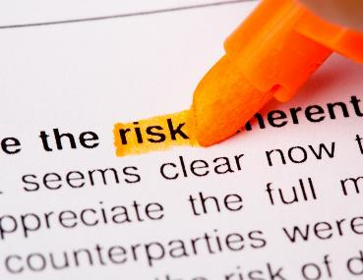
Risk
“Risk” refers to any external factor, facility characteristic (e.g., staffing or physical environment) or characteristic of an individual resident that influences the likelihood of an accident.
Notes:
Now name some risks? (next slide discusses risks)
“Risk” refers to any external factor, facility characteristic (e.g., staffing or physical environment) or characteristic of an individual resident that influences the likelihood of an accident.

Slide 14
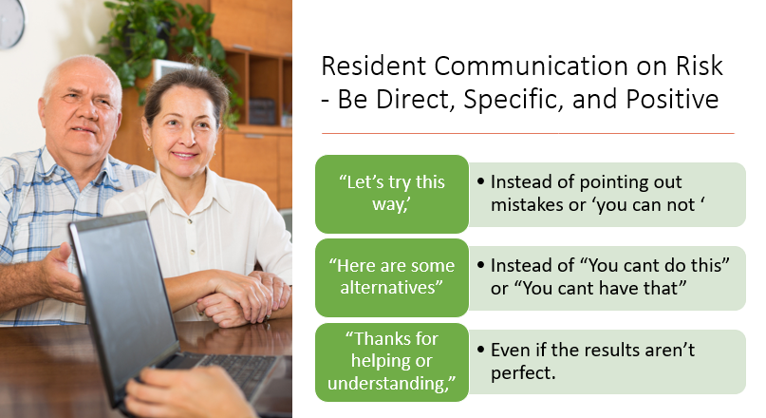
Notes:
When attempting to communicate with a resident on a risk or hazard it is best to follow this rule of thumb
NOTE TO SPEAKER: Read the slide.

Slide 15
Risks
Weakness
Medications
Unsteady gait
Side Effects
Seizures
Swallowing Problems
Vision
Behaviors
Hearing
Disease process
Stairs
Hand rails or items sharp edge
Auto door closers
Bed rails
Wheelchairs or walkers with sharp edges
Cracks in vinyl or coverings
Tears in sheets or blankets
Blocked hallways or exits
Electrical devices or plugs, extension cords, power strips, electric blankets, heating pads
Notes:
Now name some risks? (EXPLAIN EACH ITEM HOW CAN BE A RISK)
First we have appear within an individual resident that can cause an accident.
Next we have facility environment items that can cause injury or accidents
Did you know we were not supposed to have extension cords, power strips, electric blankets, heaters, or heating pads? They pose a severe fire and burn risk to residents
How about STAFF, how can they pose a RISK???? (give a minute or so) (advance slide)
This is why we educate you on Abuse and neglect policy and procedures and how to report right away and check backgrounds and testing's. We must protect residents first, and report risks and hazards right away in all different areas.
CAN YOU NAME OTHER THREATS FOR RESIDENT BEING SAFE???? (-Abuse, -verbal-physical-sexual-misappropriation-neglect-Theft-restraints-Isolated, etc.)

Slide 16
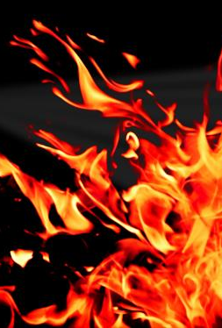
Additional Risks
Tornados
Flood
Active gun shooter
Hurricanes
Earthquakes
Fire
Smoke/Fumes
Carbon monoxide
Terrorism
Elopement
Broken equipment or equipment breaks
Improperly used equipment
*All of these are in our facility assessment and emergency preparedness plan to protect and provide a safe environment
Notes:
Have them name many and give time, then start advancing slides and discussing how these pose a risk also.
-Resident Allergies
-Food preparation, storage, and contamination
-Insufficient staff
-Automotive accident
-Chemical spill
Additional Risks

Slide 17
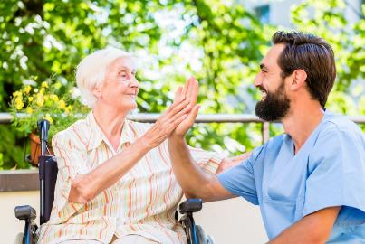
Supervision/Adequate Supervision
“Supervision/Adequate Supervision” refers to an intervention and means of mitigating the risk of an accident. Facilities are obligated to provide adequate supervision to prevent accidents. Adequate supervision is determined by assessing the appropriate level and number of staffs required, the competency and training of the staff, and the frequency of supervision needed.
https://www.cms.gov/Regulations-and-Guidance/Guidance/Manuals/downloads/som107ap_pp_guidelines_ltcf.pdf
Notes:
This determination is based on the individual resident’s assessed needs and identified hazards in the resident environment. Adequate supervision may vary from resident to resident and from time to time for the same resident.
By providing adequate supervision and staffing we decrease the likelihood of accidents due to risks or hazards. Our facility assessment determines our need of how many and when staffing levels are needed based on our resident population for each time of the day. Anytime we have a change in normal, we need to revise our facility assessment and/or our staffing for supervision to keep our residents safe and monitoring the environment
But how do we know and learn what to monitor for and all the vast different hazards and risks to watch for?

Slide 18
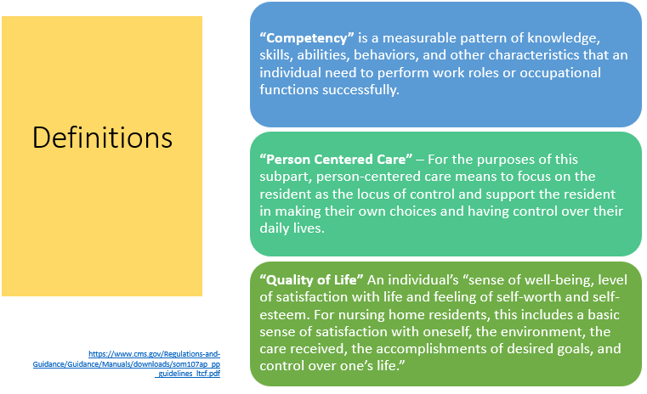
Notes:
We learn the areas and items we need through our competency testing and training. When we make our facility assessment it tells us the staff, equipment, types of residents, diseases, and items that we need to have our staff trained and competent on and Safety and Safe resident environment is large part of it. This is why we have so much orientation, ongoing education sessions, skills fairs, learning networks, and annual testing's. We need to make sure our staff are well trained and competent to care for our residents and facility.
So we have learned environmental items for safe and comfort now, and training aspects. One more thing plays a large part in the new regulations of participations, and that is Person Centered Care. Instead of the focus on routine and timings of an institution, it is each residents preferences, routines, likes, dislikes, religion, and culture that determines their needs to make them a person centered and drive care plan for us to follow. We must ask and assess those items to become familiar with them and provide them with as close as we can get to their normal daily life in a homelike environment safely.
When we put it all together for safe, clean, comfortable, homelike with their preferences, former routines, likes, dislikes, religion and culture in one large package here at our facility, we are providing
Quality of Life for each of them in our facility which is now their Safe homelike environment, that we are monitoring for hazards and risks daily to keep them safe.

Slide 19
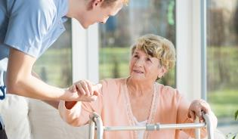
Caring for Resident Environment
Assessing to find individual preferences, routines, religion, and cultural needs to provide a homelike environment.
Retain and use personal possessions including furnishings, clothing, as space permits, unless to do so would infringe upon the rights or health and safety of other residents.
Safe temperature levels
Comfortable sound levels
Retain and user personal possessions
Notes:
So now we have learned why we need to provide a safe resident environment, and how we learn to monitor and provide it. Lets dig deeper and look at some specific things in that environment (our facility) that you need to monitor daily and each shift.
As you already know, we must assess for individual preferences, routines, religion and culture needs, provide adequate lighting, temperature, and sound levels, in a clean, orderly, and sanitary standard. But that also includes reassessments, monitoring for changes, and making those changes as needed through the assessment process and care plan development in specified times per the regulations.
Now lets take it one step deeper:
Comfortable sound levels—that means music, machinery, tv, staff talking, even other residents that are yelling –this can be a concern for the other resident’s environment as well!
Resident can retain and use personal items

Slide 20
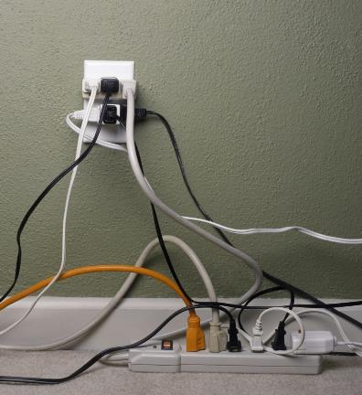
A Safe Environment is CRUCIAL!
Adequate and comfortable lighting levels
Ensuring the call system is always working
Comfortable and safe temperature levels
Comfortable sound levels
Safety with electrical systems
Wet floors
Etc.
Notes:
Just to name a few……Remember, all staff are responsible for monitoring the safety of the resident environment

Slide 21
Monitor/Evaluate/Audit
ALL departments to provide sanitary, orderly, and comfortable interior
  Clean bed and bath linens that are in good condition
  Private closet space
  Conduct inspections of all equipment, devices, and areas on regular basis
  Infection Control: cleaning and disinfecting equipment between each resident use and cleaning/disinfecting the environment in accordance with policy and procedure
Notes:
F880 clearly talks about the importance of cleaning and disinfection of both equipment and the resident environment
Even areas such as pest control are critical for a clean and safe environment!

Slide 22
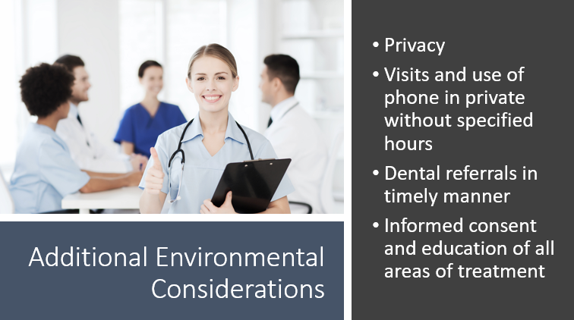

Slide 23
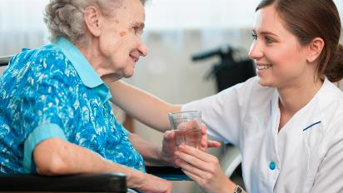
Approach to Care
  Effective and Efficient communication
    With the resident
    With the team
  Strategies for implementing person-centered care rely on having effective staff approaches and an environment conducive to carrying out recommended care practices.
Notes:
So, let’s review the overall approach to person-centered care.
We need a thorough assessment and a detailed care plan. An Interdisciplinary Team approach is essential! Everyone needs to aware of risks and hazards possible and provide a safe environment for our residents.

Slide 24
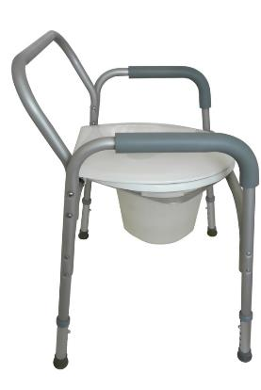
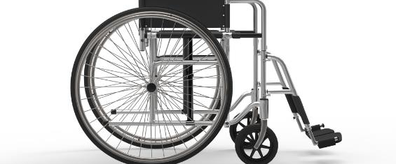
Preventative Maintenance Program
This is where you will discuss your preventative maintenance program:
Notes:
***This is where you will discuss your preventative maintenance program: F908 indicates that the facility must maintain all mechanical, electrical and patient care equipment in safe operation condition”
Policy and Procedure—plan (who, what, where, etc.)
Documentation
FIRST…..Protect the resident!!
We must communicate and let appropriate persons know of the risk or hazard observed effectively and efficiently.
Example of burned out light bulb in bathroom:
Writing this on a work order: “Mary’s bathroom light is burned out”
“Room 301, bathroom light burned out in ceiling. She is independent and needs the light to get to and from bathroom, needs to be repaired by dusk”

Slide 25
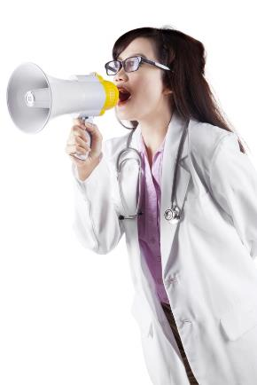
Effective and Efficient Communication
Interdisciplinary Team
Resident
Resident Representative
Practitioner
Notes:
Resident Preferences
Care Plan interventions
Considerations
Equipment needs
Cleaning Needs

Slide 26

In Summary
Notes:
Summarize the overall training with the team
It is everyone’s responsibility to look at the resident environment as person-centered and homelike—using residents preferences and belongings as much as possible.
Safety: ensuring a safe and sanitary environment by assessing risk, managing risk with individualized interventions, a good preventative maintenance program and all staff monitoring for a safe and enjoyable environment for successful quality of life outcomes for the resident.

Slide 27


Slide 28
References and Resources
Centers for Medicare & Medicaid Services State Operations Manual, Appendix PP – Guidance to Surveyors for Long Term Care Facilities (Rev. 173, 11-22-17): https://www.cms.gov/Regulations-and-Guidance/Guidance/Manuals/downloads/som107ap_pp_guidelines_ltcf.pdf
LTC Survey Pathways (Download) https://www.cms.gov/medicare/provider-enrollment-and-certification/guidanceforlawsandregulations/nursing-homes.html
Centers for Medicare & Medicaid Services Long-Term Care Facility Resident Assessment Instrument 3.0 User’s Manual, Version 1.16. October 2018: https://www.cms.gov/Medicare/Quality-Initiatives-Patient-Assessment-Instruments/NursingHomeQualityInits/MDS30RAIManual.html

Slide 29
References and Resources
CMS Hand In Hand: A Training Series for Nursing Homes https://surveyortraining.cms.hhs.gov/pubs/HandinHand.aspx
Alzheimer’s Association
https://www.alz.org/

Slide 30
Disclaimer
“This presentation provided is copyrighted information of Pathway Health. Please note the presentation date on the title page in relation to the need to verify any new updates and resources that were listed in this presentation. This presentation is intended to be informational. The information does not constitute either legal or professional consultation. This presentation is not to be sold or reused without written authorization.”

