Slide 1
Infection Prevention
To Prevent Respiratory Illnesses like COVID19
Trinity Health Senior Communities

Slide 2
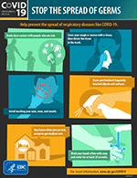
Infection Prevention Strategies
Hand Hygiene
Standard Precautions
Respiratory Etiquette
Droplet Precautions
Mask Usage
Stay home if you are ill
COVID19 FAQS

Slide 3
Hand Hygiene

Slide 4
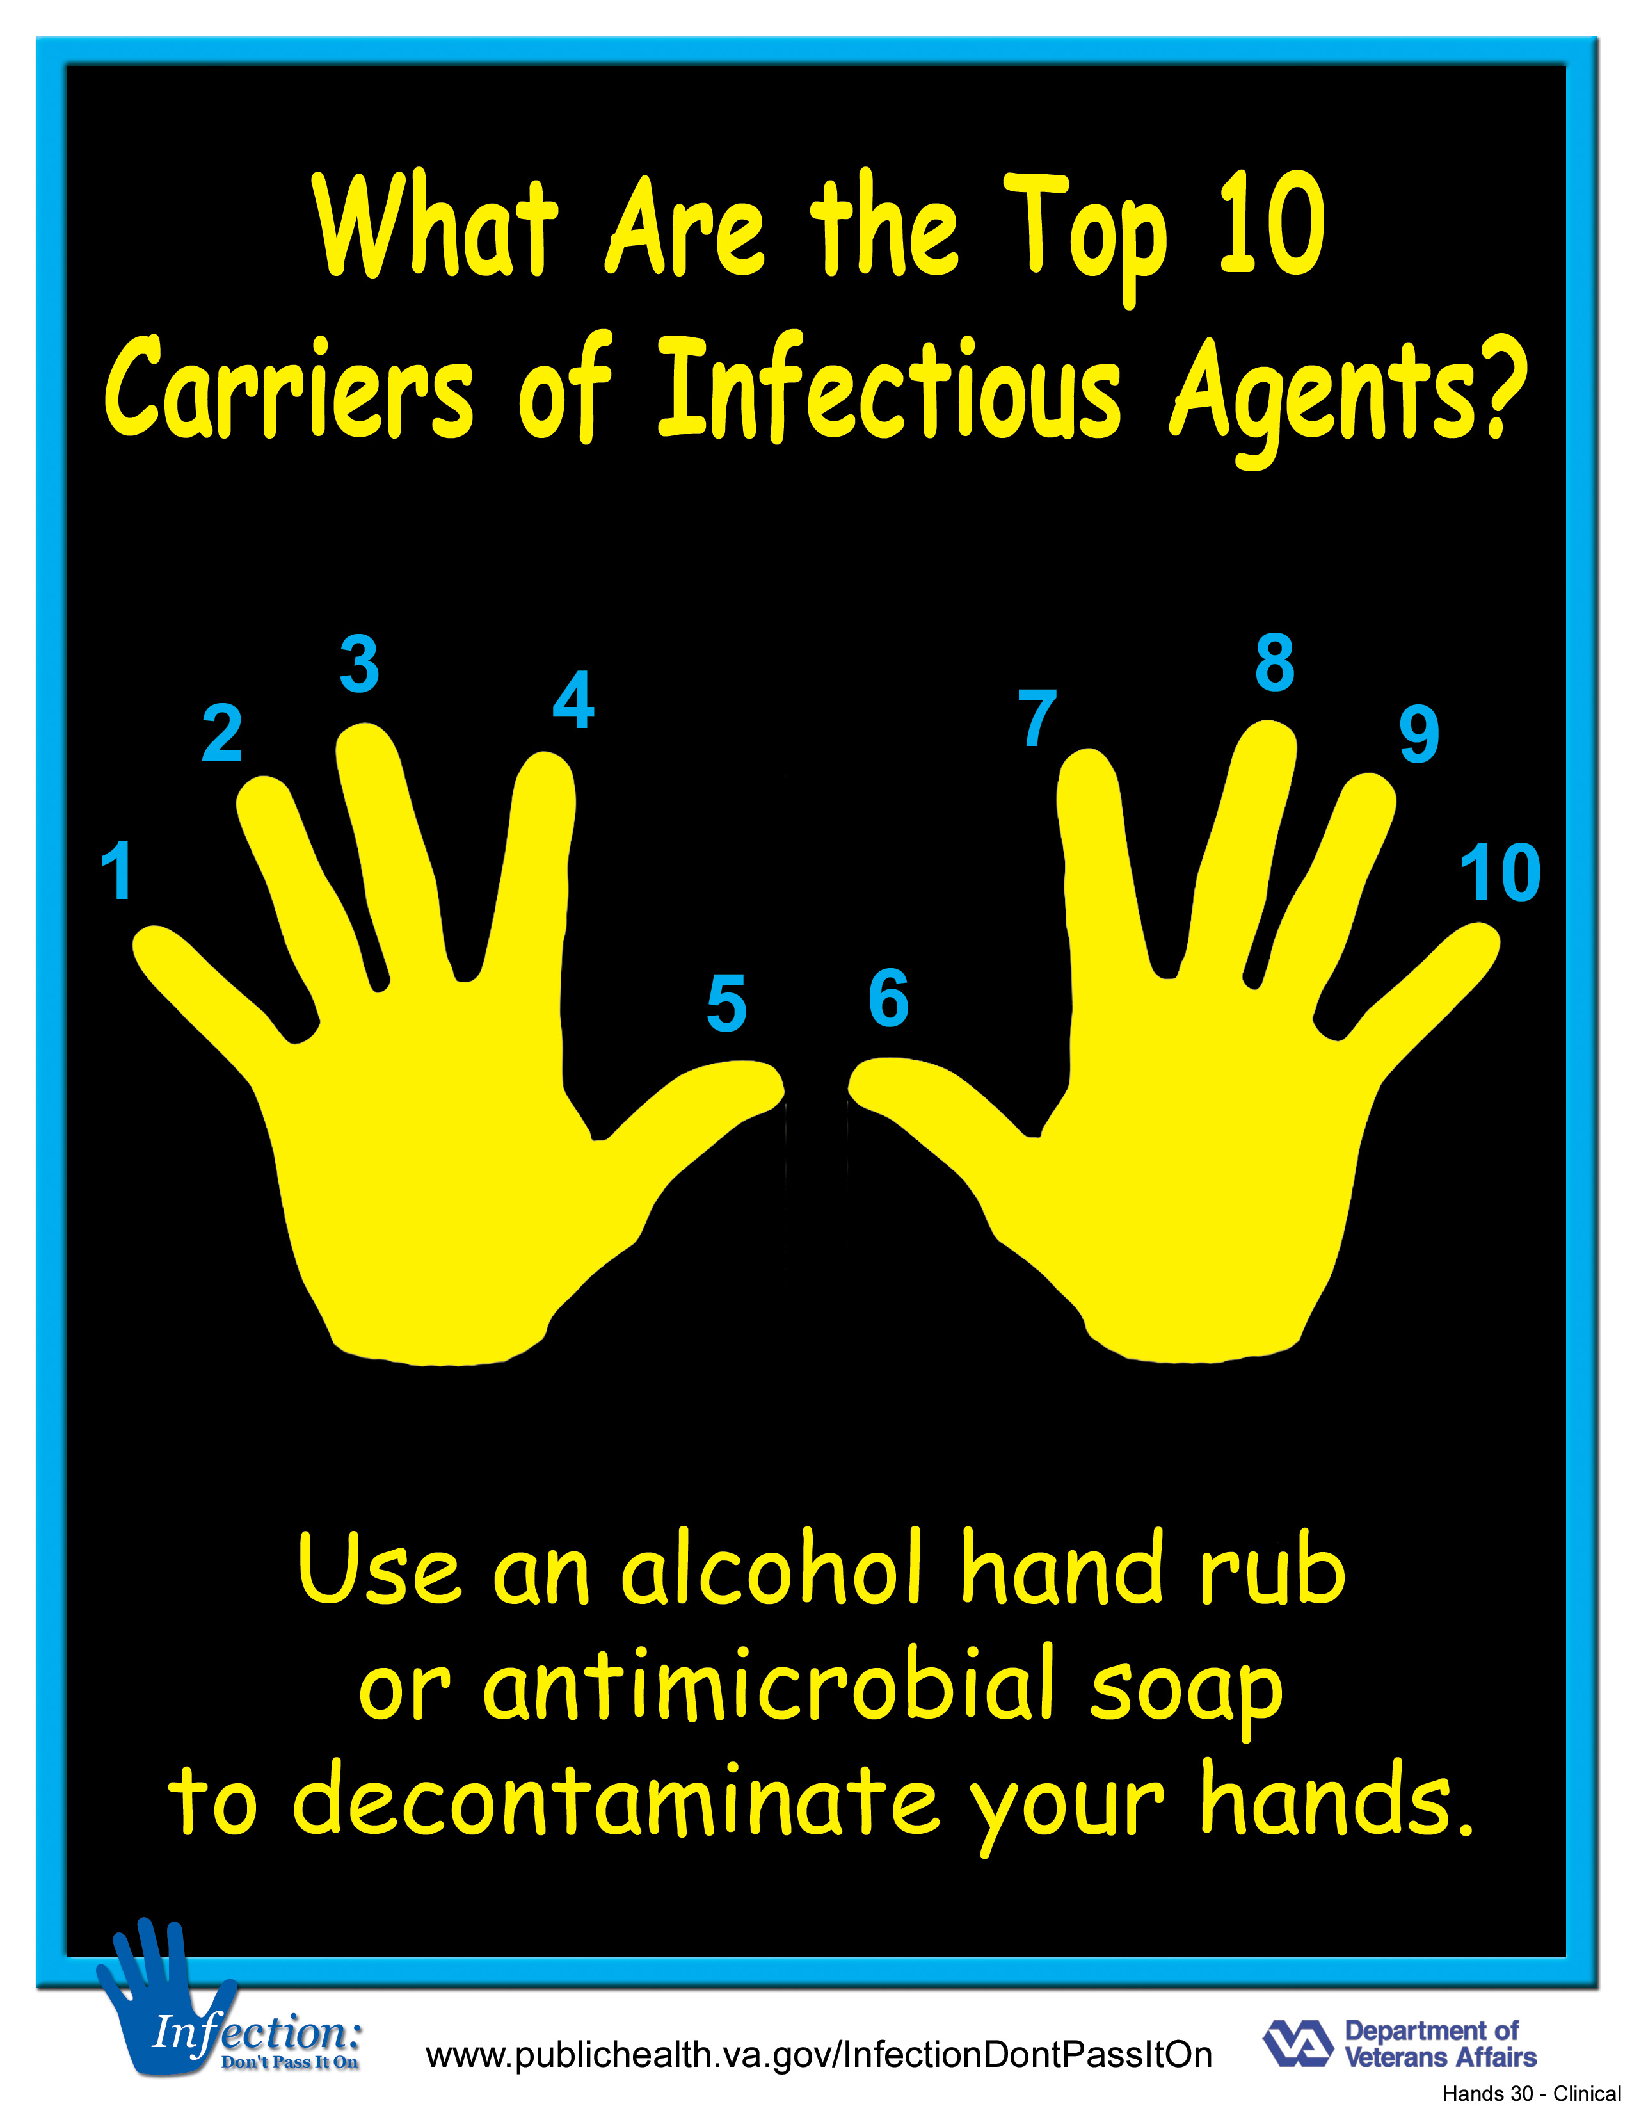
Hand Hygiene
Hand Hygiene is the #1 way to prevent infection
Unless hands are visibly soiled, an alcohol-based hand rub is preferred over soap and water in most clinical situations.

Slide 5
Hand Hygiene Instances
Use an alcohol-based hand rub or wash with soap and water for the following clinical indications:
Immediately before touching a patient.
Having contact with inanimate objects near a patient
Before moving from work on a soiled body site to a clean body site on the same patient.
After touching a patient or the patient’s immediate environment.
After contact with blood, body fluids or contaminated surfaces.
Immediately after glove removal.

Slide 6
Handwashing
Handwashing with Soap and Water
The following guidelines should be followed when performing handwashing with soap and water:
HANDWASHING
Wet hands with water.
Apply soap.
Rub hands together for at least 20 seconds, covering all surfaces, focusing on fingertips and fingernails.
Rinse under running water and dry with disposable towel
Use the towel to turn off the faucet.

Slide 7
Hand Hygiene with Alcohol based hand rub
Alcohol- based hand rubs.
Apply to palm of one hand (use enough alcohol-based hand sanitizer to cover all surfaces of your hands)
Rub hands together, covering all surfaces, focusing in particular on the fingertips and
Fingernails until dry.
Use enough rub to require at least 20 seconds to dry.

Slide 8
Standard Precautions

Slide 9
Stand Precautions
Standard precautions, is applied to all residents, regardless of the suspected or confirmed presence of an infectious agent.
Standard precaution principles are designed to reduce the risk of transmitting microorganisms from both recognized and unrecognized sources of infection in healthcare settings.
Standard precautions are designed to protect both healthcare colleagues and residents from contact with infectious agents.

Slide 10
Standard Precautions
Standard precautions emphasize:
Hand hygiene practices
Use of gloves when touching body fluids
Utilize masks, eye protection, and gown when splashing of body fluids is likely
Avoid needle sticks and sharps injuries
Respiratory hygiene and cough etiquette

Slide 11
Respiratory Etiquette

Slide 12
Respiratory Etiquette
Cover your Cough and sneezes
Cough into your elbow if tissue is not available
Cover cough or sneezes with a tissue
Immediately throw tissues away
Wash hands frequently

Slide 13
Droplet and Contact Precautions

Slide 14
Droplet Precautions
Droplet transmission involved droplets generated by the resident, colleague, or visitor primarily during coughing, sneezing and talking, or during the performance of certain procedures, such as suctioning
Transmission occurs when droplets containing microorganisms generated from the infected person are propelled a short distance through the air and deposited on the susceptible conjunctiva, nasal mucosa, or mouth.
Special air handling and ventilation are not required.

Slide 15
Droplet and Contact Precautions
In addition to Standard Precautions, the following measures are necessary for droplet and contact precautions:
Gloves and Hand Hygiene
Mask and Gown
Goggles and eye protection
Wear goggles/faceshield if likelihood of exposure during care
Resident Care Equipment
Dedicate non-disposable items that cannot be cleaned and disinfected between residents, e.g., adhesive tape, cloth covered blood pressure cuffs, stethoscopes, bedside commode, lift slings
Clean and disinfect equipment between residents
Resident Transport
Limit transport; if transport necessary, resident wears a surgical mask
Encourage resident to follow respiratory hygiene and cough etiquette to minimize dispersal of droplets

Slide 16
Mask Usage

Slide 17
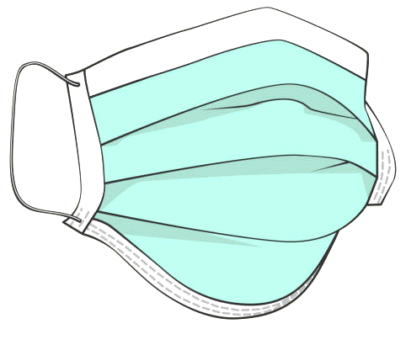
Mask Usage
Wear a mask when within three feet of the resident
Remove mask and immediately perform hand hygiene (use soap and water if hands are visibly soiled). Avoid touching front of mask during removal as it is considered contaminated.
Change surgical mask
Between residents
Between resident rooms
Between hallway
When mask becomes moist with your breath

Slide 18
Don and Doff PPE

Slide 19
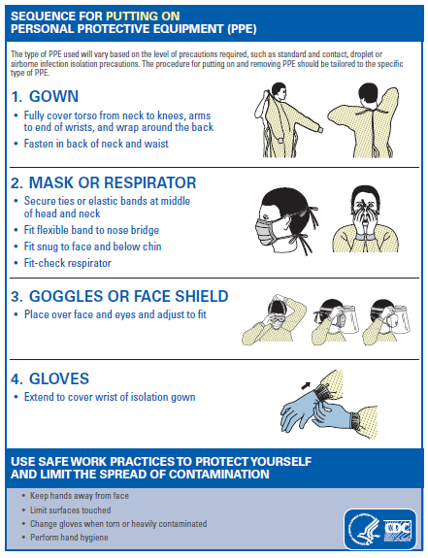
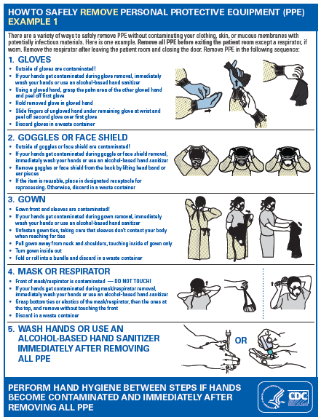
Don and Doff PPE
See Attached CDC recommendations for proper DON and DOFF procedures

Slide 20
Safe Linen Handling

Slide 21
Safe linen handling
Soiled linen has been shown to be a source of pathogenic organisms. Techniques minimizing potential risks to colleagues with soiled linen handling include:
Consider all soiled linen contaminated
Handle soiled linen as little as possible
Do not touch clean or soiled linen to you uniform
Empty linen containers when three-fourths full to prevent overflow
Secure lids to linen containers prior to transport
Wear personal protective equipment (PPE) to include impermeable apron or gown, utility gloves, and mask with goggles during manual rinsing and sorting
Linen Handling Practices
Place soiled linen in a bag at the site of use
Do not touch clean or soiled linen to your uniform
Minimize agitation of linen and contamination of colleagues and environment
Bags and containers of soiled linen are considered contaminated - do not drag or touch bag to any surface during transport to soiled linen containers

Slide 22
Cleaning and Disinfection of Patient Care Equipment

Slide 23
Cleaning and Disinfection of Patient Care Equipment
Resident Care Equipment
Use single use equipment when possible
Non-disposable items must be cleaned and disinfected between residents, e.g., blood pressure cuffs, stethoscopes, bedside commode, vitals machines, etc.
Use EPA-registered cleaning product, be sure to allow for proper disinfection time per product guidelines.
Follow product guidelines for contact time to ensure proper disinfection.

Slide 24
Stay home if you are sick

Slide 25
Colleague Illness
The same screening is involved for colleagues as visitors
Any international travel within the last 14 days to restricted countries
Signs or symptoms of respiratory infection: fever, cough, and sore throat.
Had contact with someone with or under investigation for COVID19
Health care providers who have signs and symptoms of a respiratory infection should stay home from work
Any colleagues that develop signs and symptoms of a respiratory infections while on the job should
Immediately put on a facemask and stop work. Self-isolate at home
Inform the infection preventionist
Contact the local health department
Refer to the CDC guidance that may warrant restricting healthcare personnel from reporting to work.

Slide 26
Residents who are suspected of COVID-19

Slide 27
Residents who are suspected of COVID-19
Place resident in isolation and follow standard, and contact precautions, including the use of eye protection
Notify the infection preventionist
Contact the local health department for guidance
Staff who will care for the resident will adhere to strict infection control practices and wear appropriate PPE.
Limit traffic into the resident’s room, only essential personnel should enter the room.
Use dedicated or disposable noncritical patient care equipment

Slide 28
COVID19 Coronavirus

Slide 29
Coronavirus FAQs
What is coronavirus disease 2019 (COVID-19)?
Coronavirus disease 2019 (COVID-19) is a respiratory illness that can spread from person to person. The virus that causes COVID-19 is a novel coronavirus that was first identified during an investigation into an outbreak in Wuhan, China.
How does COVID-19 spread?
The virus that causes COVID-19 probably emerged from an animal source, but is now spreading from person to person.
The virus is thought to spread mainly between people who are in close contact with one another (within about 6 feet) through respiratory droplets produced when an infected person coughs or sneezes.
It also may be possible that a person can get COVID-19 by touching a surface or object that has the virus on it and then touching their own mouth, nose, or possibly their eyes, but this is not thought to be the main way the virus spreads.
Learn what is known about the spread of newly emerged coronaviruses at https://www.cdc.gov/coronavirus/2019-ncov/about/transmission.html.

Slide 30
Corona Virus FAQs
What are severe complications from this virus?
Some patients have pneumonia in both lungs, multi-organ failure and in some cases death.
How can I help protect myself?
People can help protect themselves from respiratory illness with everyday preventive actions.
Avoid close contact with people who are sick.
Avoid touching your eyes, nose, and mouth with unwashed hands.
Wash your hands often with soap and water for at least 20 seconds. Use an alcohol-based hand sanitizer that contains at least 60% alcohol if soap and water are not available.
If you are sick, to keep from spreading respiratory illness to others, you should
Stay home when you are sick.
Cover your cough or sneeze with a tissue, then throw the tissue in the trash.
Clean and disinfect frequently touched objects and surfaces.
Is there a vaccine?
There is currently no vaccine to protect against COVID-19. The best way to prevent infection is to take everyday preventive actions, like avoiding close contact with people who are sick and washing your hands often.
Is there a treatment?
There is no specific antiviral treatment for COVID-19.People with COVID-19 can seek medical care to help relieve symptoms

Slide 31
See CDC.gov for additional information

Slide 32
References
Centers for Disease Control and Prevention. Coronavirus Disease 2019 (COVID-19). Pandemic Preparedness Resources: https://www.cdc.gov/coronavirus/2019-ncov/php/pandemic-preparedness-resources.html
Centers for Disease Control and Prevention. Strategies to Prevent the Spread of COVID-19 in LTCF. https://www.cdc.gov/coronavirus/2019-ncov/healthcare-facilities/prevent-spread-in-long-term-care-facilities.html
Centers for Disease Control and Prevention. Caring for Patients with Confirmed or Possible COVID-19. https://www.cdc.gov/coronavirus/2019-ncov/hcp/caring-for-patients-H.pdf
CDC Guidance for LTC Communties on COVID-19: https://www.cdc.gov/coronavirus/2019-ncov/healthcare-facilities/prevent-spread-in-long-term-care-facilities.html
Trinity Health Senior Communities. 2020. Practice Guidelines. Infection Control Manual.

