Slide 1

Test
Smoking Policy and Procedure
Staff Training
Test
Notes:
Hello and welcome to the presentation on Smoking. This training is designed to provide facility supervisors, leaders and front-line staff with an overview of the updated smoking regulations, discuss the facility policy and procedure and outline your responsibilities to keep the residents, visitors and all of you safe. Good communication is also essential when it comes to the smoking policy in your facility.

Slide 2
OBJECTIVES
Describe updates to the regulations with smoking
Understand the facility Smoking Policy
Understand the roles and responsibilities of the interdisciplinary team with respect to the smoking policy and procedure
Notes:
We have 3 objectives for today’s presentation (Read objectives) Smoking comes under the accident prevention area of the regulations and we will be discussing these today
Upon completion of this presentation, participants should be able to:
Describe updates to the regulations with smoking
Understand the facility Smoking Policy
Understand the roles and responsibilities of the interdisciplinary team with respect to the smoking policy and procedure

Slide 3

Regulations
Centers for Medicare & Medicaid Services
State Operations Manual
Appendix PP – Guidance to Surveyors for Long Term Care Facilities
https://www.cms.gov/files/document/appendix-pp-guidance-surveyor-long-term-care-facilities.pdf
Notes:
The Centers for Medicare & Medicaid Services or CMS, addresses the federal requirements of participation for all nursing homes. There was a recent update that will take effect October 24th, 2022, that includes updates to the smoking requirements. We will be addressing these updates today

Slide 4

F561 Self-Determination
“If a facility changes its policy to prohibit smoking (including electronic cigarettes), it should allow current residents who smoke to continue smoking in an area that maintains the quality of life for these residents and takes into account non-smoking residents. The smoking area may be an outside area provided that residents remain safe.”
https://www.cms.gov/files/document/appendix-pp-guidance-surveyor-long-term-care-facilities.pdf
Notes:
Let’s start off talking about if facilities MUST have smoking on the property. CMS indicates in F561 Self –Determination that, (Read slide). So, in essence, if your facility decides that they will no longer be a smoking campus or facility, the facility is able to do that. There are requirements that you will need to follow such as current residents WHO SMOKE now, will have to be able to continue smoking in a designated safe area,

Slide 5

F561 Self Determination
Residents admitted after the facility changes its policy must be informed of this policy at admission
https://www.cms.gov/files/document/appendix-pp-guidance-surveyor-long-term-care-facilities.pdf
Notes:
All residents admitted AFTER that date, will not be able to smoke on facility grounds and will be informed of this at admission. Communication with the resident and their representatives and families will be important.

Slide 6

F689 Accidents
“§483.25(d)(1) The resident environment remains as free of accident hazards as is possible; and §483.25(d)(2) Each resident receives adequate supervision and assistance devices to prevent accidents.”
https://www.cms.gov/files/document/appendix-pp-guidance-surveyor-long-term-care-facilities.pdf
Notes:
The Federal tag or F-tag that addresses smoking in detail is F689, Accidents. (read slide)

Slide 7
F689 Accidents
INTENT: 483.25(d) The intent of this requirement is to ensure the facility provides an environment that is free from accident hazards over which the facility has control and provides supervision and assistive devices to each resident to prevent avoidable accidents.
https://www.cms.gov/files/document/appendix-pp-guidance-surveyor-long-term-care-facilities.pdf
Notes:
Having a good system – designating smoking area(s), assessment of the resident and proper assistance in accordance with the residents' needs can prevent accidents with resident smoking

Slide 8

Regulation-Guidance
This includes:
Identifying hazard(s) and risk(s);
Evaluating and analyzing hazard(s) and risk(s);
Implementing interventions to reduce hazard(s) and risk(s); and
Monitoring for effectiveness and modifying interventions when necessary.
https://www.cms.gov/files/document/appendix-pp-guidance-surveyor-long-term-care-facilities.pdf
Notes:
(Read slide first)
This is why a solid system for smoking is essential. The facility will need to have a good process for identification of risks, prevention measures and monitoring for safe care

Slide 9
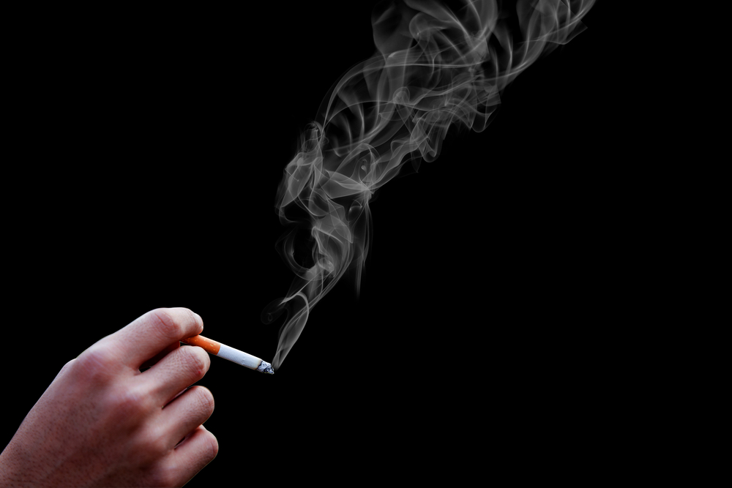
Regulatory Guidance
Resident Smoking
“Some facilities permit residents to smoke tobacco products. In these facilities, assessment of the resident’s capabilities and deficits determines whether or not supervision is required.”
https://www.cms.gov/files/document/appendix-pp-guidance-surveyor-long-term-care-facilities.pdf
Notes:
CMS indicates, (Read slide)
Discuss assessment process and how the outcomes determine level of supervision
Resident is able to demonstrate understanding of the smoking policy and designated areas.
BIMS Score: _________________
Resident is able to verbalize safe smoking principles.
Resident is able to safely remove the smoking materials out of container
Resident is able to safely utilizer a lighter
Resident is able to safely handle lit smoking materials.
Resident demonstrates safe smoking behavior while interacting with other residents
Does resident have clothing with burn holes
Do resident’s hands/fingernails show signs of burns

Slide 10

Regulatory Guidance
Resident Smoking
“If the facility identifies that the resident needs assistance and supervision for smoking, the facility includes this information in the resident’s care plan, and reviews and revises the plan periodically as needed.”
https://www.cms.gov/files/document/appendix-pp-guidance-surveyor-long-term-care-facilities.pdf
Notes:
(Read slide). Good documentation and communication to the frontline staff is essential

Slide 11
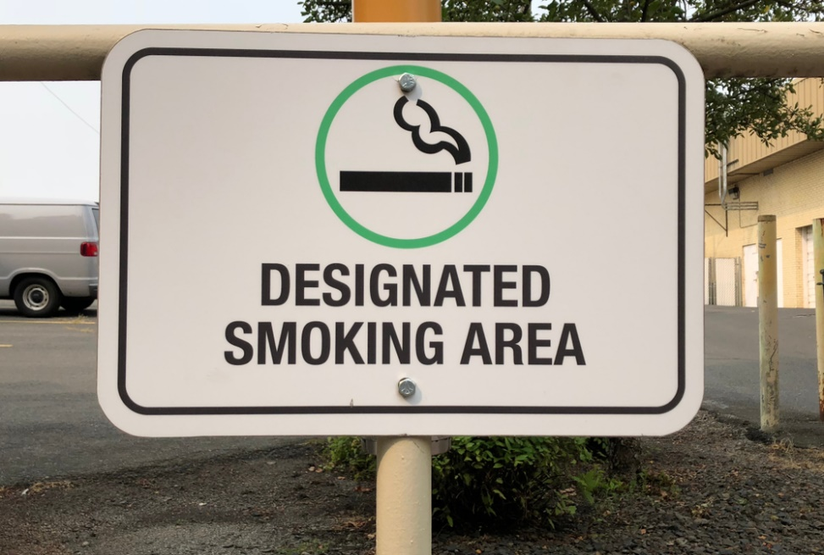
Regulatory Guidance
Resident Smoking
“The facility may designate certain areas for resident smoking. The facility must ensure precautions are taken for the resident’s individual safety, as well as the safety of others in the facility.”
https://www.cms.gov/files/document/appendix-pp-guidance-surveyor-long-term-care-facilities.pdf
Notes:
CMS indicates that Such precautions may include:
Smoking only in designated areas,
Supervising residents whose assessment and care plans indicate a need for assisted and supervised smoking,
Limiting the accessibility of matches and lighters by residents who need supervision when smoking for safety reasons.

Slide 12
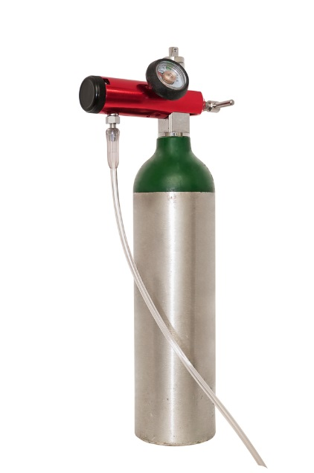
Regulatory Guidance
Resident Smoking
“Smoking by residents when oxygen is in use is prohibited, and any smoking by others near flammable substances is also problematic.”
https://www.cms.gov/files/document/appendix-pp-guidance-surveyor-long-term-care-facilities.pdf
Notes:
We will also need to inform ALL visitors about smoking policies and hazards such as oxygen and other flammable substances for not only regular cigarette smoking but also electronic cigarettes, in order to keep everyone safe. F926 requires facilities to establish policies regarding smoking, smoking areas, smoking safety and the importance of taking into account nonsmoking residents. In this regulations, it specifically indicates that the “use of oxygen in smoking areas and while smoking is forbidden”.
Discuss with attendees – O2, mechanical gas.

Slide 13
Regulatory Guidance
Resident Smoking
(Insert NFPA 101, 2012 edition, Life Safety Code at 19.7.4, requirements for signage, prohibiting smoking by residents classified as not responsible and disposal of smoking materials.)
(Insert State/Local specific regulations related to smoking and smoking materials)
Notes:
(Insert specific information as indicated)
DISCUSS with attendees

Slide 14
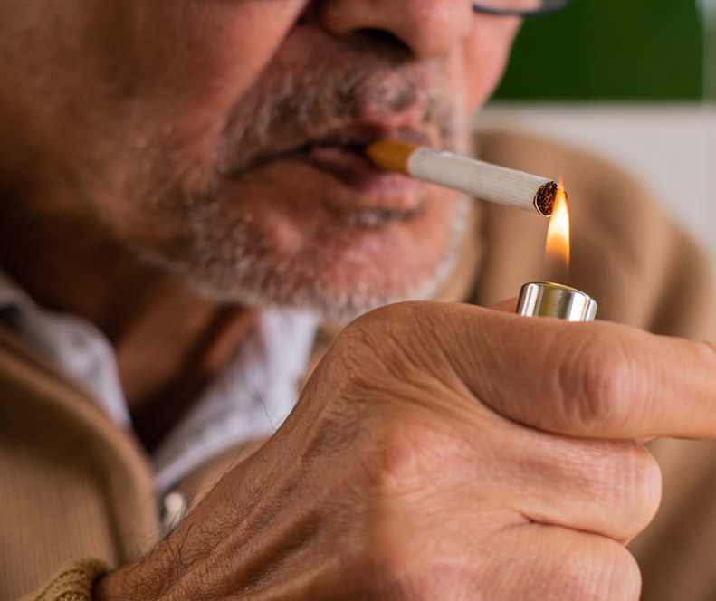
Regulatory Guidance
Resident Smoking
It is essential for all staff to follow the Life Safety Code requirements for signage and resident requirements for smoking and smoking materials
Notes:
If any employee identifies a resident smoking in a NON-Designated area or if smoking in a designated area and they are required to have supervision but are alone, IMMEDIATELY intervene for resident safety and report to the nurse.

Slide 15
F695 Respiratory Care
“If the resident is ambulatory with his/her oxygen delivery system, the resident must be informed of safety precautions and prohibitions for oxygen, such as where smoking is allowed or other hazardous areas, and staff should monitor to assure the resident adheres to the safety rules for oxygen.”
https://www.cms.gov/files/document/appendix-pp-guidance-surveyor-long-term-care-facilities.pdf
Notes:
F695 is the Respiratory Care regulation that specifically indicates, (read slide) so, if you have a smoking section/designated area, be sure to educate and inform all residents who are ambulatory with oxygen, that they should not enter the designated smoking areas and then monitor for safety.

Slide 16
F699 Trauma-Informed Care
“The facility must ensure that residents who are trauma survivors receive culturally competent, trauma-informed care in accordance with professional standards of practice and accounting for residents’ experiences and preferences in order to eliminate or mitigate triggers that may cause re-traumatization of the resident.”
https://www.cms.gov/files/document/appendix-pp-guidance-surveyor-long-term-care-facilities.pdf
Notes:
Another updated regulation that addresses smoking is F699 for Trauma-Informed Care.
(Read slide)
The facility will need to care plan past trauma and trigger specific interventions such as if the resident has an exposure to smoke or fire trigger, you will want to remove or discuss with resident not to enter the designated smoking area to eliminate the effect of the trigger.

Slide 17
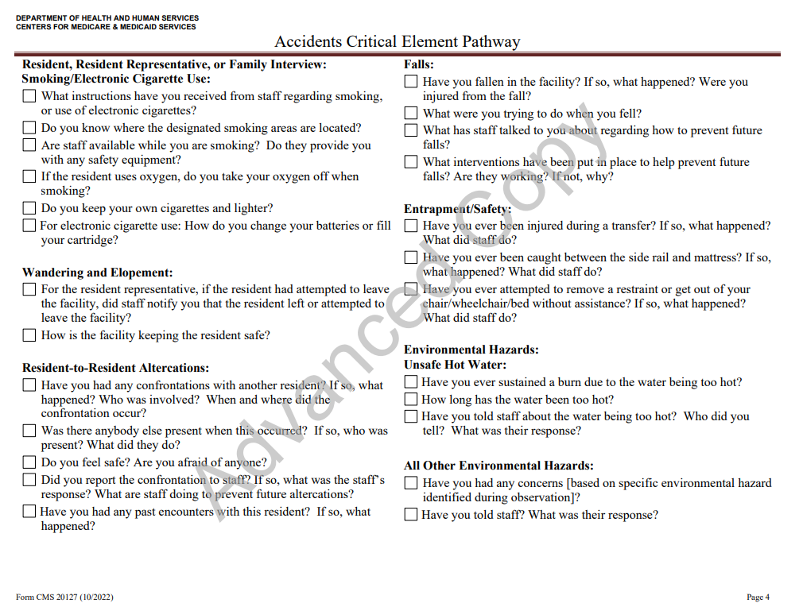
CMS 20127 Accidents Critical Element Pathway
https://www.cms.gov/files/zip/ce-pathways.zip
Notes:
Surveyors may ask the resident, resident representative or family:
What instructions have you received from staff regarding smoking, or use of electronic cigarettes?
Do you know where the designated smoking areas are located?
Are staff available while you are smoking?
Do they provide you with any safety equipment?
If the resident uses oxygen, do you take your oxygen off when smoking?
Do you keep your own cigarettes and lighter?
For electronic cigarette use: How do you change your batteries or fill your cartridge?

Slide 18
Smoking Policy and Procedure
(Insert facility policy and procedure here if different than policy and procedure provided)
Notes:
DISCUSS Facility Policy and Procedure – relative to all smoking products

Slide 19

Policy
When the resident requests to smoke, the interdisciplinary team will assess the resident’s capabilities and deficits to determine appropriate supervision and assistance.
Notes:
Some facilities do not permit smoking on the property any longer. Some facilities are “grandfathering” residents who have resided in the facility to continue to smoke—Some still allow residents to smoke. This Policy is for permitted smoking on facility grounds

Slide 20
Policy
Smoking, (also including the use of electronic cigarettes) will only be allowed in designated (outdoor) area(s) in the facility that are not near flammable substances or where oxygen is in use.
Residents, resident representatives, and visitors will be informed of the facility smoking policy.
Notes:
Continued…

Slide 21
Policy
OBJECTIVE OF THE SMOKING POLICY
The objective of this policy is to put into place a system for the resident’s safety as well as for the safety of others in the facility. When a resident requests to smoke, an assessment will be conducted to determine the level of supervision, assistance and individualized approaches required for safety.
Notes:
The facility Smoking Policy outlines the designated areas, notices, safety information, education, and requirements for smoking on the facility property.

Slide 22
Procedure
Smoking will only be permitted in the following designated areas: (List).
Smoking is prohibited in all other areas.
No residents with oxygen in use are permitted in the designated smoking area(s). No oxygen containers/tanks/materials or other flammable substances are permitted in the designated smoking area(s).
Notes:
Designated area needs to be completed
Review this example or current facility policy

Slide 23
Procedure
Smoking will only be permitted by (list—i.e., residents, staff, visitors, etc.).
Visitors will be educated on the smoking policy by (list)
Any resident choosing to smoke will be assessed by a member of the Interdisciplinary Team utilizing the Smoking Evaluation Form. This assessment will be completed upon admission, quarterly and with a change of condition and as needed. Individualized approaches and directions for safety and assistance will be documented in the resident plan of care and communicated to direct care staff.
Notes:
Designate areas in red prior to training

Slide 24

Procedure
Documentation will detail situations when the resident is not permitted to smoke
Notes:
Discuss examples with group

Slide 25
Procedure
Education of the Smoking Policy will be provided to the resident/resident representative.
The designated smoking times include: (facility to designate)
Notes:
Discuss how and when education will be provided to resident/representative (resident council, family council, 1:1 on admission and with care conferences, etc.
**Complete designated smoking times above prior to program

Slide 26
Procedure
(Insert guidance for signage, prohibiting smoking by residents classified as not responsible and disposal of smoking materials can be found in NFPA 101, 2012 edition,the Life Safety Code at 19.7.4.
Insert State specific guidance here.)
Notes:
(Insert guidance for signage, prohibiting smoking by residents classified as not responsible and disposal of smoking materials can be found in NFPA 101, 2012 edition,the Life Safety Code at 19.7.4.
Insert State specific guidance here.)

Slide 27

Electronic Cigarettes
https://www.cms.gov/files/document/appendix-pp-guidance-surveyor-long-term-care-facilities.pdf
Notes:
CMS indicates:
“While electronic cigarettes (e-cigs), or vapor pens, are not considered smoking devices, and their heating element does not pose the same dangers of ignition as regular cigarettes, they are not without risk.”¹
Risks and concerns associated with the use of electronic cigarettes include:
“Potential health effects for the smoker, such as respiratory illness or lung injury which may present with symptoms of breathing difficulty, shortness of breath, chest pain, mild to moderate gastrointestinal illness, fever or fatigue;
Second-hand aerosol exposure;
Nicotine overdose by ingestion or contact with the skin; and
Explosion or fire caused by the battery”

Slide 28
Procedure – Electronic Cigarettes
Any resident choosing to smoke an electronic cigarette, will be assessed by a member of the Interdisciplinary Team utilizing the Smoking Evaluation Form. This evaluation will be completed upon admission, quarterly, with a change of condition and as needed. Individualized approaches and directions for safety and assistance will be documented in the resident plan of care and communicated to direct care staff.
Notes:
(Read Slide)
Documentation will detail situations when the resident is not able to use the electronic cigarette.

Slide 29
Procedure – Electronic Cigarettes
2. If a resident chooses to smoke electronic cigarettes (e-cigarettes, vapes, vaporizers, vape pens, etc.) they must smoke them in designated outdoor smoking area(s) (LIST).
Notes:
(Read slide) It will be important to communicate with all staff that if they identify a resident using their electronic cigarette in areas other than the designated outdoor smoking are (i.e., resident room, bathroom, etc.), that they must immediately notify the nurse in order for the IDT to discuss with the resident and update the plan of care accordingly.

Slide 30

Procedure – Electronic Cigarettes
3. Charging of the e-cigarette should only be accomplished following the manufacturer’s recommendation and when using power sources approved by the manufacturer to recharge the lithium-ion battery (i.e., those that came with the device) on a clean, dry, and flat surface away from any other items.
Notes:
**ONLY use the batteries that are recommended to use with the e-cigarette device
DISCUSS with attendees

Slide 31

Procedure – Electronic Cigarettes
4. DO NOT charge the e-cigarette overnight or leave the device charging unattended!
https://www.fda.gov/tobacco-products/products-ingredients-components/tips-help-avoid-vape-battery-or-fire-explosions
Notes:
(Read slide) Because of the risk of fires or explosion, charging must be in accordance with the manufacturer’s recommendations or instructions. If the device does not have instructions, the manufacturer should be contacted. The US Food & Drug Administration has a “Tips to Help Avoid Vape Battery or Fire Explosions” weblink that indicates that “the exact causes of vape fires or explosions are not yet clear, but some evidence suggests that battery-related issues may be a cause”. They do recommend keeping loose batteries in a case and not let them come in contact with coins, keys or other metals. Also, do not charge the vape device with any other charger than the one that came with the device, therefore, do not use a phone or tablet charger.

Slide 32
Procedure – Electronic Cigarettes
5. Replace the battery/batteries if wet or damaged.
Follow manufacturer’s instructions on turning off machine and removal of battery
Do not discard rechargeable batteries in a trash container. Separate for hazardous waste and notify maintenance
Notes:
Read slide

Slide 33
Procedure – Electronic Cigarettes
6. Disposal of E-Cigarettes and liquid
Spent cartridges should be replaced in accordance with the manufacturer’s instruction
When replacing cartridge, handle cartridges with gloves and avoid exposure to nicotine
Do not rinse spent cartridge items
Spent cartridges are considered hazardous waste
Notes:
(Read slide first) Follow all State and local environmental agency guidance for waste disposal. If you have questions, please contact the maintenance department

Slide 34
Assessment Process
Smoking Evaluation Tool
Functional Ability
Can the resident hold their cigarette/pipe/cigar?
Can they light it independently?
Cognition
Are they able to verbalize smoking policy after educated?
Safety Awareness and Behavior
Do they observe the designated area requirements?
Do they get distracted and not focus on holding cigarette?
Observations
Burn holes in clothes
Burns on fingers/fingernails
Notes:
The smoking Evaluation Tool will evaluate the resident for safe smoking ability. First, the resident will be interviewed to identify what they smoke, have they attempted to quit, do they have respiratory issues, use oxygen, safety issues in the past, or a desire to quit smoking.
Next, they will be evaluated for:
Function—are they able to hold the cigarette, smoke, not drop ashes on clothing, etc.

Slide 35

Assessment Process
For residents who use electronic cigarettes:
Is resident able to demonstrate safe handling of juices or cartridges?
Is resident able to safely handle the device when using?
Is resident able to change batteries?
Is resident able to demonstrate safe charging of batteries?
Notes:
For residents who use electronic cigarettes, they will also need to be evaluated/assessed (read slide

Slide 36
Care Plan Process
Based on evaluation-examples include:
Type of Assistance
Supervision Requirements
Smoking Apron
Smoking materials secured at the desk
Staff to light cigarette/cigar/pipe
Facility determination that resident is not permitted to smoke
Etc.
Notes:
Based on the evaluation and discussion with the Interdisciplinary Team, the facility will put interventions in place for the resident to be able to smoke to prevent accidents in the facility. (read slide)

Slide 37

Resident Education
Notes:
For all residents who smoke, (and their representatives) it is important to provide good education on the risks, hazards and potential health effects for the smoker
Additional education must include:
Oxygen and other flammable substances near smoking areas
Risk of second-hand exposure
In addition to the above, for residents with electronic cigarettes, education on:
Nicotine overdose if exposed when filling or changing cartridges
Risk of fire or explosion when charging batteries and proper battery replacement

Slide 38

Facility Response
Understand
Inform
Limitations
Monitor
Understand
Inform
Limitations
Monitor
Notes:
Our response to these updated regulations includes:
Understand – understanding the new regulations regarding the Smoking Policy. Todays training will walked us through the changes and our roles and responsibilities.
Inform – ALL staff will be informed of new Smoking requirements
Limitations and Concerns – we will discuss how we handle any limitations and concerns
Monitor – we will monitor our policy via our QAPI program as applicable

Slide 39

Understand
In order to prevent accidents with smoking and provide a safe environment for residents and others, it is imperative to follow the smoking policy and procedure.
Residents must be informed, assessed and individualized approaches care planned for safety

Slide 40

Inform
Caregivers will be informed of resident’s assessed needs to ensure adequate supervision and assistance
All staff will need to inform the nurse and the Interdisciplinary Team of any problems with residents or others not complying with the Smoking Policy
If resident identified with unsafe smoking, immediately intervene and when safe, immediately notify the nurse

Slide 41
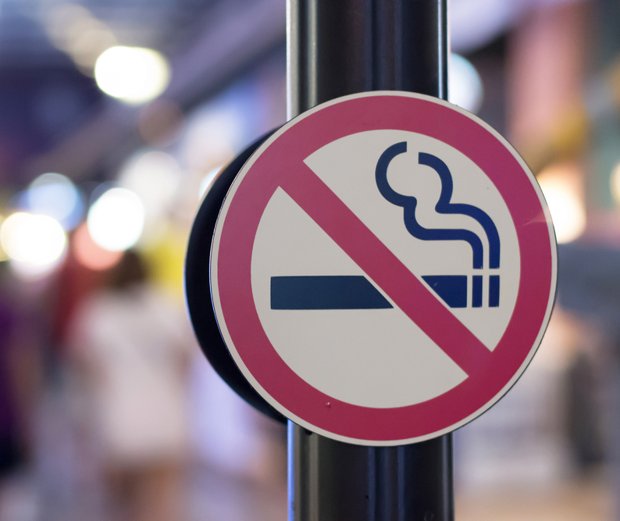
Limitations
Knowledge
Resident cognition
Resident adherence to Smoking Policy
Staff following the resident care plan
Notes:
Knowledge: Staff not aware of policies, appropriate procedure for safe smoking
Resident cognition: Resident will be assessed for safe smoking, including cognitive level. If there is a change that may compromise safety of the resident or others with smoking, please report immediately to the nurse
Resident adherence to Smoking Policy—Resident does not follow directions smoking area, wearing smoking apron or other interventions that may indicate a change for need of more supervision and assistance
Staff Following the resident care plan. Sometimes frontline staff feel resident is able to be more independent with smoking or if they are distracted when they are supervising a resident. It is imperative that staff follow the care plan

Slide 42

Monitor
All caregivers will need to monitor resident for:
Change in cognition
Change in function that could impair their ability to smoke without more assistance
Side-effects of medications that could make resident drowsy or impair their ability to smoke safely
Notes:
It is also important as caregivers to have a good system to monitor all residents in accordance with the care plan AND if there are changes in condition (read slide)

Slide 43

Summary
The facility has a policy and procedure that outlines the process for resident smoking
An assessment will be completed to identify resident’s individualized safety needs
Documentation of resident assessment and individualized approaches will be recorded in the medical record and care plan
Notes:
(Read slide)
All staff must follow the smoking guidance to include designated smoking area, designated smoking times, no oxygen use or oxygen equipment/supplies in smoking area
Monitoring residents for safety is essential with resident smoking and reporting immediately to the nurse of any concerns for re-evaluation

Slide 44

Questions

Slide 45
References and Resources
Centers for Medicare & Medicaid Services State Operations Manual, Appendix PP – Guidance to Surveyors for Long Term Care Facilities (Rev. 173, 11-22-17) Advance Copy 6/29/22: https://www.cms.gov/files/document/appendix-pp-guidance-surveyor-long-term-care-facilities.pdf
Centers for Medicare & Medicaid Services. Accidents Critical Element Pathway, CMS 20127, 10/2022: https://www.cms.gov/files/zip/ce-pathways.zip
NFPA 101 The Life Safety Code at 19.7.4: http://www.nfpa.org/codes-and-standards/all-codes-and-standards/list-of-codes-and-standards/detail?code=101

Slide 46
References and Resources
United States Food & Drug Administration (FDA) Tips to Help Avoid Vape Battery or Fire Explosions: https://www.fda.gov/tobacco-products/products-ingredients-components/tips-help-avoid-vape-battery-or-fire-explosions#blue
Food and Drug Administration (FDA): E-Cigarettes, Vapes, and other Electronic Nicotine Delivery Systems (ENDS). Content current as of: 06/29/2022: https://www.fda.gov/tobaccoproducts/labeling/productsingredientscomponents/ucm456610.htm#manufacturing

Slide 47
References and Resources
Food and Drug Administration (FDA): Tips for Safe Disposal of E-Cigarettes and E-Liquid Waste. Content Current as of: 09/23/2020: https://www.fda.gov/tobacco-products/products-ingredients-components/tips-safe-disposal-e-cigarettes-and-e-liquid-waste
U.S. Fire Administration (FEMA): Electronic Cigarette Fires and Explosions: https://www.usfa.fema.gov/downloads/pdf/publications/electronic_cigarettes.pdf

Slide 48
Disclaimer
“This presentation provided is copyrighted information of Pathway Health. Please note the presentation date on the title page in relation to the need to verify any new updates and resources that were listed in this presentation. This presentation is intended to be informational. The information does not constitute either legal or professional consultation. This presentation is not to be sold or reused without written authorization.”

