Slide 1
Test
CMS Emergency Preparedness Rule
Understanding Appendix Z - Emergency Preparedness of the State Operations Manual
Test
Notes:
Today we are going to discuss the Emergency Preparedness regulations and our roles and responsibilities – so we can be prepared for many types of emergencies or potential disasters.

Slide 2
Objectives
Understand the Emergency Preparedness requirements for health care entities.
Verbalize the four provisions of a facility Emergency Preparedness Program.
Define individual roles and responsibilities as it relates to emergency response.
Notes:
This session will assist you in how to …
READ SLIDE

Slide 3
Disasters and Emergencies
Types
Notes:
Most of us are used to emergencies; we’ve all suffered:
Car trouble
Electrical outage
Plumbing problems
General repairs
And Other types which are always inconvenient!

Slide 4
Disasters
Notes:
Disasters come in many shapes and types -
Whether large or small.
Disasters could be weather related, chemical related, fire, power outage, water supply damage or interruption, supply chain disruption, cyber attack, staffing shortages, bomb threats, mass shooter situations, or more.
If we knew when and where disaster would come- we could plan and have routine responses
A disaster could happen anytime, anywhere.
Disaster is not around us every day, constantly reminding us what to do or how to respond.
If disasters occurred everyday, our response would be routine.
We know that’s not how it works, so it is our responsibility to be ready and respond to disasters using a plan.

Slide 5
Plan
Notes:
If disasters occurred everyday, our response would be routine.
We know that’s not how it works, so it is our responsibility to be ready and respond to disasters using a plan.
Preparedness for all types of hazards and disasters is key to reducing risk and negative outcomes. That is why emergency preparedness planning is a critical component and process for all health care providers
The scope of emergency preparedness in today’s world requires:
Considering possible events
Planning for situations of high probability as well as unique events
Providing for resources to meet the event
Recovering and restoring to normal
Due to the need to prepare for potential emergencies and disasters, regulations were developed and implemented.

Slide 6
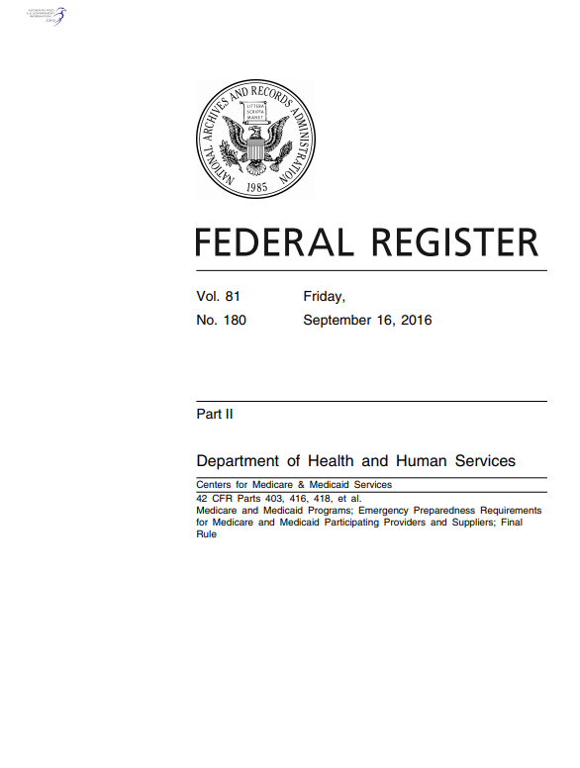
Emergency Preparedness Regulations
Purpose: To establish national emergency preparedness requirements, consistent across provider and supplier types.
Outlines Emergency Preparedness CoPs (Appendix Z E Tags)
Implementation November 15, 2017
Applies to 17 healthcare provider and supplier types
Required for Medicare participation
https://www.cms.gov/Regulations-and-Guidance/Guidance/Manuals/Downloads/som107ap_z_emergprep.pdf
Notes:
The Purpose of Emergency Preparedness requirements is To establish national emergency preparedness requirements, consistent across provider and supplier types.
The regulation is called the Emergency Preparedness Requirements for Medicare and Medicaid Participating Providers and Suppliers Also known as appendix Z.
Published September 16, 2016
Applies to all 17 provider and supplier types – including nursing homes, hospitals, Home Health Agencies (HHAs)
Hospice
Implementation date November 15, 2017
Compliance required for participation in Medicare
Emergency Preparedness is one new Condition of Participation of many already required
These requirements are the Core essentials necessary for:
Maintaining access to healthcare services
Safeguarding human resources
Maintaining business continuity
Protecting physical resources
Emergency Preparedness is a requirement of participation in the Medicare and Medicaid programs. Rather than “F tags” there are “E tags” associated with each of the requirements. The rules apply not just to LTC facilities but also to 16 other providers such as hospitals, dialysis centers, and home health agencies.

Slide 7
Healthcare Facilities Affected (17)
Inpatient
Hospitals
Critical Access Hospitals
Religious Nonmedical Health Care Institutions (RNHCIs)
Psychiatric Residential Treatment Facilities (PRTFs)
Long-Term Care (LTC) / Skilled Nursing Facilities
Intermediate Care Facilities for Individuals with Intellectual Disabilities (ICF/IID)
Notes:
The EP Rule Applies to all 17 provider and supplier types which receive Medicare and Medicaid funding. Lets take a quick look at who is all affected by these rules…
Inpatient settings and Outpatient settings
Discuss the slide

Slide 8
Healthcare Facilities Affected (17)
Outpatient
Ambulatory Surgical Centers
Clinics, Rehabilitation Agencies, and Public Health Agencies as Providers of Outpatient Physical Therapy and Speech-Language Pathology Services
Community Mental Health Centers (CMHCs)
Comprehensive Outpatient Rehabilitation Facilities (CORFs)
End-Stage Renal Disease (ESRD) Facilities
Rural Health Clinics (RHCs) and Federally Qualified Health Centers (FQHCs)
Home Health Agencies (HHAs)
Hospice
Organ Procurement Organizations (OPOs)
Programs of All-Inclusive Care for the Elderly(PACE)
Transplant Centers
Notes:
Here are the outpatient provider settings affected by the EP rule

Slide 9
Four Provisions for All Provider Types
Emergency Preparedness Program
Risk Assessment and Planning
Policies and Procedures
Communication Plan
Training and Testing
8
Notes:
There are four core elements of the Emergency Preparedness Program and elements of the plan must be reviewed and updated annually.

Slide 10
Notes:
DISCUSS – See Slide and Notes
There are four core elements of the Emergency Preparedness Program and elements of the plan must be reviewed and updated annually.
RISK ASSESSMENT AND PLANNING – all providers must develop an emergency plan using all hazards approach, plan and identify in advance essential functions and who is responsible in a crisis.
POLICIES AND PROCEDURES – developed based on the plan (e.g. medical documentation, evacuation or shelter and place)
COMMUNICATION PLAN – alternate means of communication, provide info to local authorities sharing medical info, and providing occupancy information and ability to provide assistance to other facilities in the community.
TRAINING AND TESTING PROGRAM – train staff and test the plan through drills

Slide 11
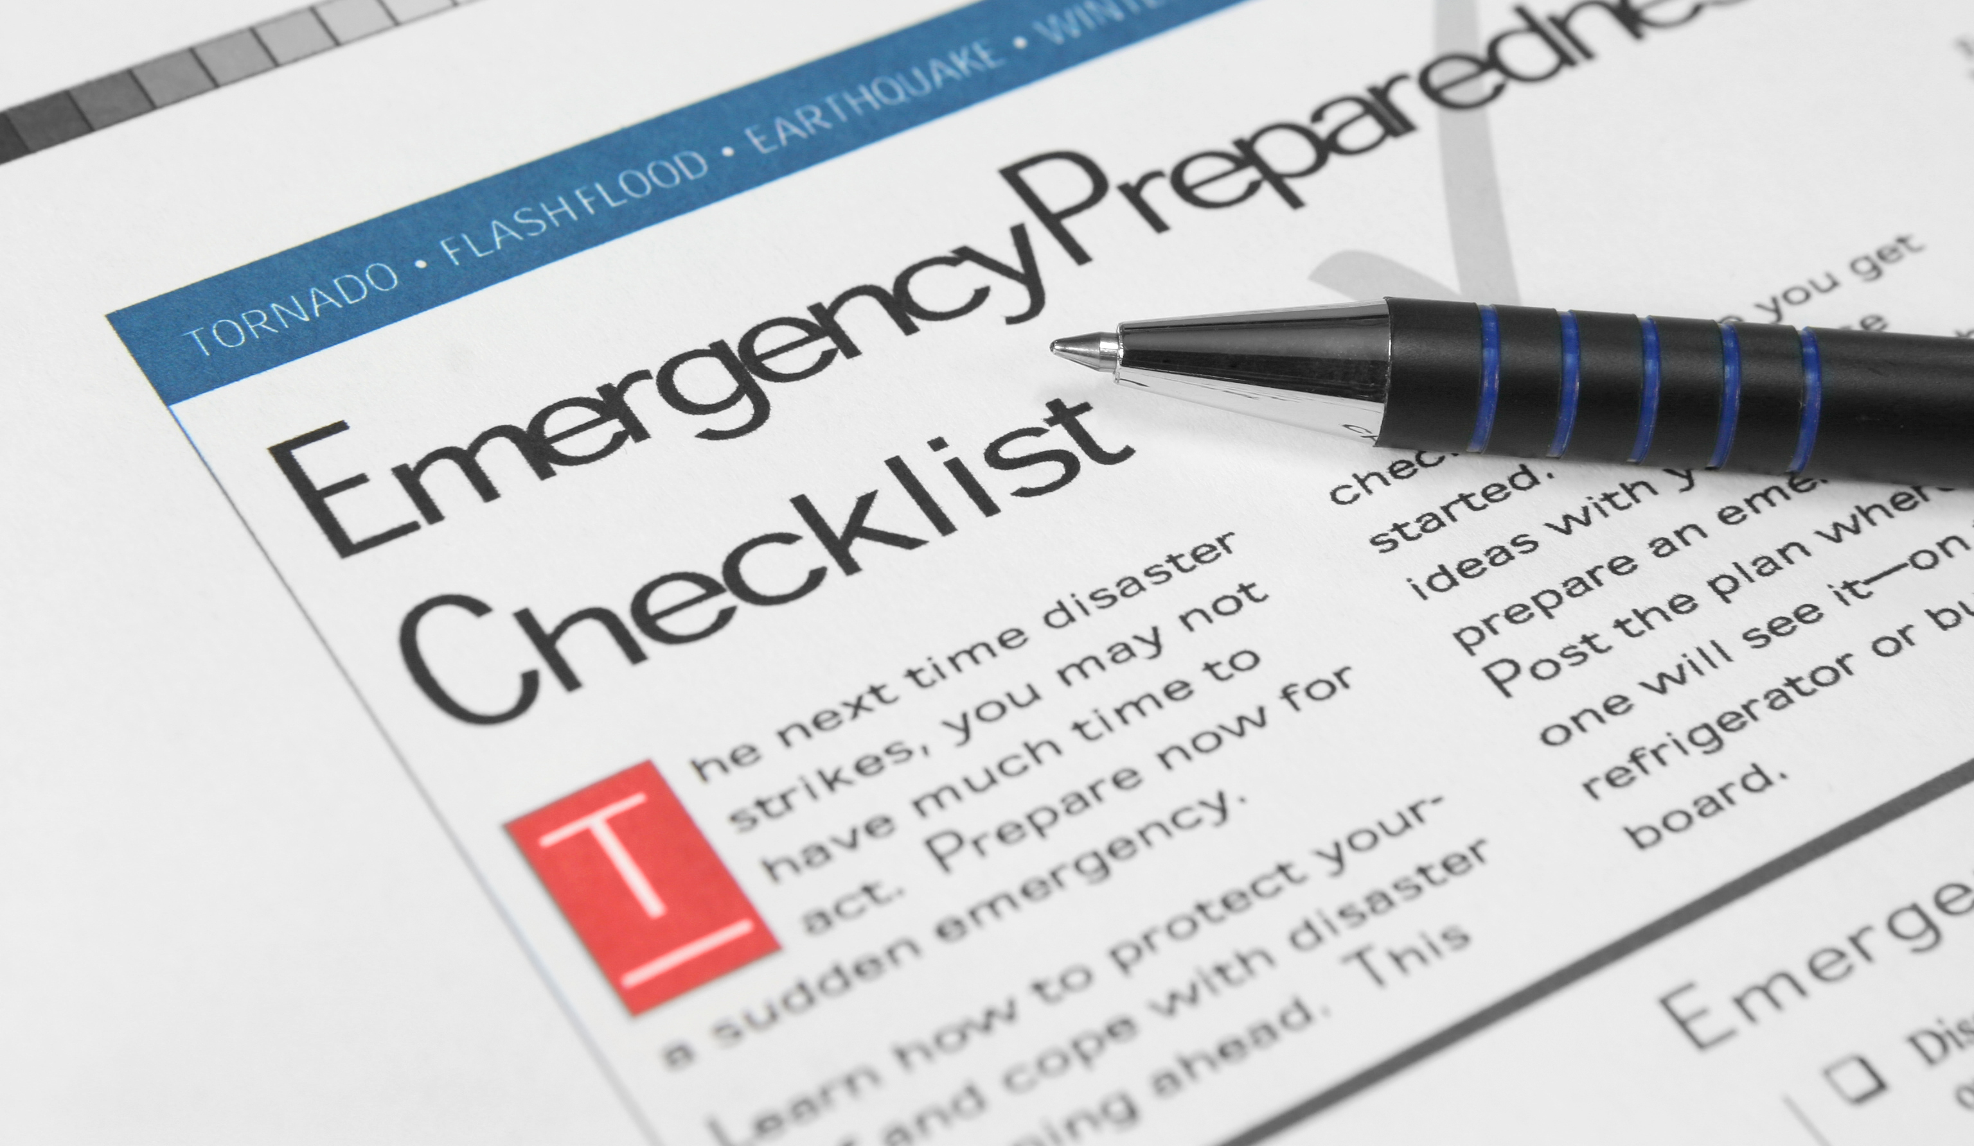
Risk Assessment and Planning
Develop an emergency plan based on a risk assessment.
Perform risk assessment using an “all-hazards” approach, focusing on capacities and capabilities.
Strategies to address emergency events/disruptive events
Update emergency plan at least annually.
What does it address?
Notes:
Plan must be based on a :
1) documented risk assessment using an “all hazards approach.
The plan must:
2) Include strategies to address events identified in the risk assessment, plans for evacuating or sheltering in place, working with other providers in the area.
3) Address patient population; continuity of operations; succession planning.
4) A process for cooperation/collaboration with local, tribal, regional, state or Federal EP officials to ensure an integrated response.
The rule to allows a provider that is part of a healthcare system consisting of multiple separately certified healthcare facilities to have one unified and integrated emergency preparedness program. The integrated emergency plan and policies and procedures must be developed in a manner that takes into account each separately certified facility's unique circumstances, patient populations, services offered. In addition, a risk assessment must be conducted for each separately certified facility within the system.
Note: Each separately certified facility must – meet the COP on its own, meaning upon survey each facility is required to be able to demonstrate how they have met the requirements.
Developing an Emergency Plan
(E-Plan)
Reviewed and updated annually
Based on facility community risk assessment; all hazards approach - include missing residents
Strategies to address emergency events/disruptive events
Address:
Residents at risk
Type of services able to provide in emergency
Continuity of operations
Delegation of authority
Succession Plans

Slide 12
Disasters Disruptive Events
Identify:
Natural
Man Made
All Hazards Approach
Notes:
In order to create an emergency preparedness plan we must first identify risks or disasters - How does a facility determine disasters or risks?
It is through a process called an all hazards approach
There are two categories of disasters or disruptive events – they are either natural or man made. Lets review those categories.

Slide 13
Disruptive Events - Natural
Tornado
Blizzard
Heat – Extreme and Prolonged
Cold – Extreme and Prolonged
Ice Storm
Flood
Landslide
Wildfire
Notes:
Lets discuss some examples of Natural Disasters or disruptive events
READ From Slide

Slide 14
Disruptive Events - Natural
Water Disruption
Fire
Power Outage
Explosion within the facility
Fuel Shortage – for operations
Flood – Dam, reservoir failure
Hazardous materials release
Facility
Transportation
Suspicious Odor
Drought
Earthquake
Epidemic
Infectious Disease Outbreak
Seasonal influenza outbreak
Gas leak
Hurricane
Natural gas failure, explosion, disruption
Radiation exposure
Notes:
As you can see here – these are additional examples of Natural Disasters or Disruptive events – such as READ From the Slide

Slide 15
Disruptive Events - Man Made
Fire
Power Outage
Explosion within the facility
Fuel Shortage – for operations
Flood – Dam, reservoir failure
Hazardous materials release
Facility
Transportation
Notes:
Now Lets discuss some examples of the other category of Emergencies – Man Made.
READ From Slide

Slide 16
Disruptive Events - Man Made
Nuclear facility incident
Power outage – major, prolonged
Water supply
Disruption/Failure
Contamination
Biological/infectious outbreak
Bomb threat
Civil disturbance – near facility
Active shooter
Communication disruption
Suspicious package
Workplace violence
Plane crash
Train crash
Supply disruption
Other
Notes:
As you can see here – these are additional examples of Man Made Disasters or Disruptive events – such as … READ From the Slide
Unfortunately, some of these have become a new reality for us in our day to day lives and as health care providers.

Slide 17
Disruptive Events - Man Made/Tech
Computer system failure
Cyber attack
Ransomware
Generator
Electrical
Transportation
Failures
Fire Alarm
Wander detection
HVAC
Medical Gas
Notes:
There are many Man Made potential hazards or emergencies and some are due to technology or cyber in nature.
As you can see here – these are examples of Man Made Technology based disasters or disruptive events
READ From Slide

Slide 18
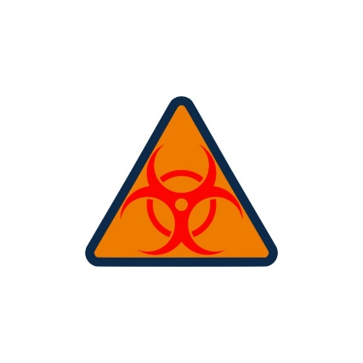
Disruptive Events - Man Made – Human Events
Human events
Mass trauma
Mass exposure to hazardous material
Mass biochemical exposure
Resident elopement
Hostage situation
Civil disturbance
Labor action
Bomb threat
Workplace violence
Workplace accidents
Forensic admission
Notes:
Here are additional examples of Man Made based potential hazards or emergencies that we need to prepare for through our emergency preparedness plan.
READ From Slide

Slide 19
All Hazards Approach
Assess and Identify – Risk Assessment
Notes:
After reviewing the previous examples of disasters, disruptive events or potential emergencies, you can understand why a health care facility needs to consider all potential hazards as they develop there disaster plan or emergency preparedness plan.
This is called an all hazards approach to identify risks and what we need to prepare for.
An all-hazards approach is an integrated approach to emergency preparedness planning that focuses on capacities and capabilities that are critical to preparedness for a full spectrum of emergencies or disasters, including internal emergencies and a man-made emergency (or both) or natural disaster. This approach is specific to the location of the healthcare facility and considers the particular type of hazards most likely to occur in their areas.
In order to identify the potential hazards – a facility needs to conduct a risk assessment

Slide 20
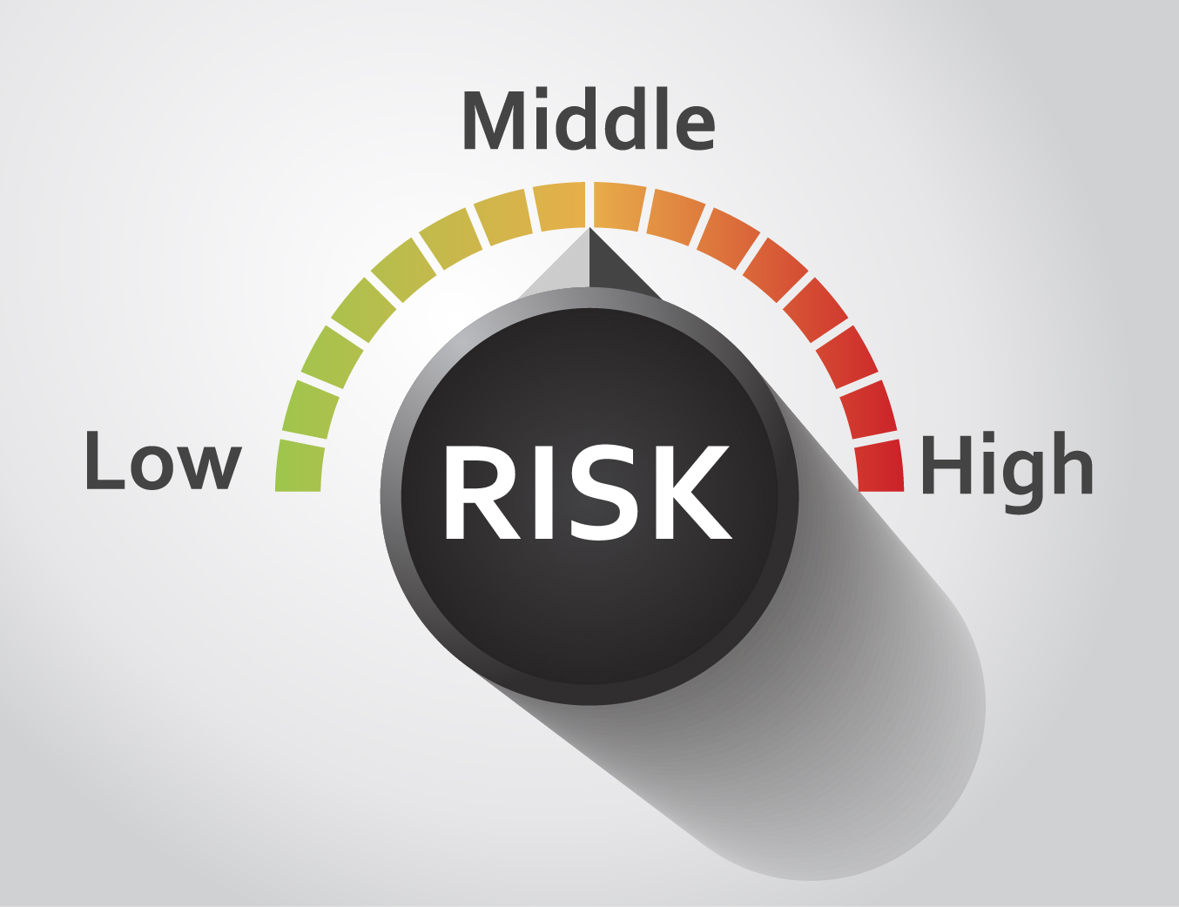
Risk Assessment and Planning
Hazard Identification
Probability of hazard
Risks/Vulnerabilities
Impact (Human, service, property)
Facility Preparedness
All Hazards Approach
Notes:
A health care facility needs to conduct a hazard vulnerability assessment which looks at all potential hazards that may affect residents at the facility.
In the assessment process, the facility (that means your leaders and possibly you as an employee on the team that completes the assessment) will need to determine the probability of the hazard occurring – meaning high risk, moderate risk or low risk
Once you have identified the types of Hazards and the Probability or Likeliness to occur, you hen have to look at how the risk will impact
Human, Service and property – for example…
Human Impact
The percentage of the facility population (residents and staff) likely to be injured or killed under an average occurrence of the hazard.
Injuries requiring medical intervention
Could there be potential of fatalities
Service Impact
The percentage of healthcare services likely to be affected under an average occurrence of the hazard.
Direct care
Facility infrastructure
Resident family support
Professional support
Ancillary services
Disruption of utilities, transportation
Contamination of food, water and air
Property/Business Impact
The percentage of properties businesses likely to be affected under an average occurrence of the hazard.
Replacement costs
Temporary replacements
Repairs
Disruption of staff, services, supplies
Financial burden
Time to recover

Slide 21
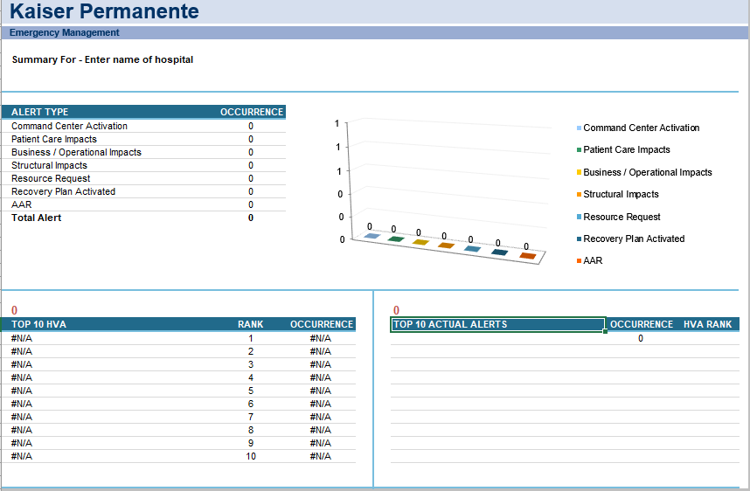
Risk Assessment (Hazard Vulnerability Assessment)
HVA Tool from Kaiser Permanente
Notes:
Pictured here is an example of a risk assessment tool – it is from Kaiser Permanente, and has been made available to all health care professionals for their use.
Remember: An all-hazards approach is an integrated approach to emergency preparedness planning that focuses on capacities and capabilities that are critical to preparedness for a full spectrum of emergencies or disasters, including internal emergencies and a man-made emergency (or both) or natural disaster. This approach is specific to the location of the provider or supplier and considers the particular type of hazards most likely to occur in their areas.

Slide 22
Emergency Planning
Basic Components of an Emergency Plan
Notes:
Part of the core components of the Emergency Preparedness requirements is overall emergency planning, once hazards or risks have been identified.

Slide 23
Emergency Plan Components
Completed | Section | Key Components
 | Operations | Purpose of Plan/Mission
 |  | Key Personnel – Authorities and Responsibilities (Structure and Leadership)
 |  | Incident Command System
 |  | Types of hazards (HVA)
 |  | Mitigation and Response to disasters
 |  | Policies and Procedures
 |  | Training – staff, residents, families, stakeholders
Notes:
Listed here are key components…of the Emergency Plan
DISCUSS

Slide 24
Emergency Plan Components
Completed | Section | Key Components
 | Operations Plan | Communication Plan - Infrastructure, back up, secondary
 |  | Employee Preparedness (Training, Drills)
 |  | Staffing During Emergency (Recall, Call-ins, Responsibilities, Support, Communication)
 |  | Coordination with Response Partners – Community and Health Care Coalitions
 |  | Public Health and Medical System Coordination
 |  | Use of Volunteers and External Partners
 |  | Annual Review and Update of Plan
Notes:
Additional components…of the Emergency Plan
DISCUSS

Slide 25
Emergency Plan Components
Completed | Section | Key Components
 | Response | Incident Command Center and System
 |  | Incident Management Team
 |  | Plan - Evacuation, Evaluation, Shelter in Place, Transportation
 |  | Emergency Response (Triage, Safety, Treatment, Vital Communication
 |  | Activation of Plan – Decision Criteria
 |  | Resident Relocation
 | Continuity | Continuity of Operations
 |  | Policies and Procedures
 |  | Agreements
` |  | Collaboration with Suppliers
Notes:
Additional components…of the Emergency Plan
DISCUSS

Slide 26
Policy and Procedure
Components of an Emergency Plan
Notes:
Part of the core components of the Emergency Preparedness Plan requirements is the development of Policies and Procedures on how to respond to the identified hazards or emergencies

Slide 27
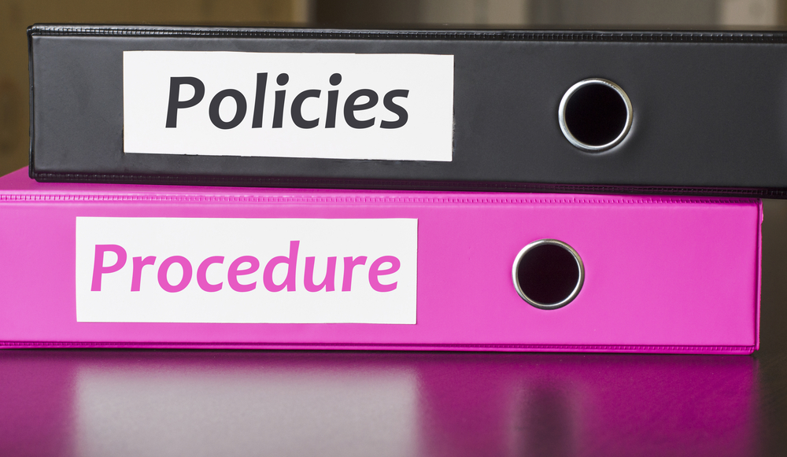
2. Policies and Procedures
Subsistence needs
Evacuation and shelter in place plans,
Tracking patients and staff during an emergency,
Medical documentation, and;
Processes to develop arrangements with other providers/suppliers.
Notes:
Policies and procedures must be based on the risk assessment and the emergency plan must address (highlights/full list in the regulations)
--provision of subsistence needs, alternate energy sources, sewage and waste disposal, procedures for evacuating or sheltering in place
--system to track location of staff and patients (accurate, readily available, shareable)
--safe evacuation considerations –Care and treatment needs, transportation, ID evacuation location
--means to shelter in place – consider ability of building to survive a disaster and proactive steps that can be taken prior to an emergency
--system to preserve medical documentation (ensures confidentiality in compliance with HIPAA)
--use of volunteers and role of State and Federal Health Officials (suggest use of Medical Reserve Cops – ensure members are screened and trained in advance)
--Arrangements with other providers to receive patients in the event of limitation or cessation of operations as well as a method for sharing medical documentation with the receiving provider.
Health care facilities need to Develop and implement policies and procedures based on the emergency plan, risk assessment, and communication plan
Included in those procedures are :
Subsistence needs
Evacuation and shelter in place plans, (Determination Process – Evacuate or SIP
Assess facility physical strength
Secure building against damages
Collaborate with emergency personnel
Ensure sufficient resources
Describe hosting procedures
Financial needs
Security
Also - Tracking patients and staff during an emergency,
Medical documentation, and;
Processes to develop arrangements with other providers/suppliers.
Review and update policies and procedures at least annually

Slide 28
2. Policies and Procedures
Food and Water
Medical and Pharma Supplies
Temperature controls
Emergency Lighting
Fire detection, suppression, alarm
Sewage/waste disposal
Notes:
Examples of the needed policies and procedures include:
READ SLIDE

Slide 29
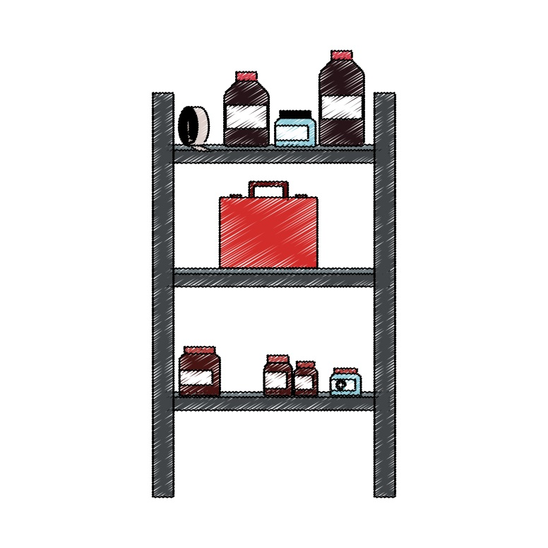
2. Policies and Procedures
Staffing Strategies - in place or relocation
Relocation processes
Evacuation
Shelter in Place
Medical documentation
Use of volunteers
Transfer agreements
Communication processes
Notes:
Additional Examples of the needed policies and procedures include:
READ SLIDE

Slide 30
2. Policies and Procedures
Medical Records
Cyber aspect
Determination of:
Shelter in Place
Evacuation Plan
Notes:
Other policies to be consider include
Medical Records – you need to answer:
Where are electronic files stored?
How often are they backed up?
Can you access them remotely?
Do you have fully charged laptops?
Are there surge protectors on all electronics?
Legal copies of physician orders
Privacy and Security provisions
Also in the policies is how to determine if you will shelter in place or evacuate.
If evacuation :
Determination to Evacuate – determine the rationale why and document
Transportation needs – EMS or Other
Resident functional status
Transportation vendors and agreements
Logistics – Medications, supplies, medical record, staff needed for provision of care
Accounting of staff and residents
Communication processes

Slide 31
2. Policies and Procedures
Incident Command
Disaster Response
Clinical Triage – Identify Patient Transport and clinical Needs
Oversight and coordination of resources
Notes:
Other policies to be consider include how to lead the disaster and respond to the disaster or emergency. This includes
Incident command – leadership and your role in the process Includes:
Command
Operations (Doers)
Planning (Planners)
Logistics (Getters)
Finance/Administration (Payers)
Also included are policies related to Clinical Triage – how to Identify Patient Transport and clinical Needs -
Part of the policies and overall Emergency Plan is how to coordinate resources such as:
Personnel
Equipment
Communication Devices
Storage Locations
Medications
Essential Clinical Supplies
Medical Records

Slide 32
Incident Management Team
Command
Operations (Doers)
Planning (Planners)
Logistics (Getters)
Finance/Administration (Payers)
Notes:
DISCUS
Discuss who in the facility is in these categories per your internal EP plan.

Slide 33
Emergency Planning Checklist:
Develop Emergency Plan
All Hazards Continuity of Operations Plan
Collaborate w/ Local Emergency Management Agency
Analyze Each Hazard
Collaborate w/ Suppliers, Providers
Decision Criteria for Executing Plan
Communication Infrastructure Contingency
Develop Shelter-in-Place Plan
Develop Evacuation Plan
Transportation & Other Vendors
Notes:
Having an EP Checklist is a key component to success. CMS , FEMA, CDC and other organizations have checklists that are available to our facility. Lets discuss some of the areas that need to be part of our planning.

Slide 34
Emergency Planning Checklist:
Train Transportation Vendors/ Volunteers
Facility Reentry Plan
Residents & Family Members
Resident Identification
Trained Facility Staff Members
Informed Residents
Needed Provisions
Location of Evacuated Residents
Helping Residents in Relocation
Review Emergency Plan
Emergency Planning Templates
Notes:
DISCUSS

Slide 35
Emergency Planning Checklist:
Collaboration w/ Local Emergency Management Agencies, Healthcare Coalitions
Communication w/ Long-Term Care Ombudsman Program
Conduct Exercises & Drills
Loss of Resident’s Personal Effects
Notes:
DISCUSS

Slide 36
Communication plan
Components of an Emergency Plan
Notes:
Part of the core components of the Emergency Preparedness Plan requirements is the development of a solid communications plan and how to respond to the identified hazards or emergencies

Slide 37
3. Communication Plan
Develop
Develop a written communication plan that complies with both Federal and State laws.
Coordinate
Coordinate patient care within the facility, across health care providers, and with state and local public health departments and emergency management systems.
Review and update
Review and update plan annually.
Notes:
The 3rd component of the facility Emergency Preparedness Plan is the overall communication plan. Your facility plan will address the following necessary and required components:
Contact information for federal, state, tribal, regional and local emergency preparedness
Sources of Assistance
Primary and Alternate communication systems
Coordination of care across entities – including your triage process and communication of clinical and medical needs so those who will be assisting you with care know how to take care of your residents.
Communication process for residents, representatives, staff, staff families and local authorities
The Communication Plan must include
--names and contact info for staff, other hospitals, volunteers, State and local EP officials
--There also must be primary and alternate means of communicating with staff identified as well as how to contact EP officials and emergency management agencies
--method to share medical records and patient information including general condition and location

Slide 38
Communications Plan
Transparent and accurate communications with stakeholders, especially the media, during and after a crisis contributes to a successful resolution of the problem, including a positive evaluation by stakeholders and the public.
The Communications plan – consisting of policies, procedures, and an incident command structure -- is the primary tool management has to ensure employees follow protocols during an emergency in contacting stakeholders, the media, and others.
The Media Outreach plan is an essential part of the Communications plan.

Slide 39
Communication Channels
One person should have final approval of all official statements.
Ideally, that person is the Commander, working with the spokesperson.

Slide 40
Training and testing
Components of an Emergency Plan
Notes:
The 4th and final core components of the Emergency Preparedness Plan requirements is training and testing on your plan and how to improve facility and staff response in preparation for an emergency.

Slide 41
4. Training and Testing
Training program for all staff
Initial and ongoing
Conduct drills and exercises per annual requirements
Exercise requirements to test the Emergency Plan
Notes:
The fourth and last component of your Emergency Preparedness plan and disaster plan is training and testing for all staff!!
It is required that the facility
Develop a training program for all staff (upon orientation and annually)
Which is Initial and ongoing training; and that the facility MUST
Conduct drills and exercises per annual requirements
Exercises to Test Emergency Plan, that are completed Annually would include:
Unannounced staff drills
Full scale exercise that is community based
If community based not available – must be individual facility based
Conduct an additional exercise
2nd full scale exercise
Table top exercise led by a facilitator
Analyze response to tests and update Plan as needed

Slide 42
Training and Testing Program Definitions
Facility-Based: When discussing the terms “all-hazards approach” and facility-based risk assessments, CMS considers the term “facility-based” to mean that the emergency preparedness program is specific to the facility. Facility-based includes, but is not limited to, hazards specific to a facility based on the geographic location; Patient/Resident/Client population; facility type and potential surrounding community assets (i.e., rural area versus a large metropolitan area).
Full-Scale Exercise: A full scale exercise is a multi-agency, multijurisdictional, multi-discipline exercise involving functional (for example, joint field office, emergency operation centers, etc.) and ‘‘boots on the ground’’ response (for example, firefighters decontaminating mock victims).
Notes:
On this slide, you will see the definitions and differences between what CMS considers a facility based exercise and a full scale exercise.
Facility-based includes, but is not limited to, hazards specific to a facility based on the geographic location, taking into account the patient population.
Full-Scale exercise is an operations based exercise which typically involves multiple agencies and disciplines and incorporates the requirements for facilities to coordinate and collaborate with their state and local emergency officials.
The Final Rule requires facilities to participate in a full-scale exercise that is community-based or when not available or accessible, the facility may conduct an individual facility-based exercise.

Slide 43
Training and Testing Program Definitions
Table-top Exercise (TTX): A table-top exercise is a group discussion led by a facilitator, using narrated, clinically-relevant emergency scenario, and a set of problem statements, directed messages, or prepared questions designed to challenge an emergency plan. It involves key personnel discussing simulated scenarios, including computer-simulated exercises, in an informal setting. TTXs can be used to assess plans, policies, and procedures.
Notes:
On this slide, you see our definition for the table top exercise. It may be in the best interest of a facility to start with a table top exercise before conducting a full-scale exercise to be able to assess its capabilities and potential effectiveness of its program.

Slide 44
Training and Testing Program Definitions
Mock Disaster Drill: A mock disaster drill is a coordinated, supervised activity usually employed to validate a specific function or capability in a single agency or organization. Mock disaster drills are commonly used to provide training on new equipment, validate procedures, or practice and maintain current skills. For example, mock disaster drills may be appropriate for establishing a community-designated disaster receiving center or shelter. Mock disaster drills can also be used to determine if plans can be executed as designed, to assess whether more training is required, or to reinforce best practices. A mock disaster drill is useful as a stand-alone tool, but a series of drills can be used to prepare several organizations to collaborate in a Full-Scale Exercise.
Notes:
On this slide, you see our definition for the mock disaster drill.

Slide 45
Temperature Controls and Emergency and Standby Power Systems
Under the Policies and Procedures, Standard (b) there are requirements for subsistence needs and temperature controls.
Additional requirements for hospitals, critical access hospitals, and long-term care facilities are located within the Final Rule under Standard (e) for Emergency Power and Stand-by Systems.
Notes:
Additional Requirement:
This is one of those examples. If you refer to the Final Rule under the Policies and Procedures Standard (b)(1), some providers are required to ensure subsistence needs as well as temperature controls.
Under Standard (e) however, LTC Facilities, CAHs and Hospitals are also required to meet requirements for stand-by power systems.

Slide 46
What We Are Doing to Be in Compliance
(The facility should add one or more slides to give an overview of its specific Emergency Preparedness Program)

Slide 47
Summary
Disasters can happen any time any where
Emergency Preparation is everyone's role
A plan is needed and vital
4 Components of the plan
Understand your Role
Notes:
In Summary –
We know that emergencies can happen anytime anywhere and being prepared is key to reducing risk and negative outcomes. Emergency preparation is everyone's role and responsibility in health care facilities. Having a well developed and coordinated emergency preparedness plan is key. remember that this plan includes Four key elements which include Risk assessment and emergency planning including an all hazard approach to emergency preparation, well developed and implemented policies and procedures, a comprehensive communication plan, and all employee training and testing so that we are all prepared for a potential disaster or emergency. Understanding your role and responsibility in emergency preparedness and disaster preparedness will help reduce risk and potential negative outcomes to resident staff and others at the facility.

Slide 48
Questions

Slide 49
References and Resources
Centers for Medicare & Medicaid Services. Revisions to the State Operations Manual (SOM) Appendix Z – Emergency Preparedness. https://www.cms.gov/Regulations-and-Guidance/Guidance/Manuals/Downloads/som107ap_z_emergprep.pdf
For additional information and tools, please visit the CMS Quality, Safety & Oversight Group Emergency Preparedness website at: https://www.cms.gov/Medicare/Provider-Enrollment-and-Certification/SurveyCertEmergPrep
United States Department of Health and Human Services. TRACIE Healthcare Emergency Preparedness Information Gateway: https://asprtracie.hhs.gov/

Slide 50
Disclaimer
“This presentation provided is copyrighted information of Pathway Health. Please note the presentation date on the title page in relation to the need to verify any new updates and resources that were listed in this presentation. This presentation is intended to be informational. The information does not constitute either legal or professional consultation. This presentation is not to be sold or reused without written authorization.”

