Slide 1
Test
Visitation During the COVID-19 Pandemic
All Staff Training
Test
Notes:
This training is designed to provide you with an overview of the updated requirements for resident visitation during the COVID-19 Pandemic, and visitation rights regulations, definitions and staff roles and responsibilities. Residents have the right to receive visitors of his or her choosing WHEN they want to visit, in a manner that doesn’t interfere with the rights of another resident. Today, we are going to cover the regulations and facility processes for residents to have quality of life with their visitation rights.

Slide 2
Objectives
Upon completion of the program, attendees should be able to:
Understand the COVID-19 visitation plan,
Identify ways that staff assist with the core principles of infection prevention for safe visitation
Verbalize ways that staff can coach visitors in proper hand hygiene, face covering or mask use, and physical distancing when indicated
Understand the importance of continued staff COVID-19 infection prevention
Notes:
Review slide with participants.

Slide 3
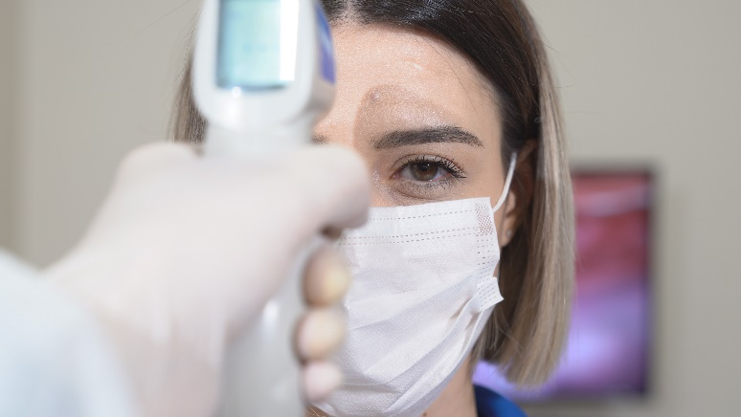
Definitions
Core Principles of COVID-19 Infection Prevention
“Facilities should provide guidance (e.g., posted signs at entrances) about recommended actions for visitors who have a positive viral test for COVID-19, symptoms of COVID-19, or have had close contact with someone with COVID-19.”
https://www.cms.gov/files/document/qso-20-39-nh-revised.pdf
Notes:
Today we will first Review the Core Principles of COVID-19 Infection Prevention. It is essential for all staff to understand the core principles in order to provide quality of care and services during all aspects of care but today we will be discussing how this is important with visitation
The Core Principles of COVID-19 Infection Prevention are requirements that CMS and the CDC expect to be followed by staff of each facility, residents, and their visitors. Following these Principles will help to prevent COVID-19 spread. During this session we will be reviewing the ways we follow these core principles in our daily work to prevent COVID-19 infection and maintain a safe place for residents to live and staff to work.
(READ SLIDE)

Slide 4
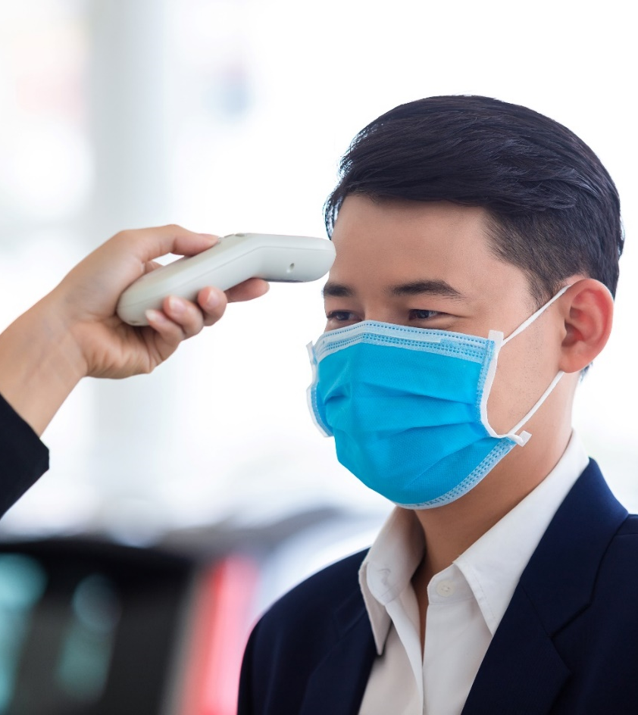
Core Principles of COVID-19 Infection Prevention
“Visitors with confirmed COVID-19 infection or compatible symptoms should defer non-urgent in-person visitation until they meet CDC criteria for healthcare settings to end isolation. For visitors who have had close contact with someone with COVID-19 infection, it is safest to defer non-urgent in-person visitation until 10 days after their close contact if they meet criteria described in CDC healthcare guidance (e.g., cannot wear source control).”
https://www.cms.gov/files/document/qso-20-39-nh-revised.pdf

Slide 5
COVID 19 Signs and Symptoms
Fever or chills
Cough
Shortness of breath or difficulty breathing
Fatigue
Muscle or body aches
Headache
New loss of taste or smell
Sore throat
Congestion or runny nose
Nausea or vomiting
Diarrhea
https://www.cdc.gov/coronavirus/2019-ncov/symptoms-testing/symptoms.html
Notes:
The CDC indicates, “People with COVID-19 have had a wide range of symptoms reported – ranging from mild symptoms to severe illness. Symptoms may appear 2-14 days after exposure to the virus. People with these symptoms may have COVID-19:
Fever or chills
Cough
Shortness of breath or difficulty breathing
Fatigue
Muscle or body aches
Headache
New loss of taste or smell
Sore throat
Congestion or runny nose
Nausea or vomiting
Diarrhea”²
Any visitor with ANY signs or symptoms, exposure to COVID-10 or confirmation of a COVID-19 test will be denied access to visitation
This list is not all inclusive. Nurses should consult with the medical provider for any other symptoms that are severe or concerning.
Temperature >100.0⁰F or two temperatures >99.0ºF

Slide 6
Core Principles of COVID-19 Infection Prevention
Core Principles of COVID-19 Infection Prevention
Hand hygiene (use of alcohol-based hand rub is preferred)
Face covering or mask (covering mouth and nose) in accordance with CDC guidance
https://www.cms.gov/files/document/qso-20-39-nh-revised.pdf
Notes:
Next, we will instruct and observe visitor perform hand hygiene, Hand Hygiene must be performed both before and after visitation.
A face covering is REQUIRED for both indoor OR Outdoor visitation when the facility’s county community transmission is HIGH

Slide 7
Core Principles of COVID-19 Infection Prevention - continued
Core Principles of COVID-19 Infection Prevention - continued
Instructional signage throughout the facility and proper visitor education on COVID- 19 signs and symptoms, infection control precautions, other applicable facility practices (e.g., use of face covering or mask, specified entries, exits and routes to designated areas, hand hygiene)
https://www.cms.gov/files/document/qso-20-39-nh-revised.pdf
Notes:
Discuss facility process for signage throughout your facility

Slide 8
Core Principles of COVID-19 Infection Prevention - continued
Core Principles of COVID-19 Infection Prevention – continued
Cleaning and disinfecting high frequency touched surfaces in the facility often, and designated visitation areas after each visit
https://www.cms.gov/files/document/qso-20-39-nh-revised.pdf
Notes:
Discuss the importance of cleaning and disinfecting high touch areas AND designated visitation areas following each visit

Slide 9
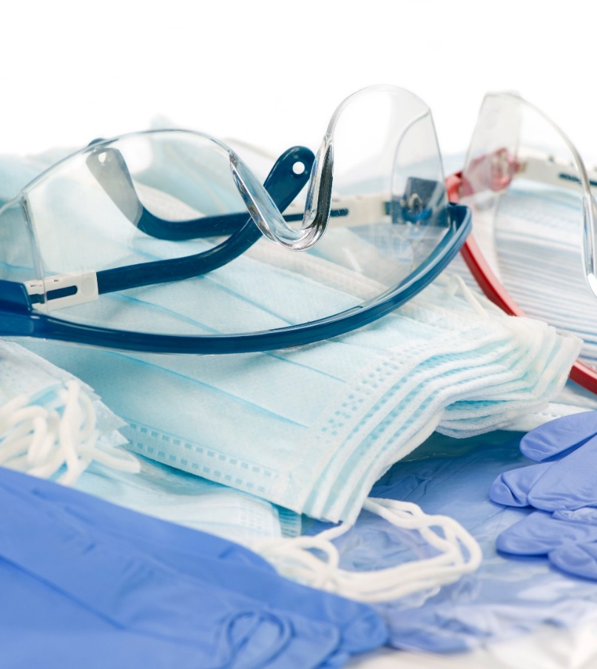
Core Principles of COVID-19 Infection Prevention - continued
Appropriate staff use of Personal Protective Equipment (PPE)
https://www.cms.gov/files/document/qso-20-39-nh-revised.pdf
Notes:
Discuss facility policy and procedure on PPE:
Face coverings/Mask
PPE for all units-eye protection
“If SARS-CoV-2 infection is not suspected in a patient presenting for care (based on symptom and exposure history), HCP working in facilities located in counties with high transmission should also use PPE:
Facilities could consider use of NIOSH-approved N95 or equivalent or higher-level respirators for HCP working in other situations where multiple risk factors for transmission are present.
Eye protection (i.e., goggles or a face shield that covers the front and sides of the face) worn during all patient care encounters.” https://www.cdc.gov/coronavirus/2019-ncov/hcp/infection-control-recommendations.html
Full PPE for quarantine residents (same as COVID-19 unit: N95, eye protection, gloves, gown)
Full PPE for residents on COVID-19 unit

Slide 10
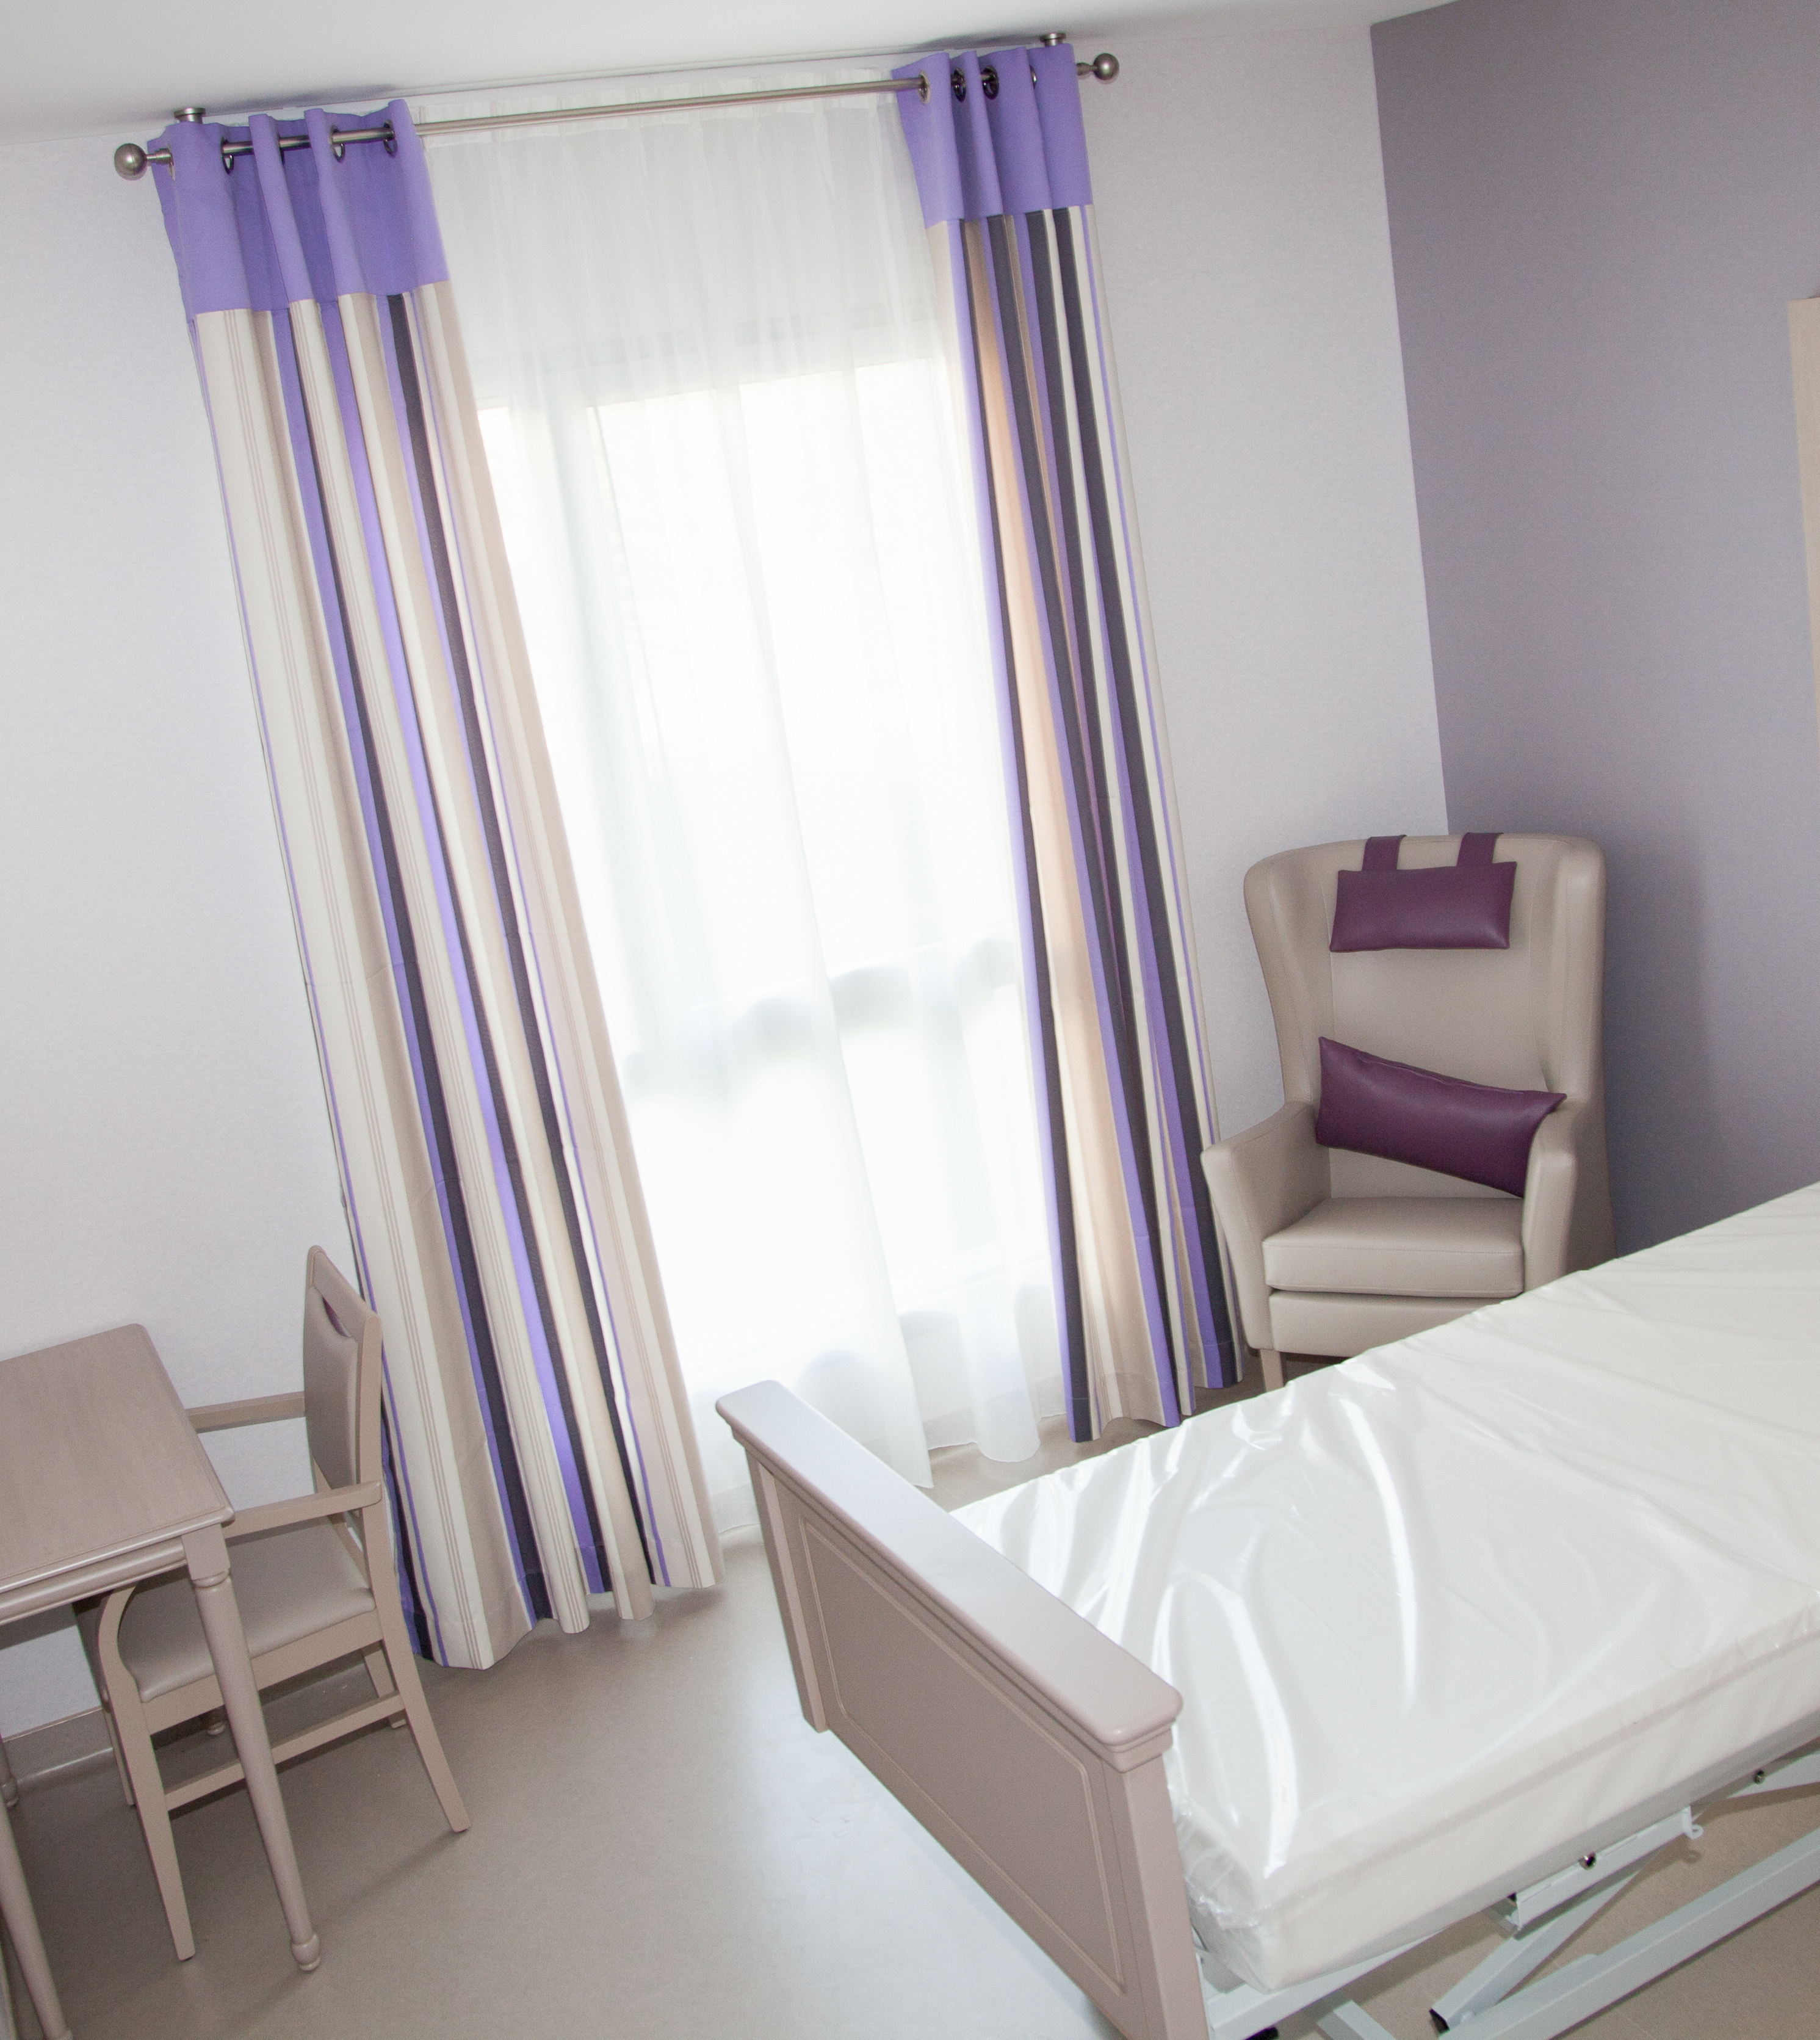
Core Principles of COVID-19 Infection Prevention - continued
Core Principles of COVID-19 Infection Prevention - continued
Effective cohorting of residents (e.g., separate areas dedicated COVID-19 care)
https://www.cms.gov/files/document/qso-20-39-nh-revised.pdf
Notes:
Another core principle of COVID-19 infection prevention is effective resident placement and cohorting.
Residents who are confirmed positive for COVID-19 can ONLY be cohorted with a resident that also has confirmed COVID-19. Residents who have been exposed, have symptoms until tested, will need to be quarantined in a room by themselves and CANNOT be cohorted (because one of them could eventually come down with COVID-19 and now you could have exposed another resident)
Residents negative for COVID-19 can be cohorted unless you have a reason NOT to put them together (i.e. another infection such as C.diff)
Testing is recommended at admission and, if negative, again 48 hours after the first negative test and, if negative, again 48 hours after the second negative test. In general, admissions in counties where Community Transmission levels are high should be tested upon admission; admission testing at lower levels of Community Transmission is at the discretion of the facility.
They should also be advised to wear source control for the 10 days following their admission. Residents who leave the facility for 24 hours or longer should generally be managed as an admission.

Slide 11
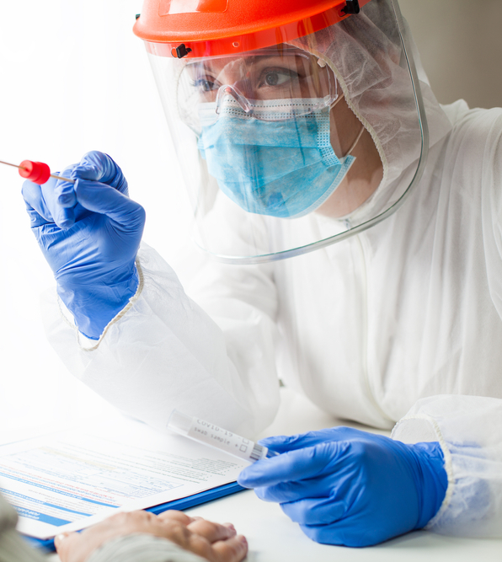
Core Principles of COVID-19 Infection Prevention - continued
Core Principles of COVID-19 Infection Prevention - continued
Resident and staff testing conducted as required consistent with current CDC and CMS guidance
Notes:
The last core principle of COVID-19 Infection Prevention is the resident and staff COVID-19 testing to be able to identify any cases quickly in order to implement interventions to prevent the spread in the facility.

Slide 12
Visitation
Visitation is now allowed for ALL residents at ALL times (with very limited and rare exceptions). Types of visitation include:
Outdoor Visitation
Indoor Visitation
Indoor Visitation during on Outbreak Investigation
Compassionate Care
Access to the Long-Term Care
Ombudsman
f. Protection & Advocacy Programs
https://www.cms.gov/files/document/nursing-home-visitation-faq-1223.pdf
https://www.cms.gov/files/document/qso-20-39-nh-revised.pdf
Notes:
CMS or the Centers for Medicare & Medicaid Services provided guidance and then on December 23rd provided clarification that indicated that there are very limited and rare exceptions that may be considered with visitation but remember, visitation must be implemented in accordance with residents’ rights. (Read slide)CMS indicates: “We note that the reason for visitation restrictions during the COVID-19 PHE were to mitigate the opportunity for visitors to introduce COVID-19 into the nursing home. Per 42 CFR § 483.10(f)(4), a resident has the right to receive visitors of his or her choosing at the time of his or her choosing, and in a manner that does not impose on the rights of another resident, such as a clinical or safety restriction (see 42 CFR § 483.10(f)(4)(v)). In other words, while all residents have a right to visitation, fully open and unrestricted visitation posed a clinical health and safety risk to other residents during this PHE, and therefore, it was reasonable to place limits on visitation. However, current nursing home COVID-19 data shows approximately 87% of residents and 83% of staff are fully vaccinated, as of February 2022.“
Federal Disability Rights Laws and Protection & Advocacy (P&A) Programs will be discussed later in today’s program

Slide 13
Visitation
CMS addresses three key points:
“Adhere to the core principles of infection prevention, especially wearing a mask and performing hand hygiene
Encourage physical distancing during large gatherings; and
Work with your state or local health department when an outbreak occurs”
https://www.cms.gov/files/document/nursing-home-visitation-faq-1223.pdf
Notes:
CMS indicates that nursing homes should enable visitation following these three key points (read slide)

Slide 14
Definitions
Vaccination status has been removed from the guidance
Notes:
On September 23, 2022, CMS revised the Nursing Home Visitation and removed vaccination status from the guidance

Slide 15
Visitor Testing and Vaccination
You can offer to test visitors (if you do not test, visitors should be encouraged to be tested on their own BEFORE coming to the facility within 2-3 days before visit.
You can ask a visitor about vaccination status, but they are NOT required to be tested or vaccinated
If visitor declines to disclose vaccination status, visitor should wear face covering or mask at ALL TIMES.
https://www.cdc.gov/coronavirus/2019-ncov/vaccines/fully-vaccinated-guidance.html
Notes:
CMS strongly encourages ALL visitors to become vaccinated and facilities should educate and encourage visitors to become vaccinated.
This also applies to the Ombudsman as well.

Slide 16
Outdoor Visitation
“Outdoor visits generally pose a lower risk of transmission due to increased space and airflow”
Courtyards
Patios
Parking lots
Use of tents
https://www.cms.gov/files/document/qso-20-39-nh-revised.pdf
Notes:
CMS indicates, (READ SLIDE) Considerations for inclement weather, poor air quality or a resident’s health status will be a factor in determining the feasibility of an outdoor visit and may hinder outdoor visits. When outdoor visits are conducted, all appropriate infection control and prevention practices should be adhered to.

Slide 17
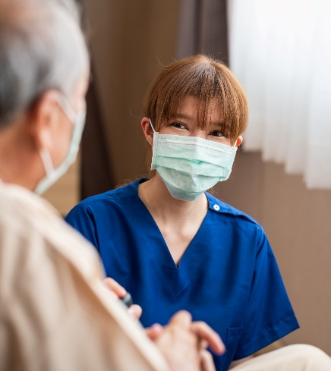
Indoor Visitation
“Facilities must allow indoor visitation at all times and for all residents as permitted under the regulations.”
Visits should be conducted in a manner in which adherence to the Core Principles of COVID-19 Infection Prevention is maintained and does not pose a risk to other residents.
https://www.cms.gov/files/document/qso-20-39-nh-revised.pdf
Notes:
Once again, there may be limited and rare exceptions to this such as a significant, uncontrolled outbreak in your facility. Your DON and Infection Preventionist will direct visitation

Slide 18
Indoor Visitation
The facility cannot limit the frequency, length of visits, number of visitors or require advance scheduling of visits
Visits still MUST adhere to the core principles of COVID-19 infection prevention AND will not increase risk for other residents
“During peak times of visitation and large gatherings (e.g., parties, events) facilities should encourage physical distancing.”
https://www.cms.gov/files/document/qso-20-39-nh-revised.pdf
Notes:
(Read slide)
Facilities may contact their local health authorities for guidance or direction on how to structure their visitation to reduce the risk of COVID-19 transmission.

Slide 19
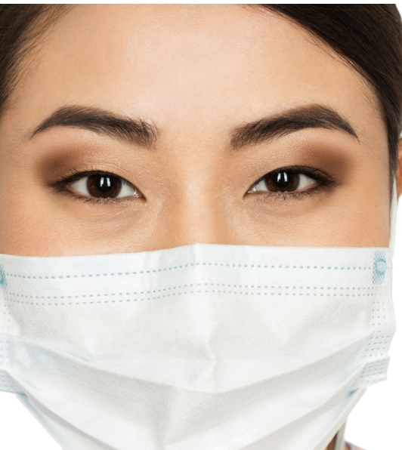
Indoor Visitation
Face Coverings and masks during visits
“If the nursing home’s county COVID-19 community transmission is high, everyone in a healthcare setting should wear face coverings or masks.”
https://www.cms.gov/files/document/qso-20-39-nh-revised.pdf
Notes:
(Read slide)
CDC also indicates, “If the nursing home’s county COVID-19 community transmission is not high, the safest practice is for residents and visitors to wear face coverings or masks, however, the facility could choose not to require visitors wear face coverings or masks while in the facility, except during an outbreak. The facility’s policies regarding face coverings and masks should be based on recommendations from the CDC, state and local health departments, and individual facility circumstances”

Slide 20
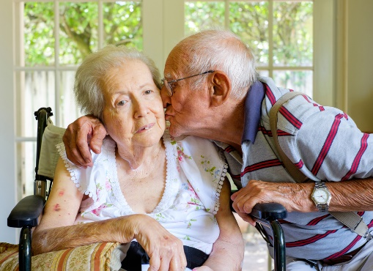
Indoor Visitation
“Regardless of the community transmission level, residents and their visitors when alone in the resident’s room or in a designated visitation area, may choose not to wear face coverings or masks and may choose to have close contact (including touch).”
https://www.cms.gov/files/document/qso-20-39-nh-revised.pdf
Notes:
(READ SLIDE)
Community transmission is now the metric that is currently recommended to guide the facility practices in order to allow for earlier interventions and is different from the COVID-19 community level that is used for NON-HEALTHCARE settings. CDC also indicates, “Residents (or their representative) and their visitors should be advised of the risks of physical contact prior to the visit. If a roommate is present during the visit, it is safest for the visitor to wear a face covering or mask.” (Discuss WHO in the facility will be responsible for advising the resident and visitors of the risks PRIOR to the visit?)

Slide 21
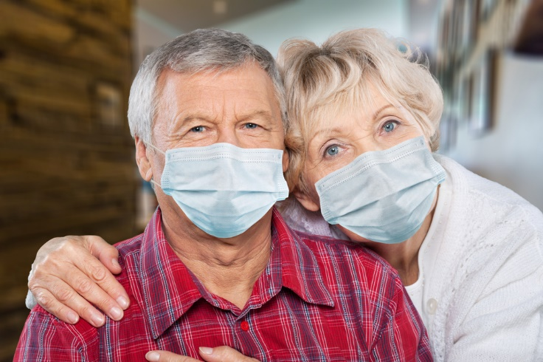
Indoor Visitation
“While not recommended, residents who are on transmission-based precautions (TBP) or quarantine can still receive visitors.”
https://www.cms.gov/files/document/qso-20-39-nh-revised.pdf
Notes:
The CDC indicates, “While not recommended, residents who are on transmission-based precautions (TBP) or quarantine can still receive visitors. In these cases, visits should occur in the resident’s room and the resident should wear a well-fitting facemask (if tolerated). Before visiting residents, who are on TBP or quarantine, visitors should be made aware of the potential risk of visiting and precautions necessary in order to visit the resident. Visitors should adhere to the core principles of infection prevention. Facilities may offer well-fitting facemasks or other appropriate PPE, if available; however, facilities are not required to provide PPE for visitors.”

Slide 22
Indoor Visitation
There should be no limit on:
The number of visitors a resident can have
The frequency of visits
Length of visits
The facility may ask visitors to schedule visits at staggered timeslots throughout the day to allow for physical distancing during holidays or when a high number of visitors is anticipated
https://www.cms.gov/files/document/qso-20-39-nh-revised.pdf
Notes:
Remember (Read slide)

Slide 23
Indoor Visitation
Residents will be able to eat with visitors if the resident, resident representative and the visitor are all aware of the risks and continue to adhere to the core principles of infection prevention.
A separate dining area is preferred
If a separate dining area is not possible, the visitor should wear a face covering when not eating and/or drinking
https://www.cms.gov/files/document/nursing-home-visitation-faq-1223.pdf

Slide 24
Indoor Visitation During an Outbreak
If residents or their representatives request to have a visit during an outbreak investigation:
They should wear face coverings or masks during visits,
Visits should occur in the resident’s room (unless this poses a risk to the roommate if applicable)
The facility should limit visitor movement in the facility (visitor should go directly to resident room/visitation area
Visitor should physically distance themselves from all staff and other residents
The facilities may contact their local health authorities for guidance or direction on how to structure their visitation to reduce the risk of COVID-19 transmission during an outbreak investigation.
https://www.cms.gov/files/document/qso-20-39-nh-revised.pdf
Notes:
The facility will conduct an outbreak investigation when a single new nursing home onset of COVID-19 occurs in any staff or resident in order to identify if others have been exposed. Outbreak testing will be conducted consistent with guidance.
The CMS indicates, “While it is safer for visitors not to enter the facility during an outbreak investigation, visitors must still be allowed in the facility.”
Visitors will be made aware of the potential risk of visiting during an outbreak investigation and educated on adherence to the core principles of infection prevention.
(Read slide)

Slide 25
Compassionate Care Visits
Compassionate Care visits are allowed at all times for all residents. Limitations will be clearly communicated such as a resident who “is severely immunocompromised and the number of visitors the resident is exposed to needs to be kept to a minimum.”
https://www.cms.gov/files/document/qso-20-39-nh-revised.pdf
Notes:
Read slide
Limitations to compassionate care visits should be RARE. (Discuss with group the importance of compassionate care visits)

Slide 26
Access to Ombudsman
The resident will be provided access to the Ombudsman during the Pandemic if they choose
https://www.cms.gov/files/document/qso-20-39-nh-revised.pdf
Notes:
Access to Ombudsman: The resident will be provided access to the Ombudsman during this COVID-19 Pandemic. If the Ombudsman is planning a visit with a resident on Transmission-based Precautions or quarantine or an unvaccinated resident, the facility will notify the Ombudsman and resident if the county level of community transmission is substantial or high in the past 7 days as well as the potential risk of visitation. Visitation should occur in the resident room.
If in-person access is not advisable, alternative communication will be provided to include:
Phone visit
Virtual visit

Slide 27
Federal Disability Rights Laws and Protection & Advocacy (P&A) Program
The laws require allowing immediate access to a resident by any representative that chooses to visit from the protection and advocacy system
If resident is on Transmission-based precautions or quarantine, or unvaccinated when the community transmission is substantial or high in the past 7 days, the resident and P&A representative should be aware of the risks of visitation and visit should occur in resident room
https://www.cms.gov/files/document/qso-20-39-nh-revised.pdf
Notes:
(Read slide)
Please notify your supervisor if anyone from the Protection & Advocacy Program. CMS indicates, “if communicating with individuals who are deaf or hard of hearing, it is recommended to use a clear mask or mask with a clear panel. Face coverings should not be placed on anyone who has trouble breathing or is unable to wear a mask due to a disability, or anyone who is unconscious, incapacitated, or otherwise unable to remove the mask without assistance. In addition, if a resident requires assistance to ensure effective communication (e.g., a qualified interpreter or someone to facilitate communication) and the assistance is not available by onsite staff or effective communication cannot be provided without such entry (e.g., video remote interpreting), the facility must allow the individual entry into the nursing home to interpret or facilitate, with some exceptions. This would not preclude nursing homes from imposing legitimate safety measures that are necessary for safe operations, such as requiring such individuals to adhere to the core principles of COVID-19 infection prevention.”

Slide 28
CMS-State Operations Manual Appendix PP-Guidance to Surveyors for Long Term Care
https://www.cms.gov/files/document/appendix-pp-guidance-surveyor-long-term-care-facilities.pdf
Notes:
We are now going to briefly talk about the federal regulations around visitation
Centers for Medicare & Medicaid Services or CMS indicates that the “resident has the right to make choices about aspects of his or her life in the facility that are significant to the resident. We further note that residents may deny or withdraw consent for a visit at any time, per 42 CFR § 483.10(f)(4)(ii) and (iii). Therefore, if a visitor, resident, or their representative is aware of the risks associated with visitation, and the visit occurs in a manner that does not place other residents at risk (e.g., in the resident’s room), the resident must be allowed to receive visitors as he/she chooses.”

Slide 29
Overview of the Regulation
Resident visitation is required under Resident Rights.
F563 “§483.10(f)(4) The resident has a right to receive visitors of his or her choosing at the time of his or her choosing, subject to the resident’s right to deny visitation when applicable, and in a manner that does not impose on the rights of another resident.”
COVID-19 has led to changes and now visitation is allowed for all residents at all times in a manner discussed today
Notes:
We have discussed the need for facility visitation changes that were made related to the COVID-19 pandemic that initially (at the beginning of the pandemic restricted visitation to protect the health and security of all residents and staff.
CMS also addresses visitation in the updated F563 (READ SLIDE)
Today facilities are really expected to meet the individualized, person-centered needs of each individually – not only clinical, social, psychosocial aspects of their lives. Person centered approach means that we are not just there for their clinical needs – we are there for all of their needs. We have had periods of time during the pandemic in which residents were not allowed to have visitors because of the efforts that were necessary to attempt to not expose the most vulnerable population to COVID-19 and that lead to a significant emotional toll on both residents and their families or loved ones. There is now updated guidance to be able to balance (meaning modifications if necessary) to visitation and still allow visitation to occur
Allowing access to visitors is key and critical to promoting a healthy psychosocial environment for all of our residents. No longer should there be visiting hours or restrictions – we need to allow access for visitors, who the resident consent to, when they would like to see them – just as if they were in their own home. So, if the resident wants to have a visitor in the middle of the night, we will need to figure out how to make that happen. (For example, if they are in a shared room and the roommate is sleeping, the visitation will need to be in a private area outside the resident room.
The regulations state that the facility must have written policies and procedures regarding the visitation rights of residents, including those setting forth any clinically necessary or reasonable restriction or limitation or safety restriction or limitation, when such limitations may apply consistent with the requirements of this subpart, that the facility may need to place on such rights and the reasons for the clinical or safety restriction or limitation.
So - our facility has updated its policy to include that we promote and support a resident centered approach to care. Our policy defines and sets expectations regarding persons visiting residents and to recognize our commitment to provide visitation in accordance with our non-discrimination policy, which provides access without regard to race, color, sex, national origin, disability, age, religion, marital status, citizenship, gender identity, gender identity, sexual orientation, and/or other legally protected classifications.
Resident visitors are not subject to visiting hour limitations or other restrictions not imposed by the resident or warranted due to reasonable clinical and safety restrictions.
Facilities must provide 24-hour access to other non-relative visitors with the consent of the resident subject to reasonable restrictions including clinical and safety restrictions as applicable. The facility will inform the resident and visitors as indicated.

Slide 30
Pre-visit Screening
Education to Residents and Visitors on Risks
Mask Use, Hand Hygiene, etc.
Refuses to follow Core Principles of COVID-19 Infection Prevention
Challenges Group Discussion-Role Play
Notes:
Split into groups do discuss and share questions and concerns which may arise and ways to solve issues.
Possible Topics for group discussion might include, but are not limited to:
How do I handle it if a visitor reports upon screening that they have a positive result but they don’t feel as if they are contagious because they have no symptoms? 2. Who can help me if a visitor refuses to wear a facial covering in the building and community transmission is high, until they reach the resident visitation area/room and refuses to leave (gets loud)? 3. How do I make sure visitors are following recommendations on location of visitation during an outbreak? 4. If I need to coach a visitor or resident to remain physically distant from all other residents or staff during an outbreak or in large gatherings, or wear their face coverings properly what do I do? 5. Where is the facility policy so I can follow it? Are there copies that I can give to the resident and their visitor so they know what to do during their visit? 6. Who will inform/educate visitors of the potential risk of visitation? Where will this be documented?

Slide 31
Your Role and Responsibility
Learn
Core Principles to follow every day
Act
How I help residents and their guests to safely visit; Cleaning and Disinfection role
Monitor
Keep Records: screening, testing, facility’s county level of community transmission, status
Notes:
Review each topic and facility policies, protocols, and tools that will be used

Slide 32
In Summary
Notes:
Summarize the overall training with the team.
In summary, CMS has updated their guidance with visitation in which the facility MUST facilitate visitation at all times consistent with the new requirements we addressed today.
We covered the Core Principles of COVID-19 Infection Prevention that should be adhered to at all times.
We discussed outdoor visitation, indoor visitation, indoor visitation during an outbreak investigation, compassionate care visits, visits with the ombudsman and the protection and advocacy program. We discussed visitation with events and large gatherings.
We discussed your role and responsibility in visitation.
We would like to thank you very much for attending this training. Remember, you can always ask your supervisor if you have any questions. Even one break in practice can potentially cause a serious transmission of COVID-19 for both you and the residents, therefore we want to do it the right way! Again, thank you and have a GREAT day!

Slide 33
Questions
Notes:
If you have any questions, please see your supervisor or the infection preventionist.

Slide 34
References and Resources
Centers for Medicare & Medicaid Services. QSO-20-39-NH, September 17, 2020, Revised 09/23/2022: Nursing Home Visitation – COVID-19 (Revised): https://www.cms.gov/files/document/qso-20-39-nh-revised.pdf
Centers for Medicare & Medicaid Services State Operations Manual, Appendix PP – Guidance to Surveyors for Long Term Care Facilities (Rev. 173, 11-22-17) Advance Copy 6/29/22: https://www.cms.gov/files/document/appendix-pp-guidance-surveyor-long-term-care-facilities.pdf
Centers for Medicare & Medicaid Services. Long Term Care Critical Element Pathways, Infection Prevention, Control & Immunizations, CMS 20054, 10/2022: https://www.cms.gov/files/zip/ce-pathways.zip

Slide 35
References and Resources
Centers for Disease Control and Prevention. Interim Infection Prevention and Control Recommendations for Healthcare Personnel During the Coronavirus Disease 2019 (COVID-19) Pandemic), Updated Sept. 23, 2022: https://www.cdc.gov/coronavirus/2019-ncov/hcp/infection-control-recommendations.html
Centers for Disease Control and Prevention. COVID-19. Symptoms of COVID-19, Updated Oct. 26, 2022: https://www.cdc.gov/coronavirus/2019-ncov/symptoms-testing/symptoms.html

Slide 36
Disclaimer
“This presentation provided is copyrighted information of Pathway Health. Please note the presentation date on the title page in relation to the need to verify any new updates and resources that were listed in this presentation. This presentation is intended to be informational. The information does not constitute either legal or professional consultation. This presentation is not to be sold or reused without written authorization.”

