Slide 1
Test
COVID-19
Personal Protective Equipment
(PPE)
All Staff Training
Test
Notes:
Hello and welcome to today’s training on COVID-19 Personal Protective Equipment –otherwise known as PPE.
The guidance from CMS or Centers for Medicare and Medicaid Services, the CDC or Centers for Disease Control and Prevention and other State and Federal entities has changed many times in regards to the use of PPE as researchers learn more about the virus—as well as due to supply chain issues. When COVID-19 first took a good hold in the United States, obtaining proper PPE was not always possible, therefore, guidance reflected options to optimize the use of PPE. Today, we have new guidance that we will be discussing in this presentation for all staff to follow.

Slide 2
Objectives
Upon completion of this presentation, participants should be able to:
Identify the types of Personal Protective Equipment (PPE) necessary for working with residents suspected or confirmed with COVID-19
Describe the proper sequence in donning and doffing PPE
Notes:
(Read objectives) Properly wearing appropriate PPE makes it less likely that you will get infected or spread infections to your residents. You will learn when and how to safely use, reuse, remove, and dispose of PPE. You will also learn some tips for managing the facility’s PPE supply.

Slide 3
Disease Transmission
COVID-19
“COVID-19 spreads when an infected person breathes out droplets and very small particles that contain the virus. These droplets and particles can be breathed in by other people or land on their eyes, noses, or mouth. In some circumstances, they may contaminate surfaces they touch.”
https://www.cdc.gov/coronavirus/2019-ncov/prevent-getting-sick/how-covid-spreads.html
Notes:
The Centers for Disease Control and Prevention indicates, (READ SLIDE)
Keep in mind, anyone that is infected with COVID-19 can transmit it to others even if they have NO SYMPTOMS!
The CDC indicates that people can even spread COVID to their pet cats and dogs too. There is no evidence, according to the CDC that food handling or consuming food can spread COVID-19, however, you still have to follow food safety guidelines whenever you are handling and cleaning food and produce.
Personal Protective Equipment or PPE is intended to protect employees, residents and anyone else that enters the facility.

Slide 4
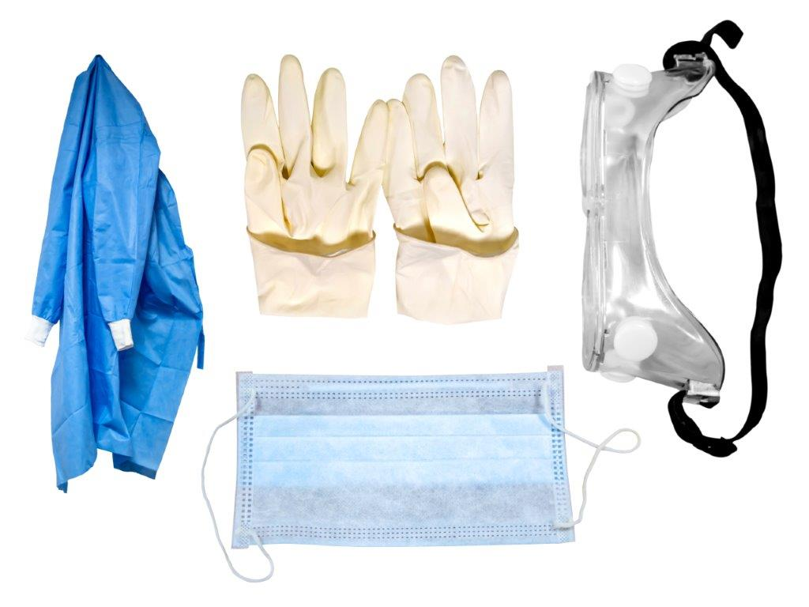
Personal Protective Equipment (PPE)
“Personal protective equipment (PPE)” refers to protective items or garments worn to protect the body or clothing from hazards that can cause injury and to protect residents from cross-transmission”
https://www.cms.gov/files/document/appendix-pp-guidance-surveyor-long-term-care-facilities.pdf
Notes:
The definition of PPE according to the Centers for Medicare and Medicaid Services is (read slide)

Slide 5
Standard Precautions
““Standard precautions” refer to the infection prevention practices that apply to all residents, regardless of suspected or confirmed diagnosis or presumed infection status. Standard precautions is based on the principle that all blood, body fluids, secretions, excretions except sweat, regardless of whether they contain visible blood, non-intact skin, and mucous membranes may contain transmissible infectious agents.”
https://www.cms.gov/files/document/appendix-pp-guidance-surveyor-long-term-care-facilities.pdf
Notes:
CMS defines standard precautions as (read slide)
Therefore, anytime you ANTICIPATE contact with blood, body fluids, secretions, excretions (except sweat)—whether they contain visible blood or not, you need to protect yourself with the use of PPE-if you anticipate splashing in your face, mouth, eyes, etc., a mask or eye protection is essential—if you feel you will contaminate your clothing—a gown, and gloves if your hands will come in contact. (Discuss with group)

Slide 6
Standard Precautions
“Furthermore, equipment or items in the resident’s environment likely to have been contaminated with infectious body fluids must be handled in a manner to prevent transmission of infectious agents. Standard precautions include hand hygiene, proper selection and use of personal protective equipment, safe injection practices, respiratory hygiene/cough etiquette, environmental cleaning and disinfection, and reprocessing of reusable resident medical equipment.”
https://www.cms.gov/files/document/appendix-pp-guidance-surveyor-long-term-care-facilities.pdf
Notes:
CMS also goes on to define standard precautions as (Read slide)

Slide 7
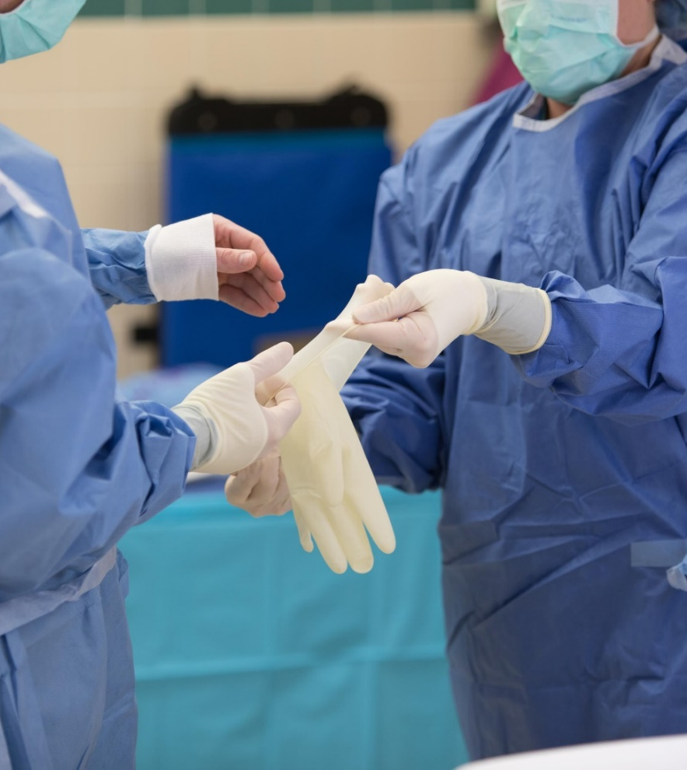
Transmission-based Precautions
“Transmission-based precautions (a.k.a. “Isolation Precautions”)” refer to actions (precautions) implemented in addition to standard precautions that are based upon the means of transmission (airborne, contact, and droplet) in order to prevent or control infections.”
https://www.cms.gov/files/document/appendix-pp-guidance-surveyor-long-term-care-facilities.pdf
Notes:
CMS also indicates that “When a resident is placed on transmission-based precautions, the staff should implement the following:
• Clearly identify the type of precautions and the appropriate PPE to be used;
• Place signage that includes instructions for use of specific PPE in a conspicuous place outside the resident’s room (e.g., on the door or on the wall next to the doorway), wing or facility-wide. Additionally, either the CDC category of transmission-based precautions (e.g., contact, droplet, or airborne),or instructions to see the nurse before entering, should be included in signage. Ensure that signage also complies with residents’ rights to confidentiality and privacy;
• Make PPE readily available near the entrance to the resident’s room;
• Don appropriate PPE before or upon entry into the environment (e.g., room or cubicle) of resident on transmission-based precautions (e.g., contact precautions);
• Use disposable or dedicated noncritical resident-care equipment (e.g., blood pressure cuff, bedside commode). If noncritical equipment is shared between residents, it will be cleaned and disinfected following manufacturer’s instructions with an EPA-registered disinfectant after use;
• Clean and disinfect objects and environmental surfaces that are touched frequently (e.g., bed rails, over-bed table, bedside commode, lavatory surfaces in resident bathrooms) with an EPA-registered disinfectant for healthcare use at least daily and when visibly soiled; and
• Provide education to residents (to the degree possible/consistent with the resident’s capacity) and their representatives or visitors on the use of transmission-based precautions”

Slide 8
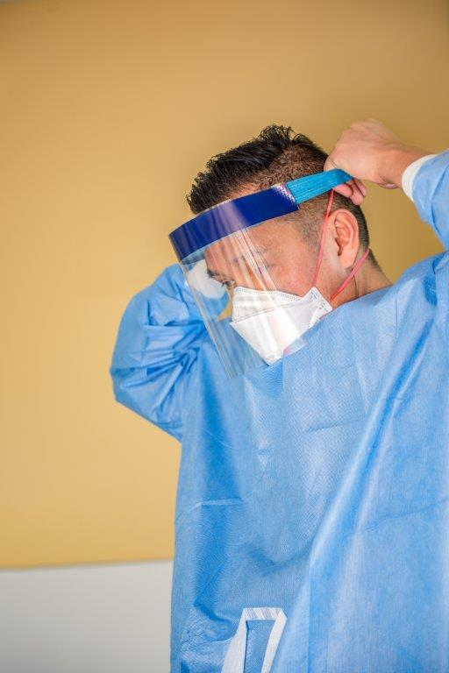
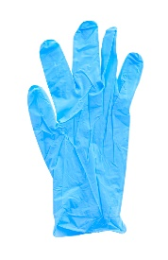
PPE for Suspected/Confirmed COVID-19
“HCP who enter the room of a patient with suspected or confirmed SARS-CoV-2 infection should adhere to Standard Precautions and use a NIOSH-approved particulate respirator with N95 filters or higher, gown, gloves, and eye protection (i.e., goggles or a face shield that covers the front and sides of the face).”
https://www.cdc.gov/coronavirus/2019-ncov/hcp/infection-control-recommendations.html
Notes:
The most current guidance from the CDC now states that (HCP is healthcare personnel) (READ SLIDE) The CDC also indicates that you need to use the respirators in the contest of your comprehensive respiratory protection program that includes a medical evaluation, fit testing and training in accordance with OSHA or the Occupational Safety and Health Administration’s Respiratory Protection Standard. (Discuss fit testing requirements in your facility)

Slide 9
Source Control vs. Respiratory Protection
Source Control
Purpose: “To reduce the spread of COVID-19 by reducing the spread of the virus through respiratory droplets from asymptomatic individuals”
Respiratory Protection N95’s:
Purpose: “to help protect the wearer by passing most of the air through the filter. N95 respirators filter at least 95% of particles of all sizes from inhaled air.”
https://blogs.cdc.gov/niosh-science-blog/2020/09/08/source-control/
Notes:
Let’s talk about the difference between “Source control” and PPE: Source control: (read slide) “Masks are recommended as a barrier to help prevent large respiratory droplets from traveling into the air and onto other people when the person wearing the mask coughs, sneezes, talks, or raises their voice.”
Respiratory Protection-NIOSH approved N95 or higher respirators (Read slide) Criteria to be effective includes:
“The respirator filter needs to be highly effective at capturing particles that pass through the filter;
The respirator must also fit the user’s face snugly to minimize the number of particles that bypass the filter and get into the breathing zone through gaps between the user’s skin and the respirator seal. A good seal helps ensure that the air goes through the filter.”
NOTE: “if the respirator does not form a tight seal with the face, it cannot provide the expected level of protection”

Slide 10
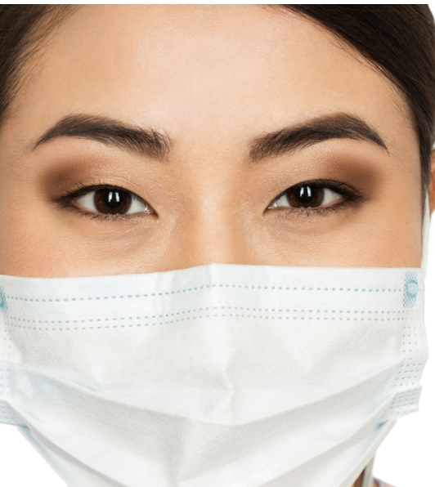
Source Control
N95 Respirator
A respirator approved under standards used in other countries similar to N95
Barrier face covering that meets ASTM F3502-21 requirements
A well-fitting facemask
https://www.cdc.gov/coronavirus/2019-ncov/hcp/infection-control-recommendations.html
https://blogs.cdc.gov/niosh-science-blog/2021/04/23/bfc-standard/
Notes:
The updated CDC guidance includes Source Control Options for Healthcare personnel:
“A NIOSH-approved particulate respirator with N95 filters or higher
A respirator approved under standards used in other countries that are similar to NIOSH-approved N95 filtering facepiece respirators (Note: These should not be used instead of a NIOSH-approved respirator when respiratory protection is indicated);
A barrier face covering that meets ASTM F3502-21 requirements including Workplace Performance and Workplace Performance Plus masks; which are not respirators or surgical masks, but they are face coverings that may prevent the wearer from SPREADING droplets that can carry infectious organisms such as COVID-19, OR
A well-fitting facemask.

Slide 11
Source Control
“When used solely for source control, any of the options listed above could be used for an entire shift unless they become soiled, damaged, or hard to breathe through.”
https://www.cdc.gov/coronavirus/2019-ncov/hcp/infection-contro l-recommendations.html
Notes:
Now this is different from the updated guidance for use as PPE. If you are using a respirator-NIOSH approved, N95 or higher, for PPE such as when caring for a resident on transmission-based precautions, you will need to discard it when you leave the room after the resident encounter and put on a new one for the next encounter.

Slide 12
Use Your Facemask the Correct Way
DO
DON’T
Clean your hands before you put on and take off your facemask
Make sure your facemask covers your mouth and your nose
Remove your facemask by touching only the straps
Don’t touch your facemask or face
Don’t wear your facemask:
On the top of your head
Around your neck
Under your nose
Don’t store your mask on your arm or in your pocket
Notes:
Have a discussion about why employees should not touch their facemask or face

Slide 13
When to Wear Source Control
When SARS-CoV-2 Community Transmission levels are high, source control is recommended for EVERYONE in a healthcare setting when in areas where you could encounter patients
https://www.cdc.gov/coronavirus/2019-ncov/hcp/infection-control-recommendations.html
Notes:
The CDC says, “HCP could choose not to wear source control when they are in well-defined areas that are restricted from patient access (e.g., staff meeting rooms) if they do not otherwise meet the criteria described below and Community Levels are not also high. When Community Levels are high, source control is recommended for everyone.”

Slide 14
When to Wear Source Control
“When SARS-CoV-2 Community Transmission levels are not high, healthcare facilities could choose not to require universal source control,” but it is recommended in healthcare settings for individuals who:
Have suspected or confirmed COVID-19 or other respiratory infection or symptoms
Have had close contact-both residents and visitors or staff with a higher-risk exposure for 10 days
Live or work on a unit under outbreak investigation until no new cases for 14 days
When recommended by public health authorities
https://www.cdc.gov/coronavirus/2019-ncov/hcp/infection-control-recommendations.html
Notes:
(Read slide) CDC also says, “Individuals might also choose to continue using source control based on personal preference, informed by their perceived level of risk for infection based on their recent activities (e.g., attending crowded indoor gatherings with poor ventilation) and their potential for developing severe disease. For example, if an individual or someone in their household is at increased risk for severe disease, they should consider wearing masks or respirators that provide more protection because of better filtration and fit to reduce exposure and infection risk, even if source control is not otherwise required by the facility. HCP and healthcare facilities might also consider using or recommending source control when caring for patients who are moderately to severely immunocompromised”
DISCUSS

Slide 15
Universal Use of PPE
Facilities in counties where Community Transmission is high should consider staff wear N95 respirators for:
All aerosol-generating procedures
All surgical procedures
When working in situations where risk factors are present (i.e., resident is unable to use source control)
For all patient care encounters on specific units or areas of the facility at higher risk
https://www.cdc.gov/coronavirus/2019-ncov/hcp/infection-control-recommendations.html
Notes:
DISCUSS

Slide 16
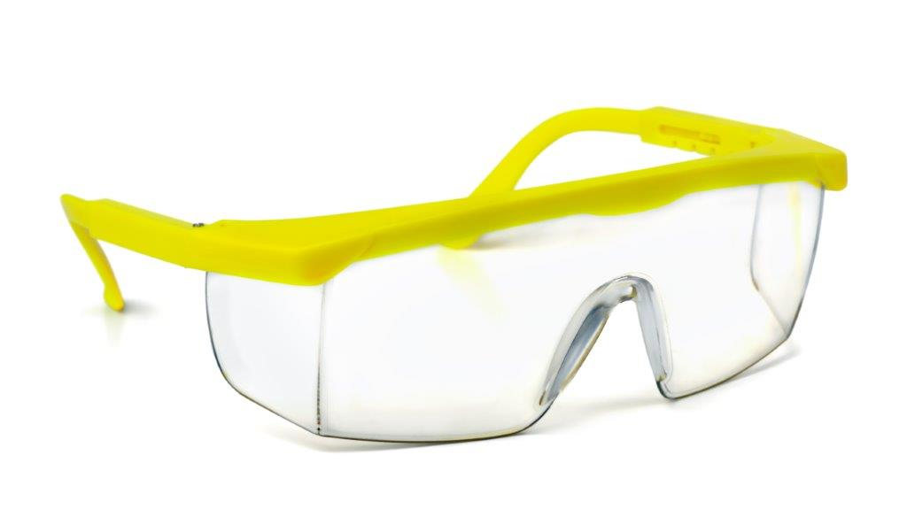
Universal Use of PPE
(Continued)
Facilities in counties where Community Transmission is high, consider:
“Eye protection (i.e., goggles or a face shield that covers the front and sides of the face) worn during all patient care encounters.”
https://www.cdc.gov/coronavirus/2019-ncov/hcp/infection-control-recommendations.html
Notes:
Read slide
DISCUSS

Slide 17
Donning PPE (Putting On)
Selection: Determine PPE required
Gather PPE
N95, eye protection, gown, gloves
Perform Hand Hygiene
Don isolation gown and make sure to secure with ties or snaps
Don N95
Don eye protection
Don gloves
Notes:
It is essential that you follow the correct sequence in donning PPE. (Note to speaker—there may be more than one way to don PPE that is still in accordance with guidance—be sure you use your process in this training) DISCUSS
Selection: Determine PPE required
Gather PPE
NIOSH approved, N95 or higher respirator-(if N95 is not available, facemask), eye protection, gown, gloves
Perform Hand Hygiene
Don isolation gown and make sure to secure with ties or snaps
Don N95 by using both hands to fit the nosepiece if it has one, fit tight over mouth and nose fitting straps and perform your user seal check every time
If N95 is not available and a mask must be used, don the mask covering both the mouth and nose securely
Next is the eye protection—either a face shield or goggles—the eye protection must cover both the front and the sides
Lastly, don gloves and put on in order for the gloves to cover over the wrist area of the gown securely

Slide 18
Doffing or Taking PPE Off
BEFORE leaving the room:
Remove gloves and throw in trash receptacle
Remove your gown
Exit the resident room
Perform Hand Hygiene
Remove face shield or goggles
Remove the N95 respirator and throw in trash receptacle
Perform hand hygiene
Notes:
It is essential that you follow the correct sequence in doffing or taking OFF PPE. (Note to speaker—there may be more than one way to take off PPE that is still in accordance with guidance—be sure you use your process in this training)
DISCUSS
PLEASE NOTE TO PARTICIPANTS: The goal is to appropriately remove the PPE without contaminating yourself or area around you.
BEFORE YOU LEAVE ROOM
Remove gloves (a good method is the glove-in-glove technique in which you pinch one glove at the wrist and remove while turning glove inside out, taking care not to contaminate, next, put your fingers under the other glove that is still on and in a downward fashion, turn inside out with the other glove inside. Throw gloves in trash receptacle
Remove gown by untying or unsnapping unless the gown is designed to break the ties. Pull the gown down from the shoulders-away from your body and roll with the outside of the gown inside, taking care not to contaminate your hands or anything else. Throw gown in trash receptacle unless the gown is linen and washable and will be placed in the soiled linen container
Exit resident room still wearing eye protection and the N95 respirator
Perform hand hygiene, making sure to include the wrist area as well
Remove goggles or face shield and pull away from your head taking care NOT to touch the front of the face shield or goggles as this area is contaminated
Next you will take off or doff the N95 by first pulling the bottom strap over the entire respirator and face and then the top strap and be careful not to touch the front of the respirator as this area is contaminated and immediately throw away or discard in the trash receptacle
You must now perform hand hygiene once again

Slide 19
Who Makes the Decision if Running Low on PPE?
Notes:
If you are running low on PPE, immediately tell your supervisor! The DON, Administrator and the Infection Preventionist will direct you on steps to take if running low on PPE.

Slide 20
Summary
Notes:
In summary, PPE is essential for protection for you, residents, families, visitors and anyone else who enters the facility. It is essential that we understand what PPE is, what source control is, how to:
Understand what Source Control is and the difference between PPE and Source Control and when to use them
Select the appropriate PPE
Know how to properly don and doff PPE
If you have any questions, please don’t hesitate to ask your supervisor or the Infection Preventionist.

Slide 21
Resources
Centers for Disease Control and Prevention. COVID-19. Transmission. Updated July 12, 2021: https://www.cdc.gov/coronavirus/2019-ncov/transmission/index.html
Centers for Medicare & Medicaid Services. State Operations Manual. Appendix PP – Guidance to Surveyors for Long Term Care Facilities, Advanced Copy, 06/29/22: https://www.cms.gov/files/document/appendix-pp-guidance-surveyor-long-term-care-facilities.pdf
Centers for Disease Control and Prevention. Interim Infection Prevention and Control Recommendations for Healthcare Personnel During the Coronavirus Disease 2019 (COVID-19) Pandemic), Updated Sept. 23, 2022: https://www.cdc.gov/coronavirus/2019-ncov/hcp/infection-control-recommendations.html

Slide 22
Resources
Centers for Disease Control and Prevention. NIOSH Science Blog. Respiratory Protection vs. Source Control – What’s the difference? September 8, 2020: https://blogs.cdc.gov/niosh-science-blog/2020/09/08/source-control/
Centers for Disease Control and Prevention. “Use Personal Protective Equipment (PPE) When Caring for Patients with Confirmed or Suspected COVID-19 Factsheet. CS316124: https://www.cdc.gov/coronavirus/2019-ncov/downloads/communication/print-resources/A_FS_HCP_COVID19_PPE_card.pdf
United States Department of Labor, Occupational Safety and Health Administration (OSHA) Standard 1910 Respiratory Protection: https://www.osha.gov/laws-regs/regulations/standardnumber/1910/1910.134

Slide 23
Questions

Slide 24
Disclaimer
“This presentation provided is copyrighted information of Pathway Health. Please note the presentation date on the title page in relation to the need to verify any new updates and resources that were listed in this presentation. This presentation is intended to be informational. The information does not constitute either legal or professional consultation. This presentation is not to be sold or reused without written authorization.”

