Slide 1

Test
MDS 3.0 Changes
The Road to Successful Transition
For Leadership and Interdisciplinary Team Members
Test
July 2023
Notes:
Welcome to today's session on the October 2023 MDS Changes – An overview for leaders and IDT members.

Slide 2
Objectives
Recognize the MDS changes that will impact discharge planning.
Discuss strategies to accurately complete section GG.
Examine updates to high-risk medications and the impact on annual survey and certification.
Notes:
Read Objectives
***Recommend that the leadership team and IDT have an MDS in front of them while going through the training!!!

Slide 3

Final Rule 2023
Updates to the Quality Reporting Program (QRP) for 2023 and future years
Updates to the Value Based Purchasing Program (VBP) for 2023 and future years.
Recalibration of the Patient Drive Payment Model Parity Adjustment
Changes to PDPM ICD-10 Code Mapping
QRP 2024 Influenza vaccines among HCP
QRP October 1, 2023, include:
  Transfer of health information measures
  Standardized elements including race, ethnicity, preferred language, health literacy, social isolation
Notes:
Let’s do a quick review of the final rule that was adopted in October 2022.
CMS adopted the CDC-developed Influenza Vaccination Coverage among Healthcare Personnel (HCP) measure; the agency proposed to adopt the measure for beginning with the FY 2025 SNF QRP, but will instead add the measure to the program one year earlier, for FY 2024. CMS accelerates the addition of this measure to the program as the agency believes “it has the potential to increase influenza vaccination coverage in SNFs.”

Slide 4
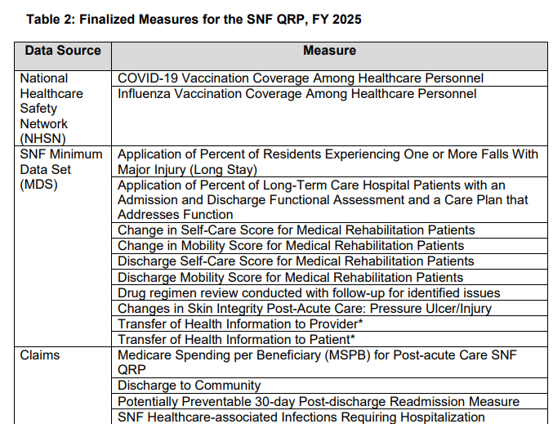
Finalized for October 1, 2024
Notes:
Data collection beginning on October 1st, 2022
So as we as provider reflect on the MDS changes, the overall importance of accuracy is evident. Not only will the data Impact Medicare reimbursement, but it may also impact future Medicaid Reimbursement - **Check with your state specific Case Mix information!!!

Slide 5

Notes:
Another change and with that a new set of challenges. CMS The Center for Medicare and Medicaid Services (CMS) has recently released a draft version of the Nursing /home Comprehensive (NC) Minimum Data Set (MDS 3.0) in April 2023. The Final Version of the MDS 3.0 is projected to be effective in October 1st of 2023. And CMS issued a statement that the changes are significant.
The last time that the MDS RAI tool was updated was in October of 2010 with the revised MDS 3.0.
The time is not to discuss the changes but develop a plan to meet the challenges and changes.
Question to the audience: What is one step that your organization has made to respond to the changes released on April 3rd, 2023.

Slide 6
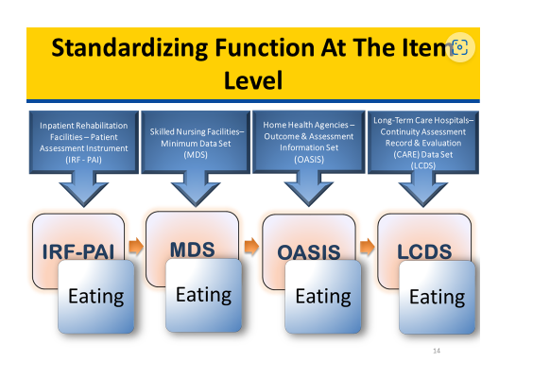
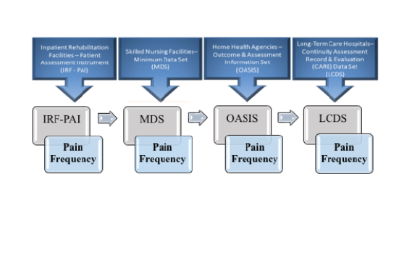
SPADES
Notes:
Animation: First part identifies standardized questions on eating
Click and it has standardized questions on pain frequency
So lets look back at where we are and where we are going. The data gathered on the MDS is going to impact the overall health and wellbeing of the older Americans. The plan to create an assessment that is transparent was identified in 2010 with the passing of the affordable care act. Since then the steps to transitioning all post acute care providers to develop a consistent set of assessment tools.
Lets discuss the SPADES
Centers for Medicare and Medicaid developed The Standardized Patient Assessment Data Elements (SPADEs) file includes standardized data elements developed by CMS to meet the requirements of the Improving Medicare Post-Acute Care Transformation (IMPACT) Act of 2014. The IMPACT Act requires the reporting of standardized patient assessment data with regard to quality measures and SPADEs. In addition, the IMPACT Act requires assessment data to be standardized and interoperable to allow for exchange of the data among post-acute providers and other providers. The Act intends for standardized post-acute care data to improve Medicare beneficiary outcomes through shared-decision making, care coordination, and enhanced discharge planning. The data elements in the SPADEs data set address care in the following post-acute settings: Inpatient Rehabilitation Facilities, Long-Term Care Hospitals, Skilled Nursing Facilities and Home Health Agencies.

Slide 7

What We Know or Anticipate
Expanded choices on ethnicity and race
Coding clarification on assessing language
Transportation
Expanded admission and discharge status
Notes:
REVIEW Slide
The ethnicity data element uses a one-question multi-response format based on whether or not the resident is of Hispanic, Latino/a, or Spanish origin. Collection of ethnic data provides data granularity important for documenting and tracking health disparities and conforms to the 2011 Health and Human Services Data Standards
The ability to improve understanding of and address racial disparities in health care outcomes requires the availability of better data related to social determinants of health, including race. • Collection of A1010. Race provides data granularity important for documenting and tracking health disparities and conforms to the 2011 Health and Human Services Data Standards. • This item uses the common uniform language approved by the Office of Management and Budget (OMB) to report racial categories (see Definitions: Race). Response choices A1010D through A1010J roll up to the Asian category of the OMB standard. Response choices A1010K through A1010N roll up to the Native Hawaiian or Other Pacific Islander category of the OMB standard. The categories in this classification are social-political constructs and should not be interpreted as being scientific or anthropological in nature.
Collection of race data is an important step in improving quality of care and health outcomes. • Standardizing self-reported data collection for race allows for the equal comparison of data across multiple post-acute-care settings. • These categories are NOT used to determine eligibility for participation in any Federal program
Language: Enter the preferred language the resident primarily speaks or understands after interviewing the resident and family, significant other and/or guardian/legally authorized representative and/or reviewing the medical record. Inability to make needs known and to engage in social interaction because of a language barrier can be very frustrating and can lead to social isolation, depression, resident safety issues, and unmet needs
Transportation is a focus for the Medicare A resident, as we know the goal is to prevent re-hospitalization and ensure that the client that is marginalized has the ability to access transportation.
Expanded admission and discharge status along with clarifications. One example is the differentiation of hospice settings. The manual added hospice and an institutional facility Code 10, Hospice (institutional facility): if the resident was admitted from an inpatient program for terminally ill persons where an array of services is necessary for the palliation and management of terminal illness and related conditions. The hospice must be licensed by the State as a hospice provider and/or certified under the Medicare program as a hospice provider. Includes community-based or inpatient hospice programs.

Slide 8

What We Know or Anticipate
Medication reconciliation
Changes to the resident PHQ interview
Special treatments and procedures.
Discharge
Transfer of health information
Pain interview
Notes:
REVIEW Slide
And not only has the MDS been updated, but the Standards of Participation updated. The MDS is the first step for payment, compliance and quality in your care center.

Slide 9

Notes:
What are some of the challenges in gathering the additional information in section A.
Will the assessments in your EMR be ready for the transition.
Who is assigned to obtaining this information?
Will business office, admissions or social service gather this information.

Slide 10
MDS Changes
Section by Section Overview of Changes
Notes:
Now that we have discussed why the changes are occurring, lets begin with an overview or highlight of the specific Section changes

Slide 11
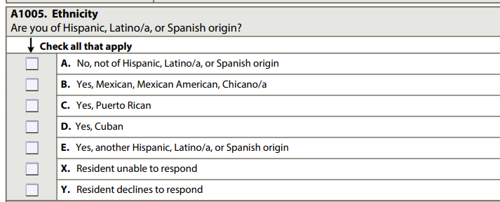
Section A Race/Ethnicity
Guidance
“We want to make sure that all our residents get the best care possible, regardless of their ethnic background. We would like you to tell us your ethnic background so that we can review the treatment that all residents receive and make sure that everyone gets the highest quality of care”
When the resident is unable to respond and the response is determined via family, significant other, or legally authorized representative input or medical record documentation, check all boxes that apply, including X. Resident unable to respond
Notes:
The ethnicity data element uses a one-question multi-response format based on whether or not the resident is of Hispanic, Latino/a, or Spanish origin. Collection of ethnic data provides data granularity important for documenting and tracking health disparities and conforms to the 2011 Health and Human Services Data Standards. • This item uses the common uniform language approved by the Office of Management and Budget (OMB) to report ethnic categories. Standardizing self-reported data collection for ethnicity allows for the comparison of data within and across multiple post-acute-care settings. • These categories are NOT used to determine eligibility for participation in any Federal program.
Key points
If the resident is unable to respond, the assessor may ask a family member, significant other, and/or guardian/legally authorized representative. 3. Ethnic category definitions are provided only if requested in order to answer the item. 4. Respondents should be offered the option of selecting one or more ethnic designations. 5. Only use medical record documentation to code A1005, Ethnicity if the resident is unable to respond and no family member, significant other, and/or guardian/legally authorized representative provides a response for this item. 6. If the resident declines to respond, do not code based on other resources (family, significant other, or guardian/legally authorized representative or medical records).

Slide 12
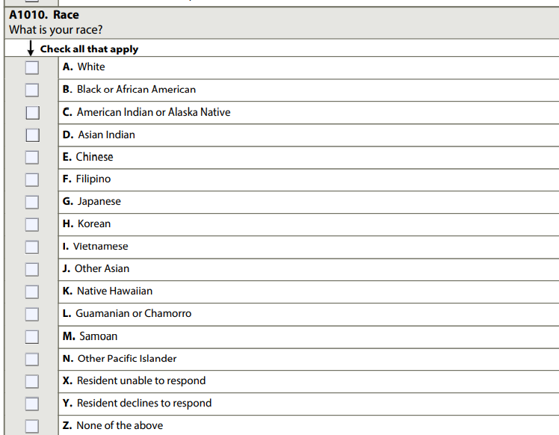

Draft MDS3.0 NC Item Set v1.18.11 Oct2023.pdf
Notes:
This item uses the common uniform language approved by the Office of Management and Budget (OMB) to report racial categories (see Definitions: Race). Response choices A1010D through A1010J roll up to the Asian category of the OMB standard. Response choices A1010K through A1010N roll up to the Native Hawaiian or Other Pacific Islander category of the OMB standard. The categories in this classification are social-political constructs and should not be interpreted as being scientific or anthropological in nature

Slide 13
Steps for Assessment
May ask a family member if resident is unable to respond.
Use medical record only if resident and or family is not available
Resident declines to respond
DON’T CODE BASED ON OTHER RESOURCES
Notes:
If the resident is unable to respond, the assessor may ask a family member, significant other, and/or guardian/legally authorized representative.
3. Racial category definitions are provided only if requested in order to answer the item. 4. Respondents should be offered the option of selecting one or more racial designations.
5. Only use medical record documentation to code A1010, Race if the resident is unable to respond and no family member, significant other, and/or guardian/legally authorized representative provides a response for this item.
6. If the resident declines to respond, do not code based on other resources (family, significant other, or legally authorized representative or medical records).

Slide 14

Steps to Implementation
Determine the member of the IDT team complete the sections
Provide training
Audit at the time of completion for compliance.
Notes:
Review with Leadership and IDT

Slide 15
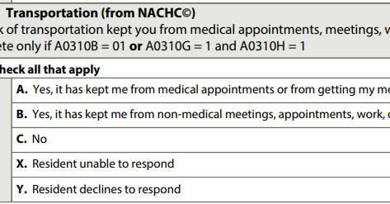
Interview Medicare 5-day NPE Discharge
Structured Interview
Allow option of selection more than one “YES” designation
May ask family
May use medical record
Resident may refuse
Notes:
Ask the resident:
• “In the past six months to a year, has lack of transportation kept you from medical appointments or from getting your medications?”
• “In the past six months to a year, has lack of transportation kept you from non-medical meetings, appointments, work, or from getting things that you need?”
2. Respondents should be offered the option of selecting more than one “yes” designation, if applicable.
3. If the resident is unable to respond, the assessor may ask a family member, significant other, and/or guardian/legally authorized representative.
4. Only if the resident is unable to respond and no family member, significant other, and/or guardian/legally authorized representative may provide a response for this item, use medical record documentation.
5. If the resident declines to respond, do not code based on other resources (family, significant other, or legally authorized representative or medical records).

Slide 16
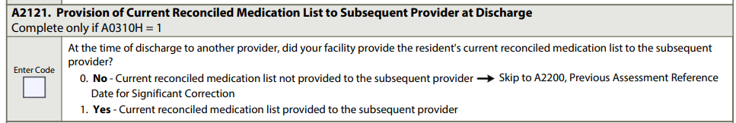
Medication Reconciliation-Subsequent Provider
Stand alone Medicare Part A PPS discharge
Remaining in the facility and with the same team of interdisciplinary professionals
Code: 1. Yes-Current reconciled medication list provided to the subsequent provider
5- day assessment
NPE item set
Notes:
The transfer of a current reconciled medication list at the time of discharge can improve care coordination and quality of care and help subsequent providers reconcile medications, and it may mitigate adverse outcomes related to medications. Communication of medication information at discharge is critical to ensure safe and effective transitions from one health care setting to another
The key to this section is identifying was is a subsequent provider at the time of discharge. The MDS manual has specific instruction related to the definition of a subsequent provider.
The MDS manual has specific guidelines related to related to subsequent providers. For example While the resident may receive care from other providers after discharge from your facility, such as primary care providers, other outpatient providers, and residential treatment centers, these locations are not considered to be a subsequent provider for the purpose of coding this item.

Slide 17

Medication Reconciliation
Resident information
Medication information
Allergies
Rationale to hold medications
Self-administration instructions
Last dose
Special instructions
Notes:
NEW
Types of medications—Current prescribed and over-the-counter (OTC) medications, nutritional supplements, vitamins, and homeopathic and herbal products administered by any route at the time of discharge.
Medications may also include total parenteral nutrition (TPN) and oxygen.
— The list of reconciled medications could include those that are: o active, including those that are scheduled to be discontinued after discharge; o held during the stay and planned to be continued/resumed after discharge; and o discontinued during the stay, if potentially relevant to the resident’s subsequent care
Information included—A reconciled medication list often includes important information about
the resident—including their name, date of birth, active diagnoses, known medication and other allergies, and known drug sensitivities and reactions; and
(2) each medication, including the name, strength, dose, route of medication administration, frequency or timing, purpose/indication, and any special instructions (e.g., crush medications).
For any held medications, it may include the reason for holding the medication and when medication should resume. This information can improve medication safety. Additional information may be applicable and important to include in the medication list, such as the resident’s weight and date taken, preferred language, and ability to self-administer medication; when the last dose of the medication was administered by the discharging provider; and when the final dose should be administered (e.g., end of treatment).

Slide 18
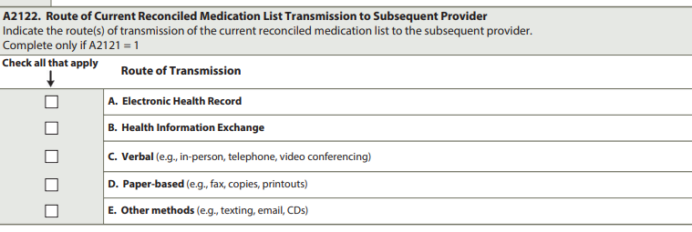
Medication List Transmission
Complete only if A2121 is Yes: Current reconciled medication list provided to subsequent provider

Slide 19
Example of Transmission of Medication List
Oak Tree is discharging and sending a resident to a hospital by ambulance. The driver obtains a printout and brings the resident’s medication list to the hospital. The facility follows up with a call to the subsequent provider and discusses the resident’s medications
Notes:
Read the scenario, Animated - and ask the audience for the correct response or responses

Slide 20

Steps to Implementation
Determine the member of the IDT team complete the sections
Provide training on the transfer/discharge processes
Develop policy and procedures
Audit at the time of completion for compliance.
Notes:
Discuss with Team

Slide 21

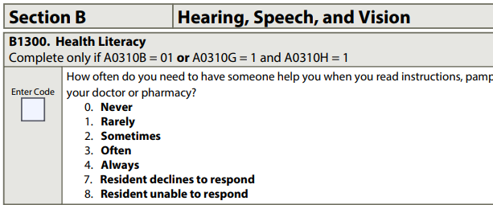
Health Literacy
Draft MDS3.0 NC Item Set v1.18.11 Oct2023.pdf
Notes:
Currently is required for a 5-day PPS assessment and an NPE assessment with a planned discharge. At this time, OBRA assessments, stand alone admission, annual quarterly do not require this question.
Now that does not mean that health literacy is ignored
The key point is that the assessment ident is to be a self report item at this time.
Similar to language barriers, low health literacy interferes with communication between provider and resident. Health literacy can also affect residents’ ability to understand and follow treatment plans, including medication management. • Poor health literacy is linked to lower levels of knowledge of health, worse outcomes, the receipt of fewer preventive services, and higher medical costs and rates of emergency department use
Make sure that the plan of care reflects the response for Section B under health literacy.

Slide 22
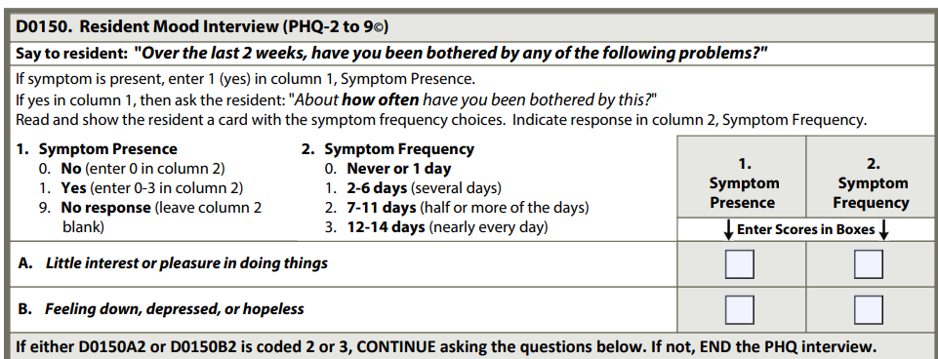
Section D
Draft MDS3.0 NC Item Set v1.18.11 Oct2023.pdf
Notes:
Significant changes to the Mood interview and the addition of social isolation. The intent of Mood has includes social isolation ad a risk factor for physical, mental illness and is a predictor of mortality.
I would like to highlight components of Section D. The symptom frequency will determine if you are going to continue with the interview. One aspect of the change is that if the symptom frequency for the first two questions is coded 0 never or 1 day or 2-6 day’s several days the interview ends.
As we know, the PHQ impact reimbursement with PDPM nursing in special care high, special care low and clinical complex. So at this time, under the proposed rule effective October 2023 I am not aware of any changes to the HIPPS codes related to signs and symptoms of depression.
The PHQ-02 to 9 apply to all MDS item sets PPS comprehensive and quarterly.

Slide 23

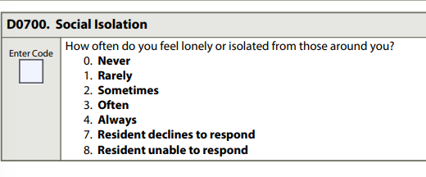
Social Isolation
Draft MDS3.0 NC Item Set v1.18.11 Oct2023.pdf
Notes:
This item is intended to be a resident self-report item. No other source should be used to identify the response. 1. Ask the resident, “How often do you feel lonely or isolated from those around you?”
Please remember, that some cultures may not understand the term.
Social isolation refers to an actual or perceived lack of contact with other people and tends to increase with age. It is a risk factor for physical and mental illness, is a predictor of mortality, and is important to assess in order to identify engagement strategies
Programs to increase residents’ social engagement should be designed and implemented, while also taking into account individual needs (e.g., disability, language) and preferences (e.g., cultural practices). • Assessing social isolation can facilitate the identification of residents who may feel lonely and therefore may benefit from engagement efforts. • Resident engagement in social interactions and activities of interest can greatly enhance quality of life. A resident’s individualized care plan should address activity planning if the resident states that they sometimes, often, or always feel lonely or isolated.

Slide 24
Section GG
Let’s Discuss
Notes:
Now let’s discuss specific information related to Section GG and its importance!
Section GG will be used to calculate Medicaid reimbursement, Medicare A and some Managed care contracts.
Now lets talk about the elephant in the room. Section GG
How many days a week should we document.
Who is going to complete section GG
How do we confirm that the documentation is correct?

Slide 25
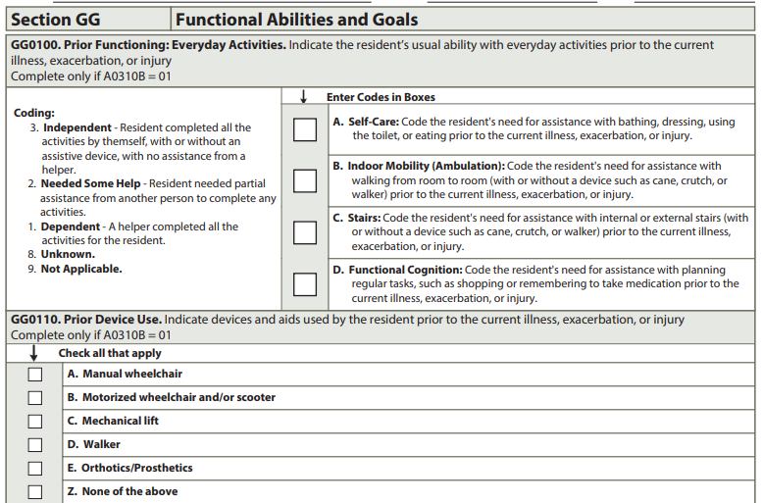
Notes:
Animation;
The information required in section GG0100 prior functioning is only completed for Medicare 5-day and managed care as directed by the contract.
The MDS has added coding tips to assist in completing the assessment. For example, when assessing for the ability to go up and down stairs, a ramp is not considered stairs.
Completing the stair activity for GG0100C indicates that a resident went up and down the stairs, by any safe means, with or without handrails or assistive devices or equipment (such as a cane, crutch, walker, or stair lift) and/or with or without some level of assistance. • Going up and down a ramp is not considered going up and down stairs for coding GG0100C. Examples for Coding Check all prior devices used before the current admission.

Slide 26
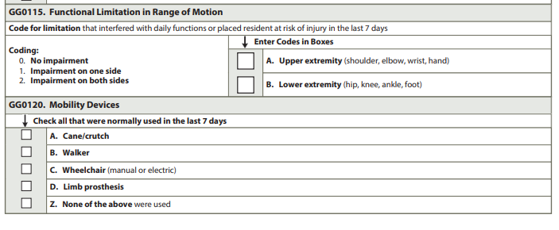
Functional Limitations in ROM
Provide training for individuals completing this assessment
Identify limitations that interfere with daily functions or place the individual at risk for injury
Item sets: 5-day- Comprehensive and Quarterly
Do not look at limited ROM in isolation
Notes:
Additional instructions are provided for functional limitations in assessing Range of motion
Review the medical record for references to functional range-of-motion limitation during the 7-day observation period. 2. Talk with staff members who work with the resident as well as family/significant others about any impairment in functional ROM. 3. Coding for functional ROM limitations is a three-step process: • Test the resident’s upper and lower extremity ROM (See item 6 below for examples). • If the resident is noted to have limitation of upper- and/or lower-extremity ROM, review GG0130 and GG0170 and/or directly observe the resident to determine whether the limitation interferes with function or places the resident at risk for injury. • Code GG0115A and GG0115B as appropriate based on the above assessment. 4. Assess the resident’s ROM bilaterally at the shoulder, elbow, wrist, hand, hip, knee, ankle, foot, and other joints unless contraindicated (e.g., recent fracture, joint replacement or pain). 5. Staff member observations of various activities, including ADLs, may be used to determine whether any ROM limitations have an impact on the resident’s functional abilities. 6. Although this item codes for the presence or absence of functional limitation related to ROM, thorough assessment ought to be comprehensive and follow standards of practice for evaluating ROM impairment. Below are some suggested assessment strategies: • Ask the resident to follow your verbal instructions for each movement. • Demonstrate each movement (e.g., ask the resident to do what you are doing). • Actively assist the resident with the movements by supporting their extremity and guiding it through the joint ROM

Slide 27
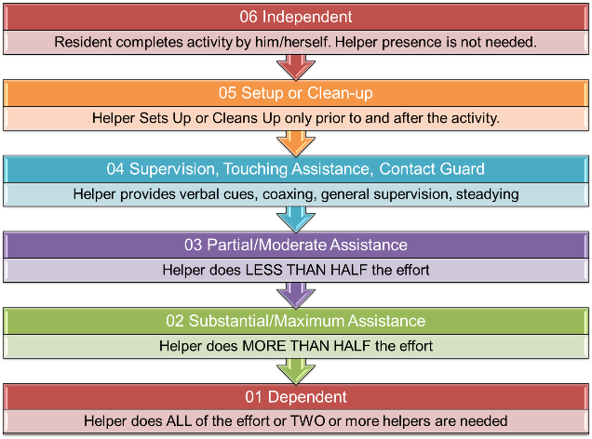
Coding for Safety and Quality of Performance
Notes:
Next I am going to discuss some additional coding clarification.
The terms independent and set-up clean up have no changes in the definition or clarification of the notes.
Supervision includes touching assistance, steadying or contact guard.
Additional clarification notes that Code 04, Supervision or touching assistance: if the resident requires only verbal cueing to complete the activity safely
Partial/moderate assistance remains the same, substantial to maximum assistance is unchanged,
Dependent has additional clarifications with include two statements:
Code 01, Dependent: if two helpers are required for the safe completion of an activity, even if the second helper provides supervision/stand-by assist only and does not end up needing to provide hands-on assistance.
Code 01, Dependent: if a resident requires the assistance of two helpers to complete an activity (one to provide support to the resident and a second to manage the necessary equipment to allow the activity to be completed).

Slide 28
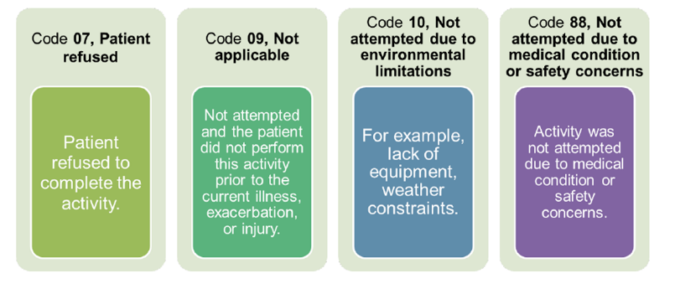
Activity Was Not Attempted Coding
Notes:
The definitions and descriptions remain unchanged. Make sure that each of the individuals completing this section do so correctly.

Slide 29
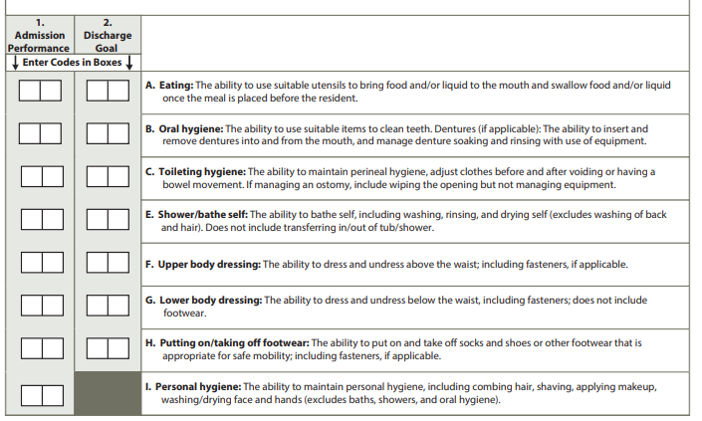
GG 0130 Self-Care
Notes:
Admission and discharge performance in section GG Additional clarification on the completion of an admission assessment for an OBRA stay. Now it is important to not that this is the admission assessment.
The admission assessment period for residents who are not in a Medicare Part A stay is the first 3 days of their stay starting with the date in A1600, Entry Date. • Note: If A0310B = 01 and A0310A = 01 – 06 indicating a 5-day PPS assessment combined with an OBRA assessment, the assessment period is the first 3 days of the stay beginning on A2400B and both columns are required. In these scenarios, do not complete Column 5. OBRA/Interim Performance
Unless your state requires discharge goals, the completion of discharge goals are only applicable for Medicare A and if stated managed care.
An additional self care item is added and this is personal hygiene: And this task is defined as Personal hygiene involves the ability to maintain personal hygiene, including combing hair, shaving, applying makeup, and washing and drying face and hands (excludes baths, showers, and oral hygiene.

Slide 30

Coding Tips: GG0130 Self Care
Assistance with tube feedings or parenteral nutrition is not considered when coding the item Eating.
Require assistance to swallow safely, code based on the type and amount of assistance required for feeding and safe swallowing.
If a resident swallows safely without assistance, exclude swallowing from consideration
If the resident eats finger foods using their hands, then code upon the amount of assistance provided.
Notes:
Assistance with tube feedings or parenteral nutrition is not considered when coding the item Eating. • If a resident requires assistance (e.g., supervision or cueing) to swallow safely, code based on the type and amount of assistance required for feeding and safe swallowing. • If a resident swallows safely without assistance, exclude swallowing from consideration when coding G
If the resident eats finger foods using their hands, then code Eating based upon the amount of assistance provided. If the resident eats finger foods with their hands independently, for example, the resident would be coded as 06, Independent. • For a resident taking only fluids by mouth, the item may be coded based on ability to bring liquid to the mouth and swallow liquid, once the drink is placed in front of the resident

Slide 31

Coding Tips: Oral Hygiene
If a resident does not perform oral hygiene during therapy, determine the resident’s abilities based on performance on the nursing care unit.
For a resident who is edentulous, code based on the type and amount of assistance required from a helper to clean the resident’s gums.
Notes:
Read the slide

Slide 32

Toileting Hygiene
Three task included in toileting hygiene
Performing perineal hygiene.
Managing clothing (including undergarments and incontinence products, such as incontinence briefs or pads) before and after voiding or having a bowel movement.
Adjusting clothing relevant to the individual resident
Notes:
When the resident requires different levels of assistance to perform toileting hygiene after voiding versus after a bowel movement, code based on the type and amount of assistance required to complete the ENTIRE activity. • If a resident manages an ostomy, toileting hygiene includes wiping the opening of the ostomy or colostomy bag, but not management of the equipment. • If a resident has an indwelling catheter, toileting hygiene includes perineal hygiene to the indwelling catheter site, but not management of the equipment. o For example, if the resident has an indwelling urinary catheter and has bowel movements, code Toileting hygiene based on the type and amount of assistance needed by the resident before and after moving their bowels. This may include the need to perform perineal hygiene to the indwelling urinary catheter site after the bowel movement

Slide 33

Mobility: Sit to Stand
If a standing lift is used and two helpers are needed to assist with the sit-to-stand lift, then code as 01, Dependent.
A full-body mechanical lift is used to assist in transferring a resident for a chair/bed-to-chair transfer, code “activity not attempted”
Notes:
The activity includes the resident coming to a standing position from any sitting surface. • If a sit-to-stand (stand assist) lift is used and two helpers are needed to assist with the sit-to-stand lift, then code as 01, Dependent. • If a full-body mechanical lift is used to assist in transferring a resident for a chair/bed-to-chair transfer, code GG0170D, Sit to stand with the appropriate “activity not attempted” code. • Code as 05, Setup or clean-up assistance, if the only help a resident requires to complete the sit-to-stand activity is for a helper to retrieve an assistive device or adaptive equipment, such as a walker or ankle-foot orthosis.

Slide 34

Chair/Bed to Chair Transfer
Begins with sitting on the edge of bed and ends with resident sitting in a wheelchair.
Include alternate sleeping furniture including a recliner.
Transfers may include stand-pivot, squat-pivot, or a slide board
When possible, the transfer should be assessed in an environmental situation in which taking more than a few steps would not be necessary to complete the transfer.
Notes:
When assessing the resident moving from the chair/bed to the chair, the assessment begins with the resident sitting at the edge of the bed (or alternative sleeping surface) and ends with the resident sitting in a chair or wheelchair.
o When assessing the resident moving from the chair to the bed, the assessment begins with the resident sitting in a chair or wheelchair and ends with the resident returning to sitting at the edge of the bed (or alternative sleeping surface).,
o The activities of GG0170B, Sit to lying and GG0170C, Lying to sitting on side of bed, are two separate activities that are not assessed as part of GG0170E

Slide 35

Toilet Transfer
Toilet transfer includes the resident’s ability to get on and off a toilet (with or without a raised toilet seat) or bedside commode
Code as 05, Setup or clean-up assistance, if the resident requires a helper to position/set up the bedside commode before and/or after the resident’s bed-to-commode transfers (place at an accessible angle/location next to the bed) and the resident does not require helper assistance during Toilet transfers.
Notes:
Review with Team

Slide 36

Walking
Do not count while in the parallel bars
Activity does not have to occur during one session
Can allow a resident to rest between activities
Can complete activity at different times during the day or on different days may facilitate completion of the activity
Notes:
Assessment of the walking activities starts with the resident in a standing position.
• A walking activity cannot be completed without some level of resident participation that allows resident ambulation to occur for the entire stated distance. A helper cannot complete a walking activity for a resident.
• During a walking activity, a resident may take a brief standing rest break. If the resident needs to sit to rest during a Section GG walking activity, consider the resident unable to complete the walking activity and use the appropriate activity not attempted code.
• Clinicians can use clinical judgment to determine how the actual resident assessment of walking is conducted. If a clinician chooses to combine the assessment of multiple walking activities, the clinician should use clinical judgment to determine the type and amount of assistance needed for each individual activity.
• Use clinical judgment when assessing activities that overlap or occur sequentially to determine the type and amount of assistance needed for each individual activity

Slide 37
MDS Section Updates
Additional Section Changes
Notes:
Let's continue with the other sections …

Slide 38
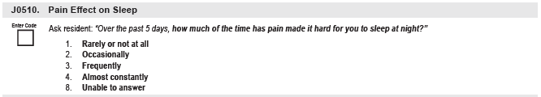
Pain Interview
Read the question and response choices exactly as they are written.
No predetermined definitions are offered to the resident. The resident’s response should be based on their interpretation of frequency response options.
If the resident’s response does not lead to a clear answer, repeat the resident’s response and then try to narrow the focus of the response.
For example, if the resident responded to the question, “Over the past 5 days, how much of the time has pain made it hard for you to sleep at night?” by saying, “I always have trouble sleeping,” then the assessor might reply, “
You always have trouble sleeping. Is it your pain that makes it hard for you to sleep?” The assessor can then narrow down responses with additional follow-up questions about the frequency
Notes:
The effects of unrelieved pain impact the individual in terms of functional decline, complications of immobility, skin breakdown and infections.
•Pain significantly adversely affects a person’s quality of life and is tightly linked to depression, diminished self-confidence and self-esteem, as well as an increase in behavior problems, particularly for cognitively impaired residents.
•Some older adults limit their activities in order to avoid having pain. Their report of lower pain frequency may reflect their avoidance of activity more than it reflects adequate pain management.
•This item should be coded based on the resident’s interpretation of the provided response options for frequency. If the resident is unable to decide between two options, then the assessor should code for the option with the higher frequency.
•If the resident reports they had pain over the past 5 days and the pain does not interfere with their sleep (e.g., because the resident is using pain management strategies successfully), code 1, Rarely or not at all.

Slide 39
J0520: Pain Interference with Therapy Activities
This item should be coded based on the resident’s interpretation of the provided response options for frequency. If the resident is unable to decide between two options, then the assessor should code for the option with the higher frequency.
Rehabilitation therapies may include treatment supervised in person by a therapist or nurse or other staff or the resident carrying out a prescribed therapy program without staff members present.
Notes:
REHABILITATION
THERAPY
Special healthcare services or programs that help a person regain physical, mental, and/or cognitive (thinking and learning) abilities that have been lost or impaired as a result of disease, injury, or treatment. Can include, for example, physical therapy, occupational therapy, speech therapy, and cardiac and pulmonary therapies

Slide 40
J0530: Pain Interference with Day-Day Activities
This item should be coded based on the resident’s interpretation of the provided response options for frequency.
If the resident is unable to decide between two options, then the assessor should code for the option with the higher frequency.
Notes:
Review with Team

Slide 41
Next Steps – Implementation
Review policy and procedures
Designate an individual to complete the interview
Secure tools or methods to interview residents in which English is a second language
Review and update the cue cards
Make sure that the plan of care is up to date.
Always listen to the resident, this is an interview.
Monitor sleep patterns for pain
Notes:
Review with team and determine roles/responsibilities.
Discuss challenges and opportunities

Slide 42
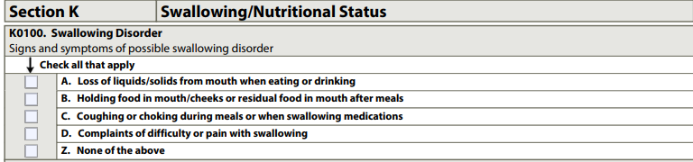
Section K
IMPACTS REIMBURSEMENT- PDPM (SLP)
Notes:
The items in this section are intended to assess the many conditions that could affect the resident’s ability to maintain adequate nutrition and hydration. This section covers swallowing disorders, height and weight, weight loss, and nutritional approaches. The assessor should collaborate with the dietitian and dietary staff to ensure that items in this section have been assessed and calculated accurately.

Slide 43
Review the Medical Record
Persistent sore throat
Hoarseness
Shortness of breath
Chest pain or discomfort
Trouble forming food and liquid into a soft ball (bolus) in the mouth
A need for extra time to chew or move food or liquid in the mouth
Trouble pushing food or liquid to the back of the mouth
Reflux or heartburn sensations
Vomiting
Notes:
The term dysphagia refers to difficulty swallowing. It is used regarding a variety of swallowing disorders.
Not all swallowing problems are dysphagia — it is normal to have occasional difficulty swallowing certain foods or liquids, such as when taking large bites of food. However, ongoing difficulty swallowing could be a cause for concern and any hospital consults during the look back period. Remember there are three types of dysphagia,
Oral dysphagia — when the problem is in the mouth, usually due to the movement of the tongue
Pharyngeal or oropharyngeal dysphagia — when the problem is regarding food passing through the throat
Esophageal dysphagia — when food is unable to move down through the esophagus
Symptoms include: READ the SLIDE

Slide 44
Section K 0100 Steps for Assessment
Ask the resident if they have had any difficulty swallowing during the 7-day look-back period.
Observe the resident during meals or at other times when they are eating, drinking, or swallowing to determine whether any of the listed symptoms of possible swallowing disorder are exhibited.
Interview staff members on all shifts who work with the resident and ask if any of the four listed symptoms were evident during the 7-day look-back period.
Review the medical record, including nursing, physician, dietician, and speech language pathologist notes, and any available information on dental history or problems.
Dental problems may include poor fitting dentures, dental caries, edentulous, mouth sores, tumors and/or pain with food consumption
Notes:
Key Point - The key here is to make sure that the information is completed within the 7 day look back and these items also collaborate with the nursing staff and nursing assistants.
In addition, the nutritionist should complete direct observation of the resident.
Documentation should include the information on direct observation.
The goal is to make sure the residents to ability to swallow safely Alterations in the ability to swallow can result in choking and aspiration, which can increase the resident’s risk for malnutrition, dehydration, and aspiration pneumonia, weight loss, isolation, and some resident may even avoid activities for fear of choking or coughing during an event.

Slide 45
Resident Centered Care Plan
Interventions may include
SLP
Muscle re-education
Positioning
Food consistency modification
Breathing techniques
Notes:
Care planning should include provisions for monitoring the resident during mealtimes and during functions/activities that include the consumption of food and liquids.
• When necessary, the resident should be evaluated by the physician, speech language pathologist and/or occupational therapist to assess for any need for swallowing therapy and/or to provide recommendations regarding the consistency of food and liquids.
• Assess for signs and symptoms that suggest a swallowing disorder that has not been successfully treated or managed with diet modifications or other interventions (e.g., tube feeding, double swallow, turning head to swallow, etc.) and therefore represents a functional problem for the resident.
• Care plan should be developed to assist resident to maintain safe and effective swallow using compensatory techniques, alteration in diet consistency, and positioning during and following meals

Slide 46

Section M: Pressure Ulcer/Injury
Skin changes at the end of life (SCALE), also referred to as Kennedy Terminal Ulcers (KTUs) and skin failure, are not primarily caused by pressure and are not coded in Section M.
If a resident has a pressure ulcer/injury that was documented on admission then closed that reopens at the same stage (i.e., not a higher stage), the ulcer/injury is coded as “present on admission
Notes:
Read the content of the slide. Before this clarification, Kennedy Ulcers were not addressed
The key point is that the Kennedy Ulcer is no longer considered a pressure injury. .

Slide 47
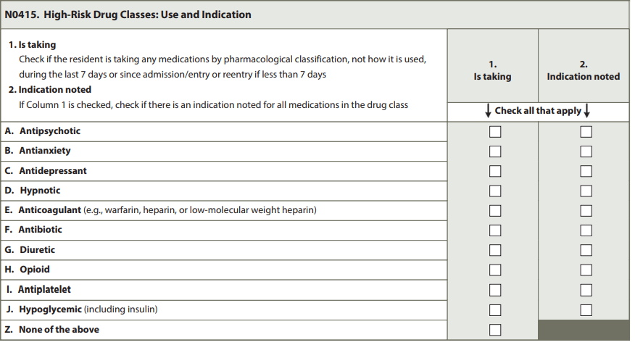
Section N - Medications
Draft MDS3.0 NC Item Set v1.18.11 Oct2023.pdf
Notes:
Two medication sections have been added.
The first is an Antipsychotic Medication Review. Including this information will assist facilities to evaluate the use and management of these medications. Each aspect of antipsychotic medication use and management has important associations with the quality of life and quality of care of residents receiving these medications.
Column 1: Check if the resident is taking any medications by pharmacological classification during the 7-day observation period (or since admission/entry or reentry if less than 7 days). o Column 2: If Column 1 is checked, check if there is an indication noted for all medications in the drug class
Column 1: Check if the resident is taking any medications by pharmacological classification during the 7-day observation period (or since admission/entry or reentry if less than 7 days). o Column 2: If Column 1 is checked, check if there is an indication noted for all medications in the drug class
(Medications Received) has been eliminated and is being replaced with Section N0415 (High Risk Drug Classes: Use and Indication). The updated version expands the medication list to include antiplatelets and hypoglycemics including insulin. The updated version expands the medication list to include antiplatelets and hypoglycemics including insulin. Also, the new section adds a column titled “indication noted.”

Slide 48
F 758 “ Indication”
Anti-psychotic
Anti-depressant
Anti-anxiety
Hypnotic
Antihistamines
Anti-cholinergic
Central nervous system agents
Notes:
REMINDER - Psychotropic Medications and Antipsychotic Medications (F758 Only Guidance)
In accordance with §483.45(d)(4) and as clarified in the section above on Indication for Use, residents must not receive any medications which are not clinically indicated to treat a specific condition. The medical record must show documentation of the diagnosed condition for which a psychotropic medication is prescribed (§483.45(e)(1)). All medications included in the psychotropic medication definition may affect brain activities associated with mental processes and behavior. Use of psychotropic medications, other than antipsychotics, should not increase when efforts to decrease antipsychotic medications are being implemented. Risks associated with psychotropic medications still exist regardless of the indication for their use (e.g., nausea, insomnia, itching), therefore the requirements pertaining to psychotropic medications in §483.45(e) apply to the four categories of drugs (anti-psychotic, anti-depressant, anti-anxiety and hypnotic) listed in §483.45(c)(3) without exception

Slide 49
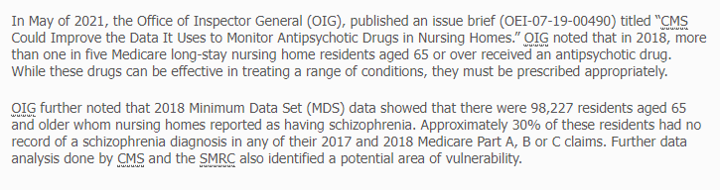
01-066 Schizophrenia in SNFs Notification of Medical Review - Noridian - SMRC (noridiansmrc.com)
Notes:
Concerns related to inappropriate prescribing of psychotropic medications may require referrals by the facility and/or the survey team to State Medical Boards or Boards of Nursing.
CMS is aware of situations where practitioners have potentially misdiagnosed residents with a condition for which antipsychotics are an approved use (e.g., new diagnosis of schizophrenia) which would then exclude the resident from the long-stay antipsychotic quality measure.

Slide 50

Diagnosis Codes
F 20 Paranoid schizophrenia
F20.2 Disorganized schizophrenia
F20.2 Catatonic schizophrenia
F20.3 Undifferentiated schizophrenia
F20.5 Residual schizophrenia
F20.9 Schizophrenia, unspecified
Notes:
This is the focus for is to review the resident diagnosis related to the use of antipsychotic medications and specific diagnosis.

Slide 51
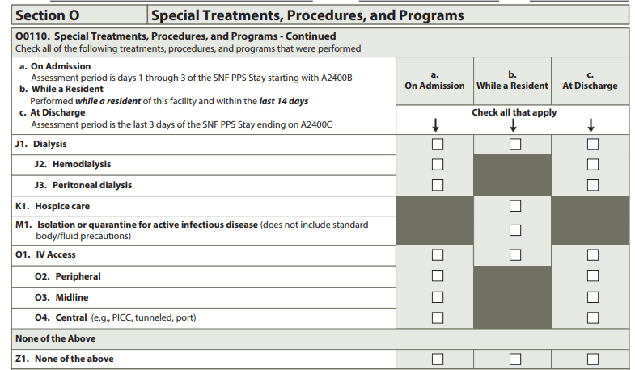
Facilities may code treatments, programs and procedures that the resident performed themselves independently or after set-up by facility staff. Do not code services that were provided solely in conjunction with a surgical procedure or diagnostic procedure, such as IV medications or ventilators. Surgical procedures include routine pre- and post-operative procedures.
Notes:
Facilities may code treatments, programs and procedures that the resident performed themselves independently or after set-up by facility staff. Do not code services that were provided solely in conjunction with a surgical procedure or diagnostic procedure, such as IV medications or ventilators. Surgical procedures include routine pre- and post-operative procedures.
The key changes in this assessment include
Coding Instructions for Column a. On Admission Check all treatments, procedures, and programs received by, performed on, or participated in by the resident on days 1–3 of the SNF PPS Stay starting with A2400B. If no treatments, procedures, or programs were received or performed in the 3-day assessment period, check Z, None of the above. Coding Instructions for Column b. While a Resident Check all treatments, procedures, and programs that the resident received or performed after admission/entry or reentry to the facility and within the last 14 days. If no treatments, procedures or programs were received by, performed on, or participated in by the resident within the last 14 days or since admission/entry or reentry, check Z, None of the above. Coding Instructions for Column c. At Discharge Check all treatments, procedures, and programs received by, performed on, or participated in by the resident in the last 3 days of the SNF PPS Stay ending with A2400C. If no treatments, procedures or programs were received by, performed on, or participated in by the resident in the 3-day assessment period, check Z, None of the above

Slide 52
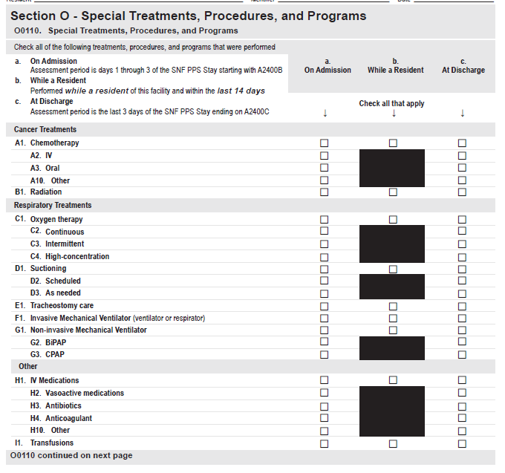
Section O0110:Chemotherapy
O0110A2, IV
Check if chemotherapy was administered intravenously.
O0110A3, Oral
Check if chemotherapy was administered orally (e.g., pills, capsules, or liquids the patient swallows). This sub-element also applies if the chemotherapy is administered through a feeding tube/PEG (i.e., enterally).
O0110A10
Other Check if chemotherapy was given in a way other than intravenously or orally (e.g., intramuscular, intraventricular/intrathecal, intraperitoneal, or topical routes).
Notes:
Read the slide

Slide 53
O011C1 Oxygen Therapy
Code continuous or intermittent oxygen administered via mask, cannula, etc., delivered to a resident to relieve hypoxia in this item.
Code oxygen used in Bi-level Positive Airway Pressure/Continuous Positive Airway Pressure (BiPAP/CPAP) here.
Do not code hyperbaric oxygen for wound therapy in this item.
This item may be coded if the resident places or removes their own oxygen mask, cannula.
Notes:
Read the Slide

Slide 54

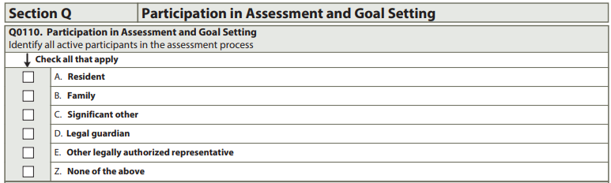
Section Q
New
Participation and Goal Setting
Notes:
Great progress has been made in this area. This progress allows individuals more choices when it comes to care options and available support options to meet care preferences and needs in the least restrictive setting possible. This progress resulted from the 1999 U.S. Supreme Court decision in Olmstead v. L.C., which states that residents needing long term services and supports have a civil right to receive services in the least restrictive and most integrated setting appropriate to their needs.
In addition, there is a focus on active discharge planning DEFINITION ACTIVE DISCHARGE PLANNING An active discharge plan means a plan that is being currently implemented. In other words, the resident’s care plan has current goals to make specific arrangements for discharge, staff are taking active steps to accomplish discharge, and there is a target discharge date for the near future. If there is not an active discharge plan, residents should be asked if they want to talk to someone about community living (Q0500B) and then referred to the LCA accordingly. Furthermore, referrals to the LCA are recommended as part of many residents’ discharge plans. Such referrals are a helpful source of information for residents and facilities in informing the discharge planning process.

Slide 55
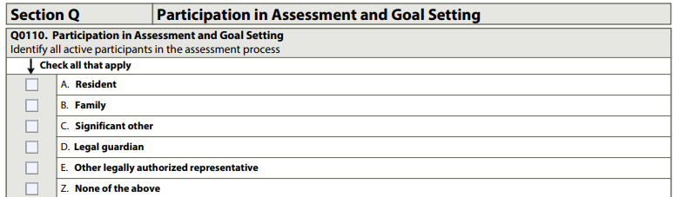
Section Q: Participation in Goal Setting
This progress allows individuals more choices when it comes to care options and available support options to meet care preferences and needs in the least restrictive setting possible.
Notes:
Intent: Interviewing the resident or designated individuals places the resident or their family at the center of decision-making. The items in this section are intended to record the participation and expectations of the resident, family members, or significant other(s) in the assessment, and to understand the resident’s overall goals. Discharge planning follow-up is already a regulatory requirement (CFR 483.21(c)(1)). Section Q of the MDS uses a person-centered approach to ensure that all individuals have the opportunity to learn about home- and community-based services and to receive long term care in the least restrictive setting possible. This may not be a nursing home. This is also a civil right for all resident

Slide 56
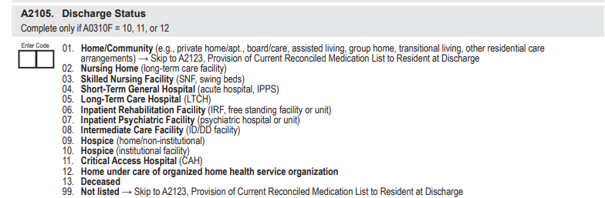
A 2105 Discharge Status
Notes:
This item documents the location to which the resident is being discharged at the time of discharge. Knowing the setting to which the individual was discharged helps to inform discharge planning. See the Glossary and Common Acronyms in Appendix A for additional descriptions of these settings

Slide 57
Q0310A Active Discharge Planning
ACTIVE DISCHARGE PLANNING An active discharge plan means a plan that is being currently implemented. In other words, the resident’s care plan has current goals to make specific arrangements for discharge, staff are taking active steps to accomplish discharge, and there is a target discharge date for the near future.
If there is not an active discharge plan, residents should be asked if they want to talk to someone about community living (Q0500B) and then referred to the LCA accordingly.
Furthermore, referrals to the LCA are recommended as part of many residents’ discharge plans.
Such referrals are a helpful source of information for residents and facilities in informing the discharge planning process.
Notes:
During the care planning meetings, the resident should be made comfortable and verbal communication should be directly with them.
• Residents should be asked about inviting family members, significant others, and/or guardian/legally authorized representatives to participate, and if they desire that they be involved in the assessment process.
• If the individual resident is unable to understand the process, their family member, significant other, and/or guardian/legally authorized representative, who represents the individual, should be invited to attend the assessment process whenever possible.
• When the resident is unable to participate in the assessment process, a family member or significant other, and/or guardian or legally authorized representatives can provide information about the resident’s needs, goals, and priorities on the resident’s behalf

Slide 58
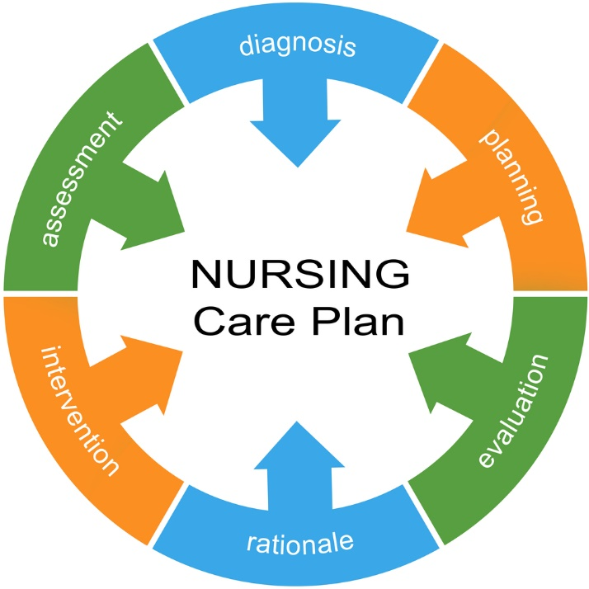
Care Area Assessment- Care Plan
1.Assisting the resident in achieving their goals.
2. Individualized interventions that honor the resident’s preferences.
3. Addressing ways to try to preserve and build upon resident strengths.
4. Preventing avoidable declines in functioning or functional levels or otherwise clarifying why another goal takes precedence (e.g., palliative approaches in end of life situation).
5. Managing risk factors to the extent possible or indicating the limits of such interventions.
6. Applying current standards of practice in the care planning process.
7. Evaluating treatment of measurable objectives, timetables and outcomes of care.
Notes:
Review the slide with the team

Slide 59
Care Area Assessment- Care Plan
8. Respecting the resident’s right to decline treatment.
9. Offering alternative treatments, as applicable
10. Using an interdisciplinary approach to care plan development to improve the resident’s abilities. 11. Involving resident, resident’s family and other resident representatives as appropriate.
12. Assessing and planning for care to meet the resident’s goals, preferences, and medical, nursing, mental and psychosocial needs.
13. Involving direct care staff with the care planning process relating to the resident’s preferences, needs, and expected outcomes
Notes:
Individual choices related to returning to community living will vary, e.g., returning to a former home or a different community home, or, the individual may choose to stay in the nursing home.
The discharge assessment process requires nursing home staff to apply a systematic and objective protocol so that every individual has the opportunity to access meaningful information about community living options and community service alternatives, with the goal being to assist the individual in maintaining or achieving the highest level of functioning and integration possible.
This includes ensuring that the individual or surrogate is fully informed and involved, identifying individual strengths, assessing risk factors, implementing a comprehensive plan of care, coordinating interdisciplinary care providers, fostering independent functioning, and using rehabilitation programs and community referrals

Slide 60
Next Steps
Prepare – Plan – Implement

Slide 61

Preparation - Organizational Strategies
Begin Now
Review your current process
Keep abreast of any changes to the EMR.
Seamless transition from acute care to SNF.
Notes:
Read the slide

Slide 62

Plan and Implement - Transition Plan
Budget for additional staff training
Interdepartmental training
Develop an action plan
Schedule training
Monitor Outcomes
Notes:
Please consider providing opportunities for the IDT team to receive education. CMS is offering training on the changes, develop an onboarding program to ensure standardization in completing the required documents.
Education utilizing the teach back method or hear see and do. Understand that we have staff in which English is a second language. Be aware that some of the verbiage in section GG may be challenging.

Slide 63

Remember…
Accuracy of GG
Multidisciplinary and Interdisciplinary Approach
ICD-10 Coding
Notes:
Develop an action plan and make decisions on who is best suited to complete the each section, GG, requires a multidisciplinary approach. And 2023 will bring about additions to the ICD 10 CODES.

Slide 64

Questions

Slide 65
References
Centers for Medicare and Medicaid Services. (10-1-2022). State Operations Manual Appendix PP - Guidance to Surveyors for Long Term Care Facilities. SOM - Appendix PP (cms.gov)
Centers for Medicare and Medicaid Services. (2023) Nursing Homes | CMS
Centers for Medicare and Medicaid Services.(2023) The Skilled Nursing Facility Value-Based Purchasing (SNF VBP) Program. The Skilled Nursing Facility Value-Based Purchasing (SNF VBP) Program | CMS
Centers for Medicare and Medicaid Services. (2023) Draft MDS 3.0 Item Sets v1.18.11. Minimum Data Set (MDS) 3.0 Resident Assessment Instrument (RAI) Manual | CMS

Slide 66
Disclaimer
“This presentation provided is copyrighted information of Pathway Health. Please note the presentation date on the title page in relation to the need to verify any new updates and resources that were listed in this presentation. This presentation is intended to be informational. The information does not constitute either legal or professional consultation. This presentation is not to be sold or reused without written authorization.”

