Slide 1

Test
MDS 3.0 Section GG
Direct Care Staff Training
Test
July 2023
Notes:
Welcome to today’s session on Section GG of the MDS. We will be discussing the components of Section GG, why this information is important and your role in order to complete this information accurately and timely.

Slide 2
Objectives
Examine steps to capture the residents' functional abilities accurately.
Review each GG item to capture functional abilities
Discuss strategies for managing the MDS under the new RAI guidelines.
Notes:
Today’s education includes items about functional abilities and goals. It includes items focused on prior function, admission and discharge performance, discharge goals, performance throughout a resident’s stay, mobility device use, and range of motion. Functional status is assessed based on the need for assistance when performing self-care and mobility activities.. The MDS manual is an excellent resource on developing a plan to ensure the resident’s functional abilities are captured accurately.

Slide 3

It Takes a Team for Section GG
Notes:
Section GG is important, it affects reimbursement for Medicare, Medicaid, Managed care and Private pay. Additionally, Section GG plays a significant role in the SNF quality reporting program. At this time, there is a proposal that SNF must meet no less than 90% to receive the APU or annual payment update.
The discussion today is to focus around making sure the IDT team is trained and has the ability to capture the care and services provided.

Slide 4
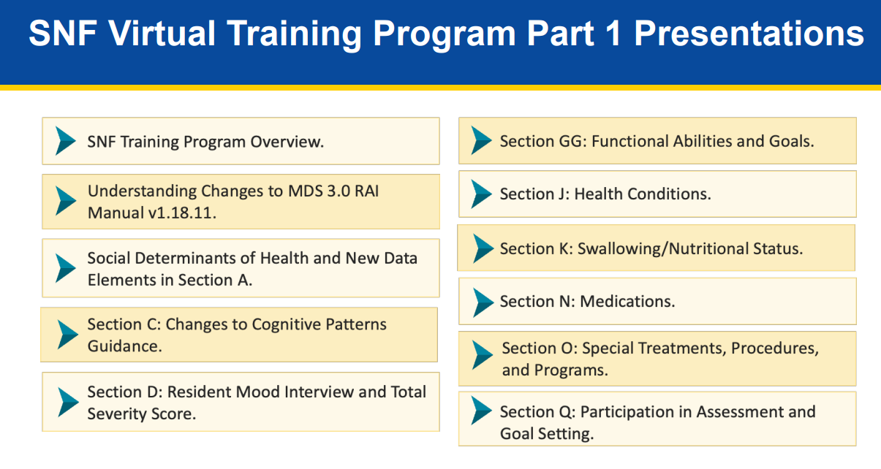
Notes:
The goal is to understand the individuals receiving the training and determine the ability to comprehend the scenarios and code correctly.
Section GG is as important as section G. Some states have been gathering data for the PDPM transition for the past 2 years. The overall importance should never be overshadowed. CMS provided excellent resources that we should utilize before the transition.

Slide 5
Step for Assessment: Establishing ARD
The admission assessment period for residents who are not in a Medicare Part A stay is the first 3 days of their stay starting with the date in A1600. Entry Date.
Sunday | Monday | Tuesday | Wednesday | Thursday | Friday | Saturday
Day 1
Day 2
Day 3
5 - day Prospective Payment System (PPS) assessment combined with an OBRA assessment, the assessment period is the first 3 days of the stay beginning on A2400B and both columns are required.
Notes:
For residents in a Medicare Part A stay, the admission assessment period is the first 3 days of the Part A stay starting with the date in A2400B. Start of Most Recent Medicare Stay. The admission assessment period for residents who are not in a Medicare Part A stay is the first 3 days of their stay starting with the date in A1600. Entry Date. − Note: If A0310B = 01 and A0310A = 01 – 06, indicating a 5 - day Prospective Payment System (PPS) assessment combined with an OBRA assessment, the assessment period is the first 3 days of the stay beginning on A2400B and both columns are required.

Slide 6
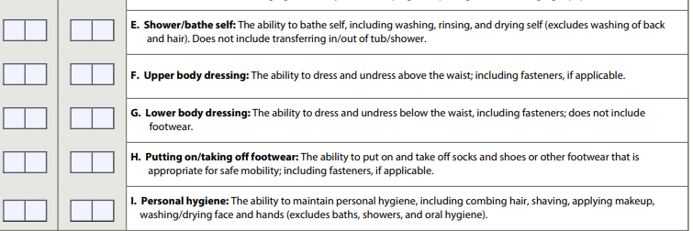
Overview of Changes: GG0130
Notes:
Personal hygiene integrated into GG0130 as GG0130I.
Tub/Shower transfer added as GG0170FF.
Omnibus Budget Reconciliation Act (OBRA) assessments focus is on health - related quality of life, planning for care, and some definitions from old Section G data element G0110.
Activities of Daily Living Assistance were added to GG0130. This will not be used in the calculation of PDPM at this point in time. The new and revised guidance to improve clarity.

Slide 7
Prior Functioning: Medicare A
Notes:
GG0100: Steps for Assessment is utilized to complete Medicare Part A 5-day MDS
Indicate resident’s Usual ability with everyday activities prior to the current illness, exacerbation, or injury
Ask the resident or his/her family about his/her prior functioning with everyday activities
Review the resident’s medical records describing the resident’s prior functioning with everyday activities. And remember to access the RAI manual for further clarification.

Slide 8
9
Larry had a stroke one year ago that resulted in their using a wheelchair to self-mobilize, as they were unable to walk.
3. Independent
2. Needed some help
1. Dependent
8. Unknown
9. Not applicable
Rationale-
The resident did not ambulate prior to the current illness or exacerbation
Notes:
Let's check our understanding on coding functional abilities
Example
Check your handout for the definitions:
Read the slide and click for the animation.

Slide 9

GG0100 Prior Function
Completing the stair activity for GG0100C indicates that a resident went up and down the stairs, by any safe means, with or without handrails or assistive devices or equipment (such as a cane, crutch, walker, or stair lift) and/or with or without some level of assistance.
Going up and down a ramp is not considered going up and down stairs
Notes:
Discuss from example –
Coding Tip: Read the updated language for GG0100 prior functioning, and make sure that you interview the family and or resident on their level of functioning before admission to the Nursing Home.

Slide 10
1
Frank lived with wife in an Assisted Living and hospitalized for surgery . His wife said that he needed complete assistance with self-care activities, including eating,
bathing, dressing, and using the toilet
3. Independent
2. Needed some help
1. Dependent
8. Unknown
9. Not applicable
Rationale -
Dependent, his wife stated that he was dependent before surgery
Notes:
Lets check our understanding on coding functional abilities
Example (Use animations)
Check your handout for the definitions:
Read Scenario:
How would you code the self care activities

Slide 11
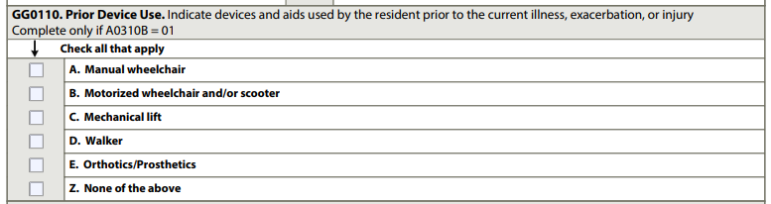
Prior Device Use: Medicare A
Notes:
For GG0110D, Prior Device Use - Walker: “Walker” refers to all types of walkers (for example, pickup walkers, hemi-walkers, rolling walkers, and platform walkers).
• GG0110C, Mechanical lift, includes sit-to-stand, stand assist, stair lift, and full-body style lifts. The goal is to check all that apply and indicate prior device use.
This item is utilized for the 5-day PPS Medicare A assessment.

Slide 12
X
X
Mark is a diabetic, obese and has had an amputation of the right lower leg. Mark uses an electric wheelchair to move around the home and
a walker to reach the shower every week.
Rationale:
Although the resident may not use a device every day, we need to code any devices that was used before the current illness, exacerbation or injury .
Notes:
Read the scenario and then instruct the class to check all that apply

Slide 13
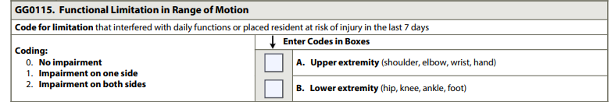
GG0115 Functional Limitation of
Range of Motion
Test the resident’s upper and lower extremity ROM
If the resident is noted to have limitation of upper- and/or lower-extremity ROM, review GG0130 and GG0170 and/or directly observe the resident to determine whether the limitation interferes with function or places the resident at risk for injury.
Code GG0115A and GG0115B as appropriate based on the above assessment
Notes:
Read the slide .
The RAI manual provides extensive instruction on how to complete the test of the resident function limitation of range of motion.
The best method to assess the resident is directly observe the resident and determine whether the limitation interferes with function or places at risk for injury.

Slide 14
Coding Scenario
The resident has a diagnosis of Parkinson’s and ambulates with a shuffling gait. The resident has had three falls in the past quarter and often forgets their walker, which they need to ambulate. They have tremors of both upper extremities that make it very difficult for them to feed themself, brush their teeth, or write
GG0115A- Coded 2 upper extremity
GG0115B- Coded 2 lower extremity
Notes:
This is an example of the impairment related to Parkinson’s disease, and the function limitations of both upper and lower extremities.
Please read the manual and make sure that there is a process on identifying any limitations. Delegate the IDT team member, make sure that the definitions are clearly defined and always You must determine whether the limited ROM has an impact on functional ability or places the resident at risk for injury. For example, if the resident has an amputation, it does not automatically mean that they are limited in function.

Slide 15

Section GG- Self Care and Mobility
Understand each definition
Ask probing questions to the staff and resident
Residents should be allowed to perform activities as independently as possible.
Score the amount of assistance provided
Helper is defined as facility staff
Notes:
When reviewing the medical record, interviewing staff, and observing the resident, be familiar with the definition for each activity (e.g., eating, oral hygiene).
For example, when assessing Eating (item GG0130A), determine the type and amount of assistance required to bring food and/or liquid to the mouth and swallow food and/or liquid once the meal is placed before the resident.

Slide 16
Section GG- Self Care and Mobility
Activities can be completed with or without an assistive device
Record the resident's usual ability, and don’t record the resident most independent performance
Do not record the resident’s most dependent performance
Refer to the Federal and State policies and procedures on which individuals can complete the assessment.
Notes:
If two or more helpers are required to assist the resident to complete the activity, code as 01, Dependent.
• To clarify your own understanding of the resident’s performance of an activity, ask probing questions to the care staff about the resident, beginning with the general and proceeding to the more specific.
See examples of probing questions at the end of this section.
• A dash (“-”) indicates “No information.” CMS expects dash use to be a rare occurrence.
• Documentation in the medical record is used to support assessment coding of Section GG.
Data entered should be consistent with the clinical assessment documentation in the resident’s medical record.
This assessment can be conducted by appropriate healthcare personnel as defined by facility policy and in accordance with State and Federal regulations.

Slide 17
Coding Instructions
Code 06, Independent: if the resident completes the activity by themself with no assistance from a helper.
Code 05, Setup or clean-up assistance: if the helper sets up or cleans up; resident completes activity. Helper assists only prior to or following the activity, but not during the activity. For example, the resident requires assistance cutting up food or opening container or requires setup of hygiene item(s) or assistive device(s).
Code 04, Supervision or touching assistance: if the helper provides verbal cues or touching/steadying/contact guard assistance as resident completes activity. Assistance may be provided throughout the activity or intermittently.
  For example, the resident requires verbal cueing, coaxing, or general supervision for safety to complete activity; or resident may require only incidental help such as contact guard or steadying assist during the activity.
  Code 04, Supervision or touching assistance: if the resident requires only verbal cueing to complete the activity safely.
Code 03, Partial/moderate assistance: if the helper does LESS THAN HALF the effort. Helper lifts, holds, or supports trunk or limbs, but provides less than half the effort.
Code 02, Substantial/maximal assistance: if the helper does MORE THAN HALF the effort. Helper lifts or holds trunk or limbs and provides more than half the effort
Notes:
Read the slide exactly as stated.
Highlight the information on 04 supervision: This was a clarification in the MDS manual.

Slide 18
Coding Instruction
Code 01, Dependent: if the helper does ALL of the effort. Resident does none of the effort to complete the activity; or the assistance of two or more helpers is required for the resident to complete the activity.
Code 01, Dependent: if two helpers are required for the safe completion of an activity, even if the second helper provides supervision/stand-by assist only and does not end up needing to provide hands-on assistance.
Code 01, Dependent: if a resident requires the assistance of two helpers to complete an activity (one to provide support to the resident and a second to manage the necessary equipment to allow the activity to be completed).
Code 07, Resident refused: if the resident refused to complete the activity.
Code 09, Not applicable: if the activity was not attempted and the resident did not perform this activity prior to the current illness, exacerbation, or injury.
Code 10, Not attempted due to environmental limitations: if the resident did not attempt this activity due to environmental limitations. Examples include lack of equipment and weather constraints
Code 88, Not attempted due to medical condition or safety concerns: if the activity was not attempted due to medical condition or safety concerns
Notes:
Read the slide.
This outlines additional clarification in the MDS manual include the coding of dependency.

Slide 19
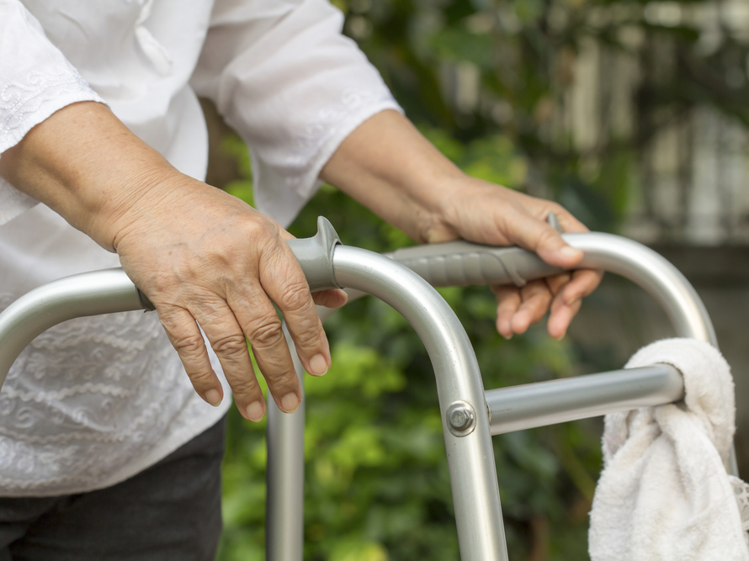
Usual Performance
Notes:
USUAL PERFORMANCE Review and Discuss with staff – give examples –
A resident’s functional status can be impacted by the environment or situations encountered at the facility. Observing the resident’s interactions with others in different locations and circumstances is important for a comprehensive understanding of the resident’s functional status. If the resident’s functional status varies, record the resident’s usual ability to perform each activity.
Do not record the resident’s best performance and do not record the resident’s worst performance, but rather record the resident’s usual performance.
QUALIFIED CLINICIAN Healthcare professionals practicing within their scope of practice and consistent with Federal, State, and local law and regulations
As stated in the MDS manual: Usual is described as
When coding the resident’s usual performance, “effort” refers to the type and amount of
assistance a helper provides in order for the activity to be completed. The six-point rating
scale definitions include the following types of assistance: setup/cleanup, touching
assistance, verbal cueing, and lifting assistance.
• Do not record the resident’s best performance, and do not record the resident’s worst
performance, but rather record the resident’s usual performance during the assessment
period.
• Code based on the resident’s performance. Do not record the staff’s assessment of the
resident’s potential capability to perform the activity.
• If the resident performs the activity more than once during the assessment period and the
resident’s performance varies, coding in Section GG should be based on the resident’s
“usual performance,” which is identified as the resident’s usual activity/performance for
any of the Self-Care or Mobility activities, not the most independent or dependent
performance over the assessment period.

Slide 20
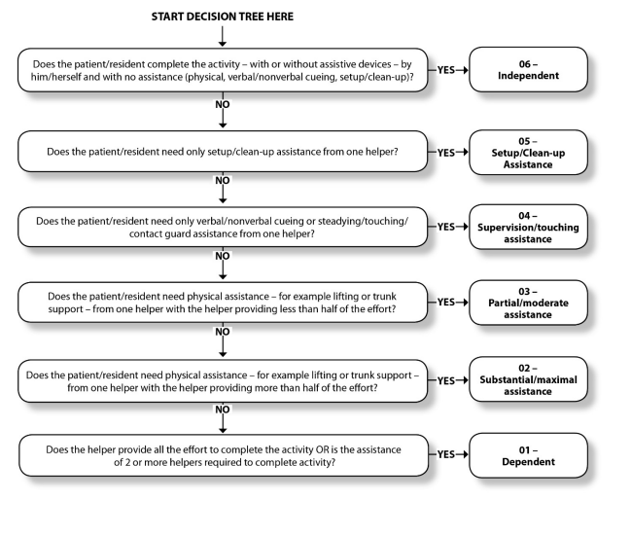
Decision Tree
MDS 3.0 RAI Manual v1.17.1_October 2019 (cms.gov)
Notes:
Decision Tree
Use this decision tree to code the resident’s performance on the assessment instrument.
If helper assistance is required because the resident’s performance is unsafe or of poor quality, score according to the amount of assistance provided.
Only use the “activity not attempted codes” if the activity did not occur; that is, the resident did not perform the activity and a helper did not perform that activity for the resident

Slide 21
Eating
Eating is to assess the resident’s ability to use suitable utensils to bring food and or liquids to mouth
The administration of tube feedings and parenteral nutrition is not considered when coding this activity.
If a resident requires assistance (e.g., supervision or cueing) to swallow safely, code based on the type and amount of assistance required for feeding and safe swallowing.
If the resident eats finger foods using their hands, code only on the amount of assistance
A resident taking only fluids by mouth, the item may be coded based on ability to bring liquid to the mouth and swallow liquid, once the drink is placed in front of the resident.
Notes:
Eating is a GG category that impacts many areas. Discuss with staff and give resident examples.
The intent of GG0130A, Eating is to assess the resident’s ability to use suitable utensils to bring food and/or liquid to the mouth and swallow food and/or liquid once the meal is placed before the resident.
The administration of tube feedings and parenteral nutrition is not considered when coding this activity.
The following is guidance for some situations in which a resident receives tube feedings or parenteral nutrition:
If the resident does not eat or drink by mouth and relies solely on nutrition and liquids through tube feedings or total parenteral nutrition (TPN) because of a new (recent-onset) medical condition, code GG0130A as 88, Not attempted due to medical condition or safety concerns.
If the resident does not eat or drink by mouth at the time of the assessment, and the resident did not eat or drink by mouth prior to the current illness, injury, or exacerbation, code GG0130A as 09, Not applicable - Not attempted and the resident did not perform this activity prior to the current illness, exacerbation, or injury.

Slide 22
Martha has generalized weakness and at the start of the meal, she can bring her food and liquids to her mouth. Martha tires easily and the nursing assistant must assist with more than half of the meal.
06 | Independent | 01 | Dependent
05 | Supervision | 07 | Refused
04 | Set up or clean up | 09 | Not applicable
03 | Partial-moderate | 10 | Not attempted
02 | Substantial-maximal | 88 | Not attempted due to medical condition
A: Substantial –maximal assistance
B. Partial-moderate assistance
C. Dependent
D. Set up or clean up
Rationale: Substantial to maximal assistance, the helper does more than 50% of the meal
Notes:
Read the slide and the rational : Animation

Slide 23
Mr. R has been living in long term care for 2 years. Last month he had a CVA and receives all nutrition through a gastrostomy tube, which is administered by the nurse
Dependent
B. 09 Not applicable
C. 88 Not attempted due to medical condition
D. Substantial-maximal
06 | Independent | 01 | Dependent
05 | Supervision | 07 | Refused
04 | Set up or clean up | 09 | Not applicable
03 | Partial-moderate | 10 | Not attempted
02 | Substantial-maximal | 88 | Not attempted due to medical condition
Rationale: The resident does not eat or drink by mouth currently due to their recent onset
stroke. This item includes eating and drinking by mouth only. Since eating and drinking did not occur due to their recent-onset medical condition
Notes:
Read the slide and animation

Slide 24
At night, the certified nursing assistant provides Resident K water and toothpaste to clean their dentures. Resident K cleans their upper denture plate. Resident K then cleans half of their lower denture plate, but states they are tired and unable to finish cleaning their lower denture plate. The certified nursing assistant finishes cleaning the lower denture plate and Resident K replaces the dentures in their mouth
06 | Independent | 01 | Dependent
05 | Supervision | 07 | Refused
04 | Set up or clean up | 09 | Not applicable
03 | Partial-moderate | 10 | Not attempted
02 | Substantial-maximal | 88 | Not attempted due to medical condition
A. Set up or clean up
B. Supervision
C. Substantial-maximal
D. Partial-moderate
Rationale - The helper provider less than half of the effort to complete oral hygiene
Notes:
Review and use animation
If a resident does not perform oral hygiene during therapy, determine the resident’s
abilities based on performance on the nursing care unit.
• For a resident who is edentulous, code Oral hygiene based on the type and amount of
assistance required from a helper to clean the resident’s gums.

Slide 25
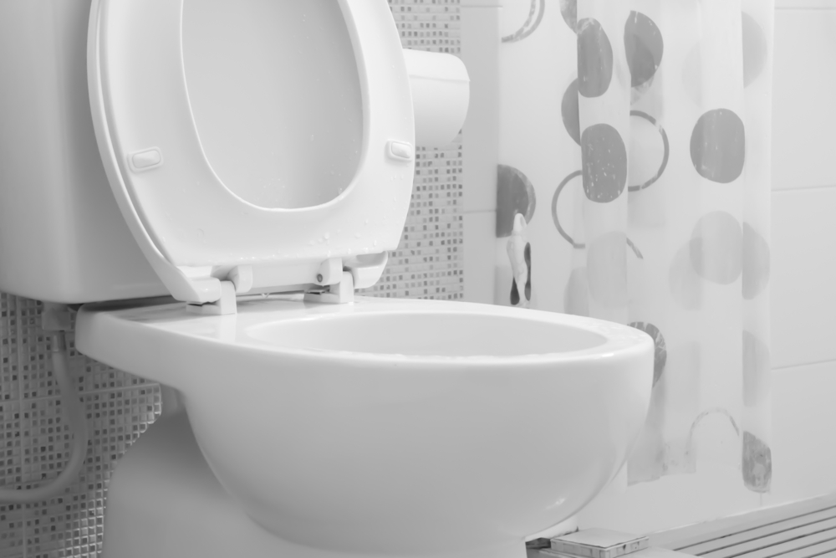
Toileting Hygiene
Managing perineal hygiene
Performing perineal hygiene
Managing clothing (including undergarments and incontinent products such as incontinent briefs or pads) before and after voiding or bowel movement.
Adjust clothing relevant to the resident
Notes:
Discuss – coding and examples below
Toileting hygiene (managing clothing and perineal cleansing) takes place before and
after use of the toilet, commode, bedpan, or urinal. If the resident completes a bowel
toileting program in bed, code the item Toileting hygiene based on the resident’s need for
assistance managing clothing and perineal cleansing.
• Includes:
o Performing perineal hygiene.
o Managing clothing (including undergarments and incontinence products, such as
incontinence briefs or pads) before and after voiding or having a bowel movement.
o Adjusting clothing relevant to the individual resident.
• If the resident has an indwelling urinary catheter and has bowel movements, code the
Toilet hygiene item based on the amount of assistance needed by the resident before and
after moving their bowels.
• When the resident requires different levels of assistance to perform toileting hygiene after
voiding versus after a bowel movement, code based on the type and amount of assistance
required to complete the ENTIRE activity.
• If a resident manages an ostomy, toileting hygiene includes wiping the opening of the
ostomy or colostomy bag, but not management of the equipment.
• If a resident has an indwelling catheter, toileting hygiene includes perineal hygiene to the
indwelling catheter site, but not management of the equipment.
o For example, if the resident has an indwelling urinary catheter and has bowel
movements, code Toileting hygiene based on the type and amount of assistance
needed by the resident before and after moving their bowels. This may include the
need to perform perineal hygiene to the indwelling urinary catheter site after the
bowel movement.
Examples for GG0130C, Toileting hygiene
1. Toileting hygiene: Resident J uses a bedside commode. The certified nursing assistant
provides steadying (touching) assistance as Resident J pulls down their pants and underwear
before sitting down on the commode. When Resident J is finished voiding or having a bowel
movement, the certified nursing assistant provides steadying assistance as Resident J wipes
their perineal area and pulls up their pants and underwear without assistance.
Coding: GG0130C would be coded 04, Supervision or touching assistance.
Rationale: The helper provides steadying (touching) assistance to the resident to
complete toileting hygiene.
Draft

Slide 26
Resident J is morbidly obese and has a diagnosis of debility. They request the use of a bedpan when voiding or having bowel movements and require two certified nursing assistants to pull down their pants and underwear and mobilize them onto and off the bedpan. Resident J is unable to complete any of their perineal/perianal hygiene. Both certified nursing assistants help Resident J pull up their underwear and pants
Substantial-maximal assist
Partial –moderate
Dependent
Refused
06 | Independent | 01 | Dependent
05 | Supervision | 07 | Refused
04 | Set up or clean up | 09 | Not applicable
03 | Partial-moderate | 10 | Not attempted
02 | Substantial-maximal | 88 | Not attempted due to medical condition
Rationale: The assistance of two helpers was needed to complete the activity of toileting hygiene.
Notes:
Read the slide and ask the questions after the class has identified the correct answer. Animation
What are the components of toileting hygiene
Performing perineal hygiene
Managing clothing (including undergarments and incontinent products such as incontinent briefs or pads) before and after voiding or bowel movement.
Adjust clothing relevant to the resident
Who preformed most of the task

Slide 27
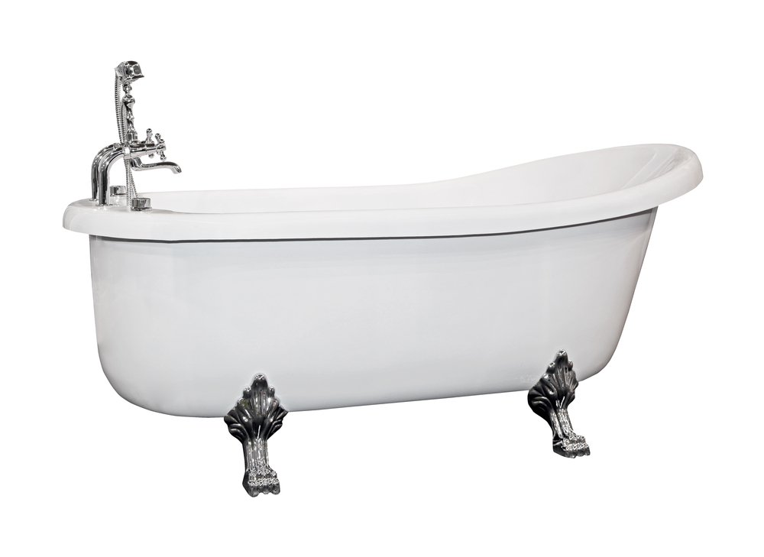
Shower / Bathe Self
Coding Tips
Includes the ability to wash, rinse and dry the face, upper and lower body, perineal area and feet.
Do not include washing rinsing and drying of back or hair.
Does not include transferring
Any location; including shower, bath, at the sink or in bed.
If a resident completes bathing tasks only after the helper retrieves or sets up supplies, code set up or clean up
Notes:
Next let's discuss the coding of bathing. Often the resident may not have a daily bath if the resident is on daily documentation.
Shower/bathe self includes the ability to wash, rinse, and dry the face, upper and lower
body, perineal area, and feet. Do not include washing, rinsing, and drying the resident’s
back or hair. Shower/bathe self does not include transferring in/out of a tub/shower.
• Assessment of Shower/bathe self can take place in any location including a shower or
bath or at a sink or in bed (i.e., full body sponge bath). Bathing can be assessed with the
resident seated on a tub bench.
• Code 05, Setup or clean-up assistance, if the resident can complete bathing tasks only
after a helper retrieves or sets up supplies necessary to perform the included tasks.
GG0130: Self-Care
• Code 05, Setup or clean-up assistance, if the only help the resident requires is assistance
before the bathing activity to cover wounds or devices for water protection during
bathing.
• If the resident cannot bathe their entire body because of a medical condition (e.g., a cast
or a nonremovable dressing), then code Shower/bathe self based on the amount of

Slide 28
Resident Z wears a bra and a sweatshirt most days while in the SNF. They require assistance from a certified nursing assistant to initiate the threading of their arms into their bra. Resident Z completes the placement of the bra over their chest. The helper hooks the bra clasps. Resident Z pulls the sweatshirt over their arms, head, and trunk. When undressing, Resident Z removes the sweatshirt, with the helper assisting them with one sleeve. Resident Z slides the bra off, once it has been unclasped by the helper.
Set up or clean up
Substantial-maximal
Dependent
Partial-moderate
06 | Independent | 01 | Dependent
05 | Supervision | 07 | Refused
04 | Set up or clean up | 09 | Not applicable
03 | Partial-moderate | 10 | Not attempted
02 | Substantial-maximal | 88 | Not attempted due to medical condition
Rationale - The helper provides assistance with threading Resident Z’s arms into their bra and hooking and unhooking their bra clasps and assistance with removing one sleeve of the sweatshirt. Resident Z performs more than half of the effort
Notes:
Discuss Example and use Animation
Upper body dressing items used for coding include bra, undershirt, T-shirt, button-down shirt, pullover shirt, dresses, sweatshirt, sweater, nightgown (not hospital gown), and pajama top. Upper body dressing cannot be assessed based solely on donning/doffing a hospital gown. • If a resident requires assistance with dressing, including assistance with buttons, fasteners and/or fastening a bra, code based on the type and amount of assistance required to complete the entire dressing activity

Slide 29
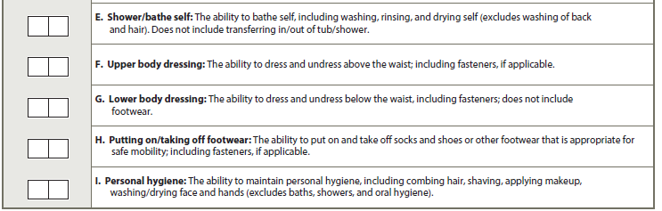
0 3
Mrs. R has peripheral neuropathy in her upper and lower extremities. Each morning, Mrs. R needs assistance from a helper to place her lower limb into, or to take it out of (don/doff), her lower limb prosthesis. She needs no assistance to put on and remove her underwear or slacks.
06 | Independent | 01 | Dependent
05 | Supervision | 07 | Refused
04 | Set up or clean up | 09 | Not applicable
03 | Partial-moderate | 10 | Not attempted
02 | Substantial-maximal | 88 | Not attempted due to medical condition
Rationale: A helper performs less than half the effort of lower body dressing (with a prosthesis considered a piece of clothing). The helper lifts, holds, or supports Mrs. R’s trunk or limbs, but provides less than half the effort for the task of lower body dressing.
Notes:
Discuss Example – Animation
Lower body dressing items used for coding include underwear, incontinence brief, slacks, shorts, capri pants, pajama bottoms, and skirts.
Lower body dressing examples: knee brace, elastic bandage, stump sock/shrinker, lower-limb prosthesis.
If donning and doffing an elastic bandage, elastic stockings, or an orthosis or prosthesis occurs while the resident is dressing/undressing, then count the elastic bandage/elastic stocking/orthotic/prosthesis as a piece of clothing when determining the amount of assistance the resident needs when coding the dressing item.

Slide 30
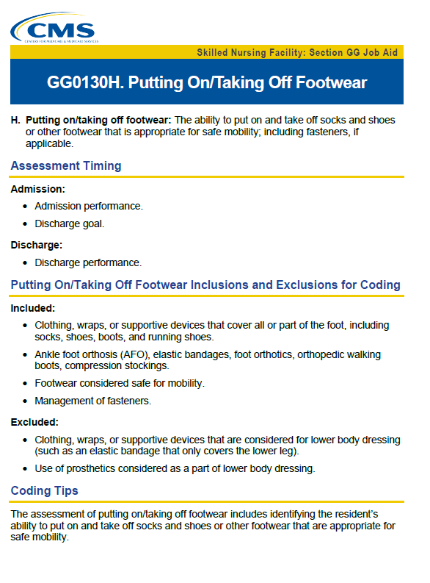
Footwear
Notes:
Footwear dressing items used for coding include socks, shoes, boots, and running shoes.
• For residents with bilateral lower extremity amputations with or without use of
prostheses, the activity of putting on/taking off footwear may not occur. For example, the
socks and shoes may be attached to the prosthesis associated with the upper or lower leg.
o If the resident performed the activity of putting on/taking off footwear immediately
prior to the current illness, exacerbation, or injury, code as 88, Not attempted due to
medical condition or safety concerns.
If the resident did not perform the activity of putting on/taking off footwear
immediately prior to the current illness, exacerbation, or injury because the resident
had bilateral lower-extremity amputations and the activity of putting on/taking off
footwear was not performed during the assessment period, code as 09, Not applicable
- Not attempted and the resident did not perform this activity prior to the current
illness, exacerbation, or injury.
For residents with a single lower extremity amputation with or without use of a prosthesis, the activity of putting on/taking off footwear could apply to the intact limb or both the limb with the prosthesis and the intact limb.
If the resident performed the activity of putting on/taking off footwear for the intact limb only, then code based upon the amount of assistance needed to complete the activity.
If the resident performed the activity of putting on/taking off footwear for both the intact limb and the prosthetic limb, then code based upon the amount of assistance needed to complete the activity.

Slide 31

Mobility Performance
Observe the resident
Assess the environment in the facility
Record the usual performance
Allow to perform activities as independently as possible
Always remember safety
With or without an assisted device
Notes:
Observing the resident’s interactions with others in different locations and circumstances is important for a comprehensive understanding of the resident’s functional status.
A resident’s functional status can be impacted by the environment or situations encountered at the facility
Read the instructions for Medicare Part A stay.
For residents in a Medicare Part A stay, the admission functional assessment, when possible, should be conducted prior to the resident benefitting from treatment interventions in order to reflect the resident’s true admission baseline functional status. If treatment has started, for example, on the day of admission, a baseline functional status assessment can still be conducted. Treatment should not be withheld in order to conduct the functional assessment.
Always refer to facility, Federal, and State policies and procedures to determine which SNF staff members may complete an assessment. Resident assessments are to be done in compliance with facility, Federal, and State requirements.

Slide 32
Resident R has a history of skin breakdown. A nurse instructs them to turn onto their right side, providing step-by-step instructions to use the bedrail, bend their left leg, and then roll onto their right side. Resident R attempts to roll with the use of the bedrail, but indicates they cannot perform the task. The nurse then rolls them onto their right side. Next, Resident R is instructed to return to lying on their back, which they successfully complete. Resident R then requires physical assistance from the nurse to roll onto their left side and to return to lying on their back to complete the activity
Dependent
Partial-moderate
Supervision
Substantial-maximal
06 | Independent | 01 | Dependent
05 | Supervision | 07 | Refused
04 | Set up or clean up | 09 | Not applicable
03 | Partial-moderate | 10 | Not attempted
02 | Substantial-maximal | 88 | Not attempted due to medical condition
Rationale: The nurse provides more than half of the effort needed for the resident to complete the activity of rolling left and right.
Notes:
Discuss Example and animation
If the resident does not sleep in a bed, clinicians should assess bed mobility activities using the alternative furniture on which the resident sleeps (for example, a recliner)..
This is part of the rationale: This is because the nurse provides physical assistance to move Resident R’s body weight to turn onto their right side. The nurse provides the same assistance when Resident R turns to their left side and when they return to their back. Resident R is able to return to lying on their back from their right side by themself.

Slide 33

0 4
Resident F had a stroke about 2 weeks ago and is unable to sequence the necessary movements to complete an activity (apraxia). They can maneuver themself when transitioning from sitting on the side of the bed to lying flat on the bed if the certified nursing assistant provides verbal instructions as to the steps needed to complete this task.
06 | Independent | 01 | Dependent
05 | Supervision | 07 | Refused
04 | Set up or clean up | 09 | Not applicable
03 | Partial-moderate | 10 | Not attempted
02 | Substantial-maximal | 88 | Not attempted due to medical condition
Rationale: A helper provides verbal cues in order for the resident to complete the activity of sit to lying flat on the bed.
Notes:
Discuss Example and animation
For bed mobility items, clinical judgment should be used to determine what is considered a “lying” position for the patient or resident. For example, a clinician could determine that a slightly elevated resting position is “lying” for a patient or resident.
If a clinician determines that a new medical need requires that the patient or resident be seated in an upright sitting position rather than a slightly elevated position, code the bed mobility items as 88, Not attempted due to medical conditions or safety concerns.
Sit to lying assesses the ability of a patient or resident to move from sitting on the side of the bed to lying flat on the bed.
GG0170C no longer includes "feet flat on the floor” instruction.

Slide 34
Coding Tips: Bed Mobility
The activity includes resident transitions from lying on their back to sitting on the side of the bed without back support. The residents’ ability to perform each of the tasks within this activity and how much support the residents require to complete the tasks within this activity is assessed.
For item GG0170C, Lying to sitting on side of bed, clinical judgment should be used to determine what is considered a “lying” position for a particular resident.
Back support refers to an object or person providing support for the resident’s back.
If the qualified clinician determines that bed mobility cannot be assessed because of the degree to which the head of the bed must be elevated because of a medical condition, then code the activities GG0170A, Roll left and right, GG0170B, Sit to lying, and GG0170C, Lying to sitting on side of bed, as 88, Not attempted due to medical condition or safety concern.
Notes:
Read Coding tips for Bed Mobility

Slide 35

The activity includes the resident coming to a standing position from any sitting surface.
If a sit-to-stand (stand assist) lift is used and two helpers are needed to assist with the sit-to-stand lift, then code as 01, Dependent.
If a full-body mechanical lift is used to assist in transferring a resident for a chair/bed-to-chair transfer, code GG0170D, Sit to stand with the appropriate “activity not attempted” code
Code as 05, Setup or clean-up assistance, if the only help a resident requires to complete the sit-to-stand activity is for a helper to retrieve an assistive device or adaptive equipment, such as a walker or ankle-foot orthosis.
Notes:
If a mechanical lift is used to assist in transferring a patient or resident for a chair/bed-to-chair transfer, and the patient or resident is not able to complete the sit to stand activity due to medical condition or safety issues, then GG0170D would be coded 88, Not attempted due to medical condition or safety issues.
However, if the patient or resident did not attempt to perform sit to stand during the assessment and did not perform this activity prior to the current illness, exacerbation, or injury, then use code 09, Not applicable.
If a sit to stand lift is used and two helpers are needed to assist with the sit to stand lift, then code as 01, Dependent.

Slide 36
Resident R has severe rheumatoid arthritis and uses forearm crutches to ambulate. The certified nursing assistant brings Resident R their crutches and helps them to stand at the side of the bed. The certified nursing assistant provides some lifting assistance to get Resident R to a standing position but provides less than half the effort to complete the activity
Supervision
Set up or clean up
Substantial-maximal
Partial- moderate
06 | Independent | 01 | Dependent
05 | Supervision | 07 | Refused
04 | Set up or clean up | 09 | Not applicable
03 | Partial-moderate | 10 | Not attempted
02 | Substantial-maximal | 88 | Not attempted due to medical condition
Rationale: The helper provided lifting assistance and less than half the effort for the resident to complete the activity of sit to stand
Notes:
Review Sample and discuss –
Animation

Slide 37

Chair/Bed-to-Chair Transfer
The activity begins with the patient sitting in a chair or wheelchair or sitting upright at the edge of the bed and returning to sitting in a chair, wheelchair, or sitting upright at the edge of the bed.
If a mechanical lift is used to assist in transferring a patient or resident for a chair/bed-to-chair transfer and two helpers are needed to assist with the mechanical lift transfer, then code 01, Dependent, even if the patient or resident assists with any part of the chair/bed-to-chair transfer.
Notes:
Guidance in coding chair/bed to chair transfer
Additional information
Depending on the resident’s abilities, the transfer may be a stand-pivot, squat-pivot, or a slide board transfer.
For item GG0170E, Chair/bed-to-chair transfer:
When assessing the resident moving from the chair/bed to the chair, the assessment begins with the resident sitting at the edge of the bed (or alternative sleeping surface) and ends with the resident sitting in a chair or wheelchair.
When assessing the resident moving from the chair to the bed, the assessment begins with the resident sitting in a chair or wheelchair and ends with the resident returning to sitting at the edge of the bed (or alternative sleeping surface).
When possible, the transfer should be assessed in an environmental situation in which taking more than a few steps would not be necessary to complete the transfer.

Slide 38
0 3
The therapist supports Resident M’s trunk with a gait belt by providing weight-bearing as Resident M pivots and lowers themself onto the toilet.
06 | Independent | 01 | Dependent
05 | Supervision | 07 | Refused
04 | Set up or clean up | 09 | Not applicable
03 | Partial-moderate | 10 | Not attempted
02 | Substantial-maximal | 88 | Not attempted due to medical condition
Rationale -The helper provides less than half the effort to complete the activity. The helper provided weight-bearing assistance as the resident transferred on and off the toilet
Notes:
Read the slide and discuss the scenario. Indicate that it is important that the staff are trained on coding all sections of GG

Slide 39
8 8
Resident S is on bedrest due to a medical complication. They use a bedpan for bowel and bladder management
06 | Independent | 01 | Dependent
05 | Supervision | 07 | Refused
04 | Set up or clean up | 09 | Not applicable
03 | Partial-moderate | 10 | Not attempted
02 | Substantial-maximal | 88 | Not attempted due to medical condition
Rationale: The resident does not transfer onto or off a toilet due to being on bedrest because of a medical condition.
Notes:
Review Sample and discuss –
Animation

Slide 40
Knowledge Check
Which of the following tasks are part of the toilet transfer activity? Select all that apply?
Transferring onto a bedside commode
Transferring onto a bedpan
Managing clothing and undergarments
Transferring off a toilet
Performing perineal hygiene
Notes:
Animation
GG0130C. Toileting hygiene item tasks such as managing clothing, undergarments, or perineal hygiene are not considered when assessing the toilet transfer activity. Transferring on and off a bedpan is also not included in GG0170F. Toilet transfer.

Slide 41
Tub/Shower Transfers
Tub/shower transfers involve the ability to get into and out of the tub or shower. Do not include washing, rinsing, drying, or any other bathing activities in this item.
If the resident does not get into or out of a tub and/or shower during the observation period, use one of the “activity not attempted” codes (07, 09, 10, or 88).
Notes:
Tub/shower transfers involve the ability to get into and out of the tub or shower.
Do not include washing, rinsing, drying, or any other bathing activities in this item.
If the resident does not get into or out of a tub and/or shower during the observation period, use one of the “activity not attempted” codes (07, 09, 10, or 88).

Slide 42
Toilet Transfer Coding Tips
Toilet transfer includes the resident’s ability to get on and off a toilet (with or without a raised toilet seat) or bedside commode.
Toileting hygiene, clothing management, and transferring on and off a bedpan are not considered part of the Toilet transfer activity.
Setup or clean-up assistance, if the resident requires a helper to position/set up the bedside commode before and/or after the resident’s bed-to-commode transfers (place at an accessible angle/location next to the bed) and the resident does not require helper assistance during Toilet transfers.
Notes:
Read the slide and remember that a bed pan is not considered toileting transfers

Slide 43
Coding Tips for Car Transfer
The Car transfer does not include getting to or from the vehicle, opening/closing the car door, or fastening/unfastening the seat belt.
If the resident remains in a wheelchair and does not transfer in and out of a car or van seat, then the activity is not considered completed, and the appropriate “activity not attempted” code would be used.
The setup and/or clean-up of an assistive device that is used for walking to and from the car, but not used for the transfer in and out of the car seat, would not be considered when coding the Car transfer activity.
Notes:
An indoor car can be used to simulate outdoor car transfers. These half or full cars need to have similar physical features of a real car—that is, a car seat within a car cabin. In the event of inclement weather or if an indoor car simulator or outdoor car is not available during the assessment period, then use code 10. Not attempted due to environmental limitations.
Car transfer assesses the ability of a patient or resident to transfer in and out of a car or van on the passenger side. It does not include the ability to open or close a car door or fasten a seat belt.

Slide 44

Coding Tips Car Transfer
In the event of inclement weather or if an indoor car simulator or outdoor car is not available during the entire assessment period, then use code 10, Not attempted due to environmental limitations.
If at the time of the assessment the resident is unable to attempt car transfers and could not perform the car transfers prior to the current illness, exacerbation or injury, code 09, Not applicable.
Notes:
DISCUSS

Slide 45
Knowledge Check – Car Transfer
They require lifting assistance from a helper to get from a seated position in the wheelchair to a standing position. The helper provides trunk support when the patient/resident takes several steps during the stand-pivot transfer as they turn their back towards the entrance of the car.
The patient/resident lowers themselves into the car seat with steadying assistance from the helper.
They lift their legs into the car with support from the helper.
When exiting the car, the patient/resident requires the helper to lift their legs out of the car as they move their hips and trunk to place their feet on the ground. The helper must provide considerable lifting assistance as the patient/resident transfers out of the car to a standing position.
Notes:
Read this scenario and then the knowledge check follows.

Slide 46
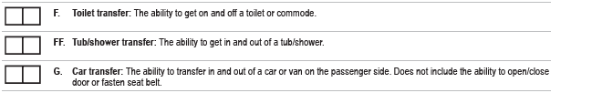
Code 05 Set up or clean up
Code 04 Supervision or touching assistance
Code 03 Partial/moderate assistance
Code 02. Substantial to maximal assistance
Notes:
How would you code the scenario just discussed? ANIMATION

Slide 47
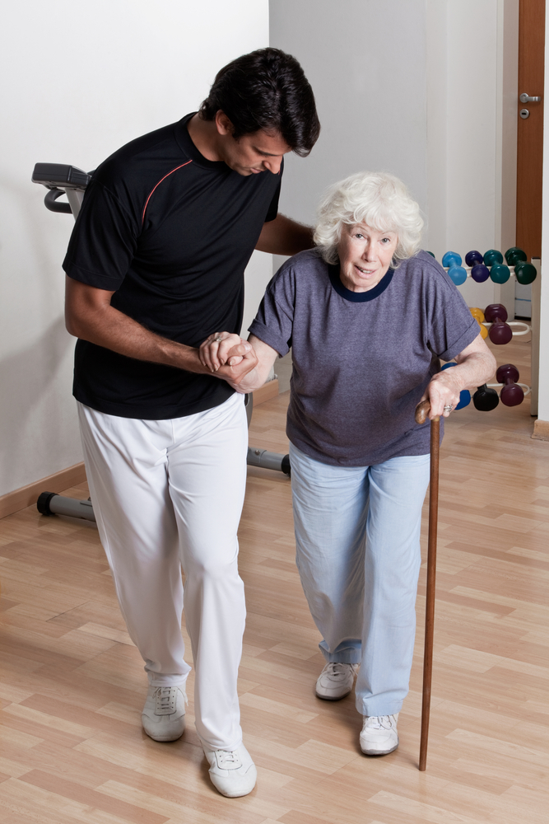
Coding Tips: Walking
Assessment of the walking activities starts with the resident in a standing position.
A walking activity cannot be completed without some level of resident participation that allows resident ambulation to occur for the entire stated distance. A helper cannot complete a walking activity for a resident.
During a walking activity, a resident may take a brief standing rest break. If the resident needs to sit to rest during a Section GG walking activity, consider the resident unable to complete the walking activity and use the appropriate activity not attempted code.
Notes:
Read the slide on walking tips

Slide 48
Coding Tips: Walking
Walking activities do not need to occur during one session.
Allowing a resident to rest between activities or completing activities at different times during the day or on different days may facilitate completion of the activities.
Do not consider the resident’s mobility performance when using parallel bars.
Notes:
Clinicians can use clinical judgment to determine how the actual resident assessment of walking is conducted. If a clinician chooses to combine the assessment of multiple walking activities, the clinician should use clinical judgment to determine the type and amount of assistance needed for each individual activity.

Slide 49
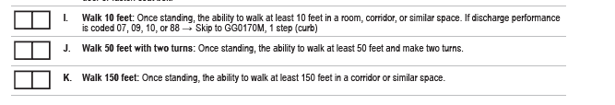
8 8
Resident C has resolving sepsis and has not walked in three weeks because of their medical condition. A physical therapist determines that it is unsafe for Resident C to use a walker, and the resident only walks using the parallel bars. On day 3 of the Admission assessment period, Resident C walks 10 feet using the parallel bars while the therapist provides substantial weight-bearing support throughout the activity.
06 | Independent | 01 | Dependent
05 | Supervision | 07 | Refused
04 | Set up or clean up | 09 | Not applicable
03 | Partial-moderate | 10 | Not attempted
02 | Substantial-maximal | 88 | Not attempted due to medical condition
Rationale: When assessing a resident for GG0170 walking items, do not consider walking in parallel bars, as parallel bars are not a portable assistive device. If the resident is unable to walk without the use of parallel bars because of their medical condition or safety concerns
Notes:
Review Scenario and Discuss –
Animation

Slide 50
0 1
Walking 50 Feet Resident T walks 50 feet with the therapist providing trunk support. They also require a second helper, the rehabilitation aide, who provides supervision and follows closely behind with a wheelchair for safety. Resident T walks the 50 feet with two turns with the assistance of two helpers.
06 | Independent | 01 | Dependent
05 | Supervision | 07 | Refused
04 | Set up or clean up | 09 | Not applicable
03 | Partial-moderate | 10 | Not attempted
02 | Substantial-maximal | 88 | Not attempted due to medical condition
Rationale: Resident T requires two helpers to complete the activity.
Notes:
Review Scenario and Discuss –
Animation

Slide 51
Coding Tips for Steps
Getting to and from the stairs or curb is not included in coding
Ascending and descending stairs does not have to occur sequentially or during one session
A resident that uses a wheelchair may be assessed gong up and down stairs in the wheelchair such as a curb
Notes:
Completing the stair activities indicates that a resident goes up and down the stairs, by any safe means, with or without any assistive devices (for example, railing or stair lift) and with or without some level of assistance. Getting to and from the stairs is not included when coding the curb or step activities.
Ascending and descending stairs does not have to occur sequentially or during one session. If the assessment of going up the stairs and then down the stairs occurs sequentially, the resident may take a standing or seated rest break between ascending and descending the 4 steps or 12 steps.
If a resident requires a helper to provide total assist (for example, the resident requires total assist from a helper to move up and down over a curb in their wheelchair), code as 01, Dependent.
A resident who uses a wheelchair may be assessed going up and down stairs (including one step or curb) in a wheelchair. Code based on the type and amount of assistance
If, at the time of the assessment, a resident is unable to complete the activity because of a physician-prescribed restriction (for instance, no stair climbing for two weeks) but could perform this activity prior to the current illness, exacerbation, or injury, code 88, Not attempted due to medical condition or safety concern.

Slide 52
Tips for Picking Up and Object
Includes bending and stooping from a standing position
Resident must be in the standing position
Assistive devices may be used
If a resident is not able to stand, the activity did not occur
Notes:
•The activity includes the resident bending or stooping from a standing position to pick up a small object, such as a spoon, from the floor.
•Picking up the object must be assessed while the resident is in a standing position. If the resident is not able to stand, the activity did not occur, and the appropriate “not attempted” code would be used.
•If a standing resident is unable to pick up a small object from the floor, therefore requiring the helper to assist in picking up the object, code as 01, 02, or 03, depending on whether the helper is providing all the effort, more than half of the effort, or less than half of the effort, respectively.
•Assistive devices and adaptive equipment may be used, for example, a cane to support standing balance and/or a reacher to pick up the object.

Slide 53
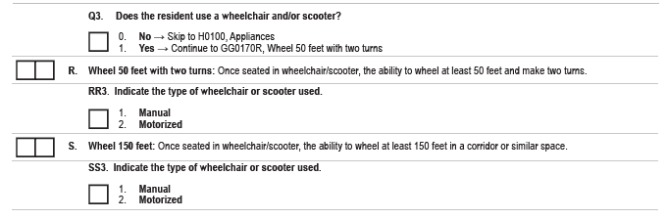
If the resident used a wheelchair for self-mobilization prior to admission to the facility, indicate 1, Yes
If a wheelchair is used for transport purposes only, then code 0 no
Example: If using a wheelchair for transport convenience: A resident is transported in a wheelchair by staff between their room and the therapy gym or by family to the facility cafeteria, but the resident is not expected to use a wheelchair after discharge.
Notes:
The intent of the wheelchair mobility items is to assess the ability of residents who are learning how to self-mobilize using a wheelchair or who used a wheelchair for self-mobilization prior to admission. Use clinical judgment to determine whether a resident’s use of a wheelchair is for self-mobilization as a result of the resident’s medical condition or safety
If a resident’s environment does not accommodate wheelchair or scooter use for 150 feet without turns, but the resident demonstrates the ability to mobilize a wheelchair or scooter with or without assistance for 150 feet with turns without jeopardizing the resident’s safety, code GG0170S, Wheel 150 feet, using the 6-point scale.
For GG0170S, Wheel 150 feet, a helper can assist a resident in completing the required distance in the wheelchair or in making turns if required. When a resident is unable to wheel the entire distance themself, the activity can still be completed, and a performance code can be determined based on the type and amount of assistance required from the helper to complete the entire activity.

Slide 54
0 4
Wheel 150 feet: Resident G always uses a motorized scooter to mobilize themself down the hallway and the certified nursing assistant provides cues due to safety issues (to avoid running into the walls).
06 | Independent | 01 | Dependent
05 | Supervision | 07 | Refused
04 | Set up or clean up | 09 | Not applicable
03 | Partial-moderate | 10 | Not attempted
02 | Substantial-maximal | 88 | Not attempted due to medical condition
Rationale: The helper provides verbal cues to complete the activity. .
Notes:
f a resident’s environment does not have 12 steps, the combination of going up and down 4 stairs three times consecutively in a safe manner is an acceptable alternative to comply with the intention and meet the requirements of this activity.
Read the slide

Slide 55

Notes:
An onboarding process is a structured approach to welcome new hires and set them up for success.
And the IDT team member that is gathering information on the resident’s functional status needs training at the time of hire and quarterly there after. A new job is extremely stressful and providing the newly hired employee with the proper tools and opportunities to understand the coding definitions will assist in accurate and complete documentation.

Slide 56

Coding Correctly
On-boarding competency
Post test
Periodic audits
Agency competency test
Integrate the CMS training videos into the facility educational platform
Communicate the importance of accuracy.
Competency completion for licensed nursing, nursing assistants and therapy.
Notes:
Read the slide

Slide 57
Look Back Periods:
Section GG
Type of Assessment | Look Back Period
OBRA Admission | The first three days based on A1600
Quarterly Assessment | The last 3 days of the 7 day look back period The ARD plus the 2 previous days
IPA Interim Payment Assessment | The last 3 days of the 7 day look back period The ARD plus the 2 previous days
5- day Assessment | The first 3 days based on A2400 B ( Start of Medicare Stay)
NPE Discharge Assessment | The last 3 days of the most recent Medicare stay Based on A2400C
OBRA Discharge Assessment | The last 3 days of the 7 day look back period The ARD plus the 2 previous days
Notes:
Review with the team

Slide 58
Type of Assessment | Look Back Period
Admission & 5-day | The first 3 days based on A2400 B ( Start of Medicare Stay)
Quarterly & 5-day | The first 3 days based on A2400 B ( Start of Medicare Stay)
Annual & 5-day | The first 3 days based on A2400 B ( Start of Medicare Stay)
Significant change & 5-day | The first 3 days based on A2400 B ( Start of Medicare Stay)
OBRA Discharge & PPS Discharge Anticipated return Meets definition of NPE | The last 3 days of the most recent Medicare stay Based on A2400C
OBRA Discharge & PPS Discharge Is NOT anticipated to return Meets definition of NPE | The last 3 days of the most recent Medicare stay Based on A2400C
Look Back Periods:
Section GG
Notes:
Review with Team

Slide 59
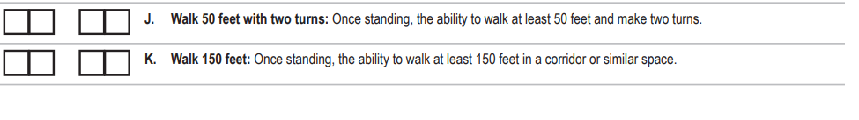
Clarification Note and Collaboration
0 3
Nursing Assistant Documentation during the 3-day look back period
8 8
Therapy initial evaluation and documentation with section GG
Notes:
The goal of section GG is to collaborate with the interdisciplinary team on the USUAL performance. There are tools available to assist with the process either in the EMR or available form other sources.
Discussing the importance of this collaboration and the need for a clarification notation in the medical record.
I will use ambulating as one example of the need for clarification
The restorative nurse is interviewing therapy on the new admission. She asks the PTA if Alma can walk. And the answer was yes, up to 150 feet today. So the restorative nurse reported to the nursing staff on Alma’s ability to ambulate.
But the only ambulation Alma is doing in in the parallel bars, so The code on the therapy document is 88.
If this occurred, how would we complete the assessment. The Nursing assistants documented that the resident ambulated on the day shift during the look back period. The impact on the PDPM score could be impacted.

Slide 60

Clarification Notes
The Interdisciplinary team reviewed the documentation on the resident's usual functional status during the scheduled 3-day look back period.
The resident is only ambulating in the parallel bars.
The resident is not ambulating due to medical conditions and unsteady gait.
Based on the review of the information the correct code for the three day look back period is 88.
Notes:
Review with Team

Slide 61
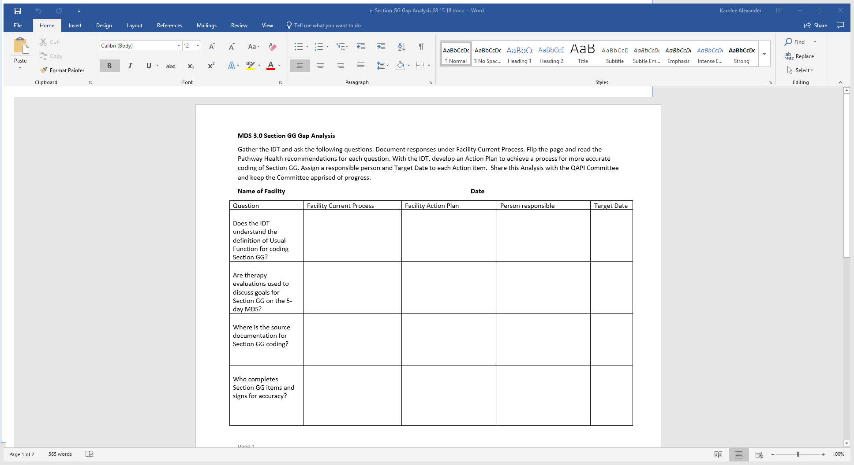
Section GG Gap Analysis
Notes:
Please review the Section GG Gap Analysis to help your facility assess your current readiness for the Section GG changes. The questions in the left corner help evaluate the systems in place to support accurate Section GG coding.
Identify the action steps you need to take for improvement of the process and document them in the second blank column titled, “Facility Action Plan”.
It is helpful to identify who will be responsible for assuring that the action steps are completed. Use the column titled, “Person responsible” to identify that person. Other staff may also be involved in making the needed changes.
The “target date” records the expected completion date. Remember that October 1 is the effective date for the new MDS.

Slide 62

Questions

Slide 63
References and Resources
Centers for Medicare & Medicaid Services. IMPACT Act of 2014 Data Standardization & Cross Setting Measures. https://www.cms.gov/Medicare/Quality-Initiatives-Patient-Assessment-Instruments/Post-Acute-Care-Quality-Initiatives/IMPACT-Act-of-2014/IMPACT-Act-of-2014-Data-Standardization-and-Cross-Setting-Measures.html
Centers for Medicare & Medicaid Services. Long-Term Care Facility Resident Assessment Instrument 3.0 User’s Manual. Version 1.16. October, 2018: https://www.cms.gov/Medicare/Quality-Initiatives-Patient-Assessment-Instruments/NursingHomeQualityInits/MDS30RAIManual.html
Centers for Medicare & Medicaid Services: Skilled Nursing Facility (SNF) Quality Reporting Program Measures and Technical Information: https://www.cms.gov/Medicare/Quality-Initiatives-Patient-Assessment-Instruments/NursingHomeQualityInits/Skilled-Nursing-Facility-Quality-Reporting-Program/SNF-Quality-Reporting-Program-Measures-and-Technical-Information.html

Slide 64
References and Resources
Centers for Medicare & Medicaid Services. SNF Quality Reporting Program Data Submission Deadlines. https://www.cms.gov/Medicare/Quality-Initiatives-Patient-Assessment-Instruments/NursingHomeQualityInits/Skilled-Nursing-Facility-Quality-Reporting-Program/SNF-Quality-Reporting-Program-Data-Submission-Deadlines.html
Centers for Medicare & Medicaid Services. MDS 3.0 Technical Information. https://www.cms.gov/Medicare/Quality-Initiatives-Patient-Assessment-instruments/NursingHomeQualityInits/NHQIMDS30TechnicalInformation.html

Slide 65
Disclaimer
“This presentation provided is copyrighted information of Pathway Health. Please note the presentation date on the title page in relation to the need to verify any new updates and resources that were listed in this presentation. This presentation is intended to be informational. The information does not constitute either legal or professional consultation. This presentation is not to be sold or reused without written authorization.”

